Slide 1


Psychology
132
M. Hines
Professor of Psychology
Chapter 5

Slide 2
Chapter Objectives (1 of 6)
By the end of this chapter, you should be able to:
5.1.1 Define consciousness
5.1.2 Distinguish between disordered states of consciousness and altered states of consciousness.
5.2.1 Describe how hypnosis works, distinguishing between stte and nonstate theories of hypnosis.
5.2.2 Describe how meditation works, distinguishing between mindfulness and concentrative meditation

Slide 3
Chapter Objectives (2 of 6)
By the end of this chapter, you should be able to:
5.3.1 Describe the typical patterns of sleeping and waking
5.3.2 Describe NREM (non-REM) sleep, including its function and four stges
5.3.3 Describe REM sleep and its function
5.3.4 Explain why we need to sleep, and the consequences of not sleeping
5.3.5 Name and briefly describe the three theories of dreaming.
5.3.6 Outline five sleep disorders

Slide 4
Chapter Objectives (3 of 6)
By the end of this chapter, you should be able to:
4.3.2 Describe the process of transduction in the ear, and two associated forms of hearing loss.
4.3.3 Contrast the frequency and place theory of hearing pitch.
4.4.1 Name the two chemical senses and three somesthetic senses.
4.4.2 Describe the process of transduction in the nose.
4.4.3 Describe the process of transduction on the tongue.

Slide 5
Chapter Objectives (4 of 6)
By the end of this chapter, you should be able to:
4.4.4 Describe the process of transduction on the skin, including the function of large and small nerve fibers in the sensation of pain.
4.4.5 Describe the process of transduction in the vestibular system.
4.4.6 Define multimodal integration.
4.5.1 Explain what research on multitasking has indicated with respect to the limits on attention.
4.5.2 Identify four factors that influence whether we will pay attention to a stimulus.

Slide 6
Chapter Objectives (5 of 6)
By the end of this chapter, you should be able to:
4.5.3 Describe the positive and negative effects of mind-wandering.
4.6.1 Describe the relationship between sensation and perception.
4.6.2 Contrast bottom-up and top-down processing.
4.6.3 Explain how both sensory transduction and experience contribute to similarities and differences in perception.
4.6.4 Describe the effects of culture on the perception of the Müller-Lyer illusion.

Slide 7
Chapter Objectives (6 of 6)
By the end of this chapter, you should be able to:
4.6.5 Differentiate between monocular and binocular depth cues, giving examples of each.
4.6.6 Explain how depth cues are used in the world of art and by clinical psychologists using virtual reality to treat clients.
4.7.1 Distinguish between verbal and nonverbal communication.
4.7.2 Outline two verbal communication methods and two verbal communication points of view.
4.7.3 Create a plan to improve your own communication with others.

Slide 8
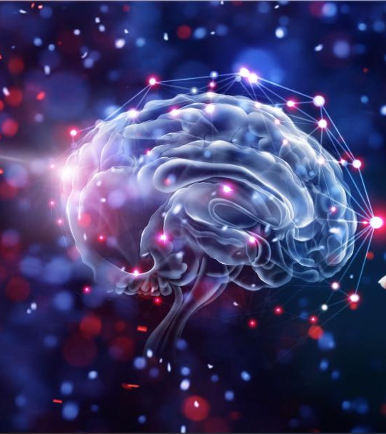




Sensation, Attention, and Perception

Slide 9

Sensation
Sect. 4.1

Slide 10

Transduction: The Sense Organs’ Primary Job
Sense organs: eyes, ears, tongue, nose and skin
Act as biological transducers: convert one kind of energy into another.
Converts the signals that are from the world into electrical energy so the brain can understand it.
Eyes: convert light energy
Ears: convert mechanical energy
Nose and Tongue: convert chemical energy

Slide 11
Transduction: The Sense Organs’
Primary Job
Primary function of sensory organs:
Biological transducers convert forms of energy into electrical energy to help brain understand information
Process of sensation converts energy to sensory impressions

Slide 12
3 Steps of Transduction
The signal transduction pathway has three main steps:
Reception: The process by which a cell detects a signal in the environment.
Transduction: The process of activating a series of proteins inside the cell from the cell membrane.
Response: The change in behavior that occurs in the cell as a result of the signal.

Slide 13
General Principles of Sensory Transduction
What is the general principle of sensory transduction? Sensory transduction is defined as energy transformation from the external world to the internal world. The energy of the external world, such as thermal energy (heat), electro-magnetic energy (light), mechanical energy (sound) and the energy from molecules (chemicals), is converted into electrochemical events in the animal nervous system.

Slide 14
General Principles of Sensory Transduction
The following five classes of special sense receptors are utilized for energy conversion: vision (photo); audition (sound); taste and smell (chemo); and tactile (mechano). There are also other special sense receptors, including thermo and noxious receptors.

Slide 15
General Principles of Sensory Transduction
There are two broad types of cellular systems that perform sensory transduction. In one, a neuron works with a sensory receptor, a cell, or cell process that is specialized to engage with and detect a specific stimulus. Stimulation of the sensory receptor activates the associated afferent neuron, which carries information about the stimulus to the central nervous system.

Slide 16
General Principles of Sensory Transduction
In the second type of sensory transduction, a sensory nerve ending responds to a stimulus in the internal or external environment: this neuron constitutes the sensory receptor. Free nerve endings can be stimulated by several different stimuli, thus showing little receptor specificity. For example, pain receptors in your gums and teeth may be stimulated by temperature changes, chemical stimulation, or pressure.

Slide 17
How Transduction Works
https://www.youtube.com/watch?v=pO2x4bsdK9w

Slide 18
Psychophysics: Measuring
Sensory Impressions
Difference Threshold
Psychophysics
Absolute Threshold
Physical properties of stimuli
Measured and related to resulting experiences our brain constructs
Minimum amount of physical energy that can be detected 50 percent of the time
Minimum difference in physical energy between two stimuli
Must be large enough to be detected 50 percent of the time

Slide 19
Measuring Sensory Receptors
Sensory receptors for different senses are very different from each other, and they are specialized according to the type of stimulus they sense: they have receptor specificity. For example, touch receptors, light receptors, and sound receptors are each activated by different stimuli. Touch receptors are not sensitive to light or sound; they are sensitive only to touch or pressure. However, stimuli may be combined at higher levels in the brain, as happens with olfaction, contributing to our sense of taste.

Slide 20
Measuring Sensory Receptors
Encoding and Transmission of Sensory Information
Four aspects of sensory information are encoded by sensory systems: the type of stimulus, the location of the stimulus in the receptive field, the duration of the stimulus, and the relative intensity of the stimulus. Thus, action potentials transmitted over a sensory receptor’s afferent axons encode one type of stimulus, and this segregation of the senses is preserved in other sensory circuits. For example, auditory receptors transmit signals over their own dedicated system, and electrical activity in the axons of the auditory receptors will be interpreted by the brain as an auditory stimulus—a sound.

Slide 21
Measuring Sensory Receptors
The intensity of a stimulus is often encoded in the rate of action potentials produced by the sensory receptor. Thus, an intense stimulus will produce a more rapid train of action potentials, and reducing the stimulus will likewise slow the rate of production of action potentials.
A second way in which intensity is encoded is by the number of receptors activated. An intense stimulus might initiate action potentials in a large number of adjacent receptors, while a less intense stimulus might stimulate fewer receptors. Integration of sensory information begins as soon as the information is received in the CNS, and the brain will further process incoming signals.

Slide 22
Measuring Sensory Receptors
Perception
Perception is an individual’s interpretation of a sensation. Although perception relies on the activation of sensory receptors, perception happens not at the level of the sensory receptor, but at higher levels in the nervous system, in the brain. The brain distinguishes sensory stimuli through a sensory pathway: action potentials from sensory receptors travel along neurons that are dedicated to a particular stimulus. These neurons are dedicated to that particular stimulus and synapse with particular neurons in the brain or spinal cord.

Slide 23
Measuring Sensory Receptors
All sensory signals, except those from the olfactory system, are transmitted though the central nervous system and are routed to the thalamus and to the appropriate region of the cortex. Recall that the thalamus is a structure in the forebrain that serves as a clearinghouse and relay station for sensory (as well as motor) signals. When the sensory signal exits the thalamus, it is conducted to the specific area of the cortex ([link]) dedicated to processing that particular sense.

Slide 24
Measuring Sensory Receptors
How are neural signals interpreted? Interpretation of sensory signals between individuals of the same species is largely similar, owing to the inherited similarity of their nervous systems; however, there are some individual differences. A good example of this is individual tolerances to a painful stimulus, such as dental pain, which certainly differ.
In humans, with the exception of olfaction, all sensory signals are routed from the (a) thalamus to (b) final processing regions in the cortex of the brain.

Slide 25
Selection: Four Ways to Reduce
Sensory Overload
Sensory transduction involves some selection.
Data selection system: Which information to code and send to the brain
Lack of specific transducers
Restricted range of transducers
Sensory adaptation
Feature detection

Slide 26

Lack of Specific Transducers
There is energy all around us
Human sensory receptors do not transduce all of the energies they encounter.
If you swim in the ocean a shark can detect you, but you may not sense him until it is too late.

Slide 27
Knowledge Check Activity 1
When your roommate turns music on, you likely notice it right away. As time goes on and you resume studying, you might not notice the music anymore. Which of the following describes this process?
Sensory adaptation
Feature detection
Transduction
Absolute threshold

Slide 28
Knowledge Check Activity 1: Answer
When your roommate turns music on, you likely notice it right away. As time goes on and you resume studying, you might not notice the music anymore. Which of the following describes this process?
Sensory adaptation
Sensory receptors respond less over time to unchanging stimuli, a process called sensory adaptation. Sensory receptors generally respond best to changes in stimulation, such as when the music is turned off.

Slide 29
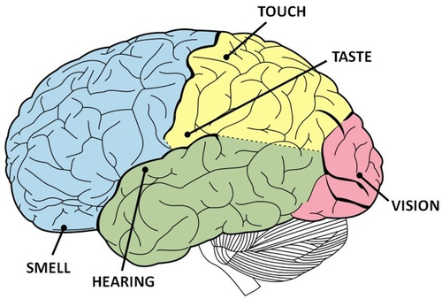
Location of the five senses in the brain

Slide 30
Psychophysics: Measuring Sensory Impressions
  Investigates the relationship between physical stimuli and the perceptions they produce.
  Psychophysics - psychology plus physics so psychophysics basically involves the determination of the psychological reaction to events that lie along a physical dimension
So…changes in loudness, changes in brightness, changes in pressure-temperature those kinds of things and how we really experience them that is pretty much what the discipline of psychophysics is about.

Slide 31

Selection: Four Ways to Reduce Sensory Overload

Slide 32
Restricted Range of Transducers
High pitched sounds like dog whistles are out of range for humans to hear.
Cats can see 16% better than humans in the dark.
If we were able to see and hear everything that is out there our brains would not be able to process it all.

Slide 33
Sensory Adaptation
Imagine that you just walked into your favorite Italian restaurant. The delicious smell of garlic and tomatoes is almost overwhelming when you first walk through the door. You sit down to wait for a table, and after a few minutes, the scents dissipate until you barely notice them. This is an example of sensory adaptation.
What Is Sensory Adaptation?
Sensory adaptation is a reduction in sensitivity to a stimulus after constant exposure to it.
While sensory adaptation reduces our awareness of a stimulus, it helps free up our attention and resources to attend to other stimuli in our environment.
Give your own example.

Slide 34
Feature Detection
A theory that states that all complex stimuli are able to be broken down into individual parts or features each of which is then analyzed by a feature detector.
FEATURE DETECTION THEORY: "Feature detection theory states that complex stimuli is made up of individual parts.“
The ability to detect certain types of stimuli, like movements, shape, and angles, requires specialized cells in the brain called feature detectors. Without these, it would be difficult, if not impossible, to detect a round object, like a baseball, hurdling toward you at 90 miles per hour.

Slide 36
Vision
Sect. 4.2

Slide 37
Definitions
Cornea: a curved transparent area that protects the eye and bends light inward.
Lens: located behind the pupil that bends light toward the retina
Hyperopia: the eye is too short so nearby objects are blurred and distant objects are sharp
Myopia: eye is too long, hard to focus on distant objects
Astigmatism: The eye has more than one focal point because part of the eye is misshapen
Presbyopia: The lens become less flexible and makes it harder to focus

Slide 38
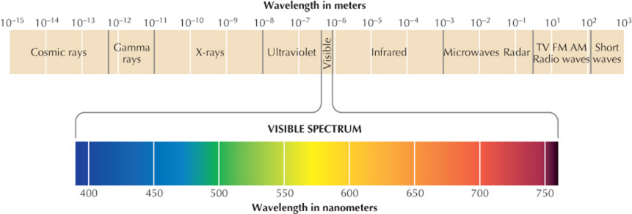
Vision—An Overview
The eyes transduce only a tiny fraction of the range of electromagnetic energies, called the visual spectrum.
The visible spectrum

Slide 39
Characteristics of Light: What the Eye Sees
Visible spectrum: The part of the electromagnetic energies to which the eyes respond
The dimensions of vision:
Hue: Various colors of light that correspond with wavelengths of the light that reaches our eyes
Saturation: The purity of the hues. Hues from a narrow band of wavelengths are saturated, or pure.
Brightness: The amplitude, or height, of light waves. Waves with greater amplitude carry more energy and cause colors to appear brighter or more intense.

Slide 40
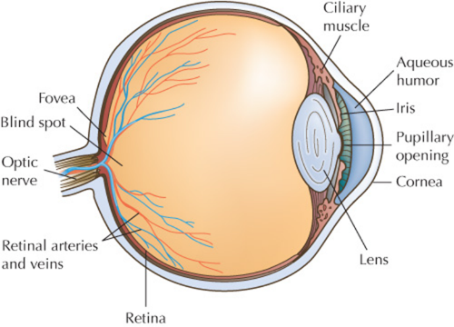
The Process of Accommodation in the Eye: Focus! (1 of 2)
Cornea: Frontmost clear window of the eye; bends light inward to help focus
Lens: Located behind the pupil; adjusts curvature to focus light on the retina
Accommodation: Allows focus on object regardless of distance

Slide 41
The Process of Accommodation in the Eye: Focus! (2 of 2)
Hyperopia
Myopia
Presbyopia
Farsightedness
Eye is too short
Nearby objects are blurred
Distant objects sharp
Nearsightedness
Eyeball is too long
Inability to focus on distant objects
Astigmatism is an imperfect curvature of the cornea, results in multiple focal points
Lens become less flexible
Accommodating is more difficult
Due to aging
Corrected with bifocal lenses

Slide 42
The Process of Transduction in the Eye
Cornea and lens focus light rays on a light-sensitive surface.
Photoreceptors: Located in the retina
Cones: Produce color sensations and fine details
Rods: Cannot detect color, but more sensitive to light than cones
Blind spot: Caused by no photoreceptors at the location where optic nerve exits the eye

Slide 43
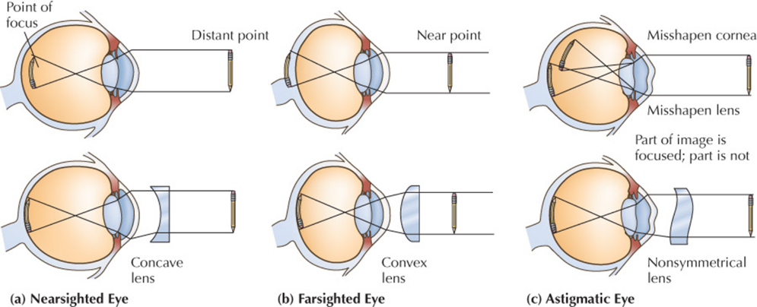
Visual Defects and Corrective Lenses

Slide 44
Cones and Rods
Cones
Rods
Fovea, in center of the retina, contains only cones
Responsible for color vision
Some may experience color blindness or color weakness
Area outside of fovea gets light, creating peripheral (side) vision
Most numerous about 20 degrees from center of retina
Dark adaptation allows us to see in dim light
Pupil opens to allow more light to enter eye

Slide 45
Theories of Color Vision
Trichromatic theory
Opponent-Process theory
Three types of cones, each most sensitive to either red, green, or blue
Basic problem is four, not three, colors of light seem to be primary
Impossible to have reddish green or yellowish blue colors
Vision analyzes colors into “either-or” messages
Messages for either red or green, yellow or blue, black or white
Fatigue by cone response to color produces afterimage of opposite color

Slide 46
Hearing
Sect. 4.3

Slide 47
Characteristics of Sound: What the Ear Hears
Sound travels in series of invisible wavs of compression (peaks) and rarefaction (valleys)
Important characteristics:
Frequency: Frequency of sound waves correspond to perceived pitch of a sound
Amplitude: Height of a sound wave indicates energy, which corresponds to sensed loudness or sound intensity

Slide 48
Characteristics of Sound: What the Ear Hears
Memorize all the parts of the ear (figure 4.16)
No, just kidding unless you really want to!
But do know that transduction is part of the hearing process.

Slide 49
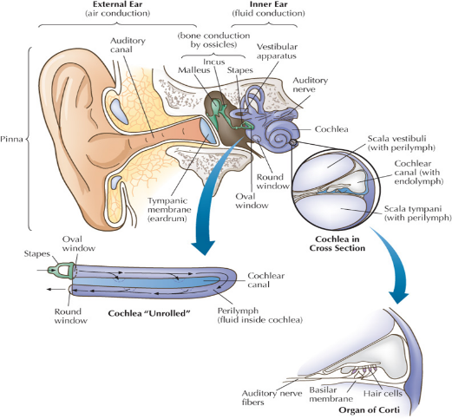
The Process of Transduction in the Ear
(1 of 2)
Pinna: Visible part of ear that focuses sound into ear canal
Eardrum vibrates in response and transmits inward to ossicles, creating vibration
Ossicles link eardrum with cochlea

Slide 50
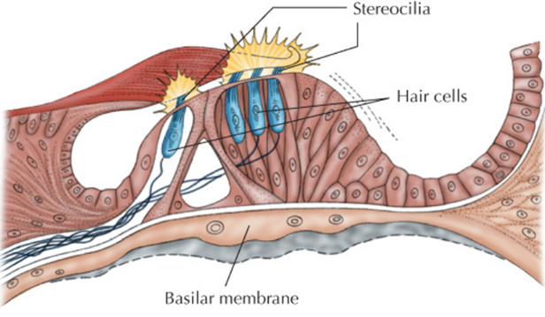
The Process of Transduction in the Ear
(2 of 2)
Inside cochlea, fluid waves trigger vibrations in basilar membrane, the floor of the organ of Corti
Hair cells in basilar membrane push against tectorial membrane

Slide 51
How we Hear
Your ear has three parts that lead to your brain. These parts are the outer ear, the middle ear, and the inner ear.
OUTER EAR
Your outer ear includes your pinna and ear canal. The pinna is the part of your ear that you see on the sides of your head. It is cartilage and soft tissue, not bone. This helps it keep its shape but stay flexible. Sounds go into the pinna and down your ear canal. The pinna helps you figure out which direction sounds come from.

Slide 52
Cont.
Middle Ear
Your eardrum is at the end of your ear canal. This is where your middle ear starts. Your middle ear has three tiny bones in it, called ossicles. These three bones form a chain from the eardrum to the inner ear. The eardrum moves back and forth when sounds hit it. Different pitches, or how high or low a sound is, make the eardrum move more or less. The eardrum makes the small bones move. This movement sends a signal to the inner ear.

Slide 53
Cont.
Inner Ear
Your inner ear helps with both hearing and balance. The cochlea is the hearing part of the inner ear. The semicircular canals are part of your balance system.
The cochlea is bony and looks like a snail. It has fluid and hair cells inside of it. When the bones in your middle ear move, the fluid in your inner ear starts to move. This movement triggers the hair cells. Not all hair cells move at the same time. Different hair cells move for different sounds.
The hair cells change the movement into electrical signals. These signals go through your auditory nerve into your brain. Your brain understands these electrical signals as sounds. Your brain then has to figure out what the sounds mean and how to respond. This is how we hear.
Your inner ear also helps control your balance. The parts of your inner ear that help with balance share the same space and fluid as the cochlea. These parts are the semicircular canals, utricle, and saccule.

Slide 54
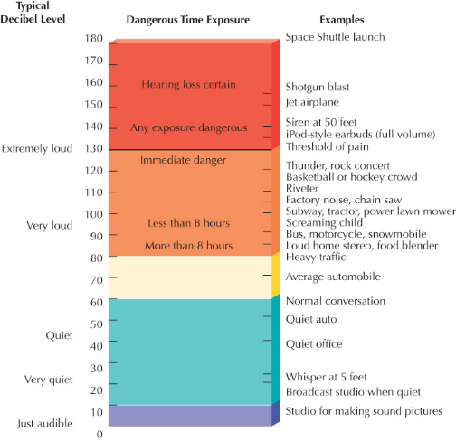
Hearing Loss
Conductive hearing loss:
Transfer of vibrations from outer ear to inner ear weakens
May be caused by disease or injury
to eardrums or ossicles
Sensorineural hearing loss:
Damage to inner ear hair cells or auditory nerve
Noise-induced

Slide 55
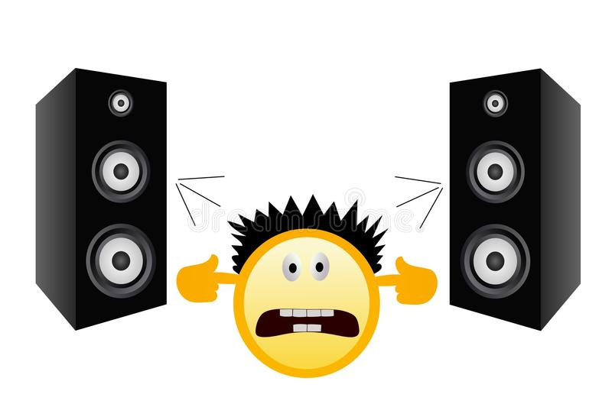
Hearing Loss
  Types of hearing loss:
    Conductive Hearing Loss: damage to the eardrum or ossicles from disease or injury. May be overcome with the help of hearing aids.
    Sensorineural Hearing Loss: damage to the inner ear hair cells or the auditory nerves. Caused by loud sounds from music, cars, construction work, etc.
      May need a cochlear implant.

Slide 56
Theories of Hearing Pitch
Frequency theory of hearing:
As pitch rises, nerve impulses of corresponding frequency are fed into auditory nerve
Accounts for sound but not how we hear pitch higher than 4,000 hertz
Place theory of hearing:
Higher and lower tones excite specific places in the cochlea
Pitch signaled by area of cochlea most strongly activated

Slide 57
Theories of Hearing Pitch
Frequency Theory: Measures neural impulses travelling the auditory nerve. (lower pitch sounds travel at lesser speed)
Place Theory: Links the pitch we hear with the place that is stimulated in the cochlea (different pitches of sound affect different places within cochlea)
  We hear different pitches because different sound waves trigger activity at different places along the cochlea’s basilar membrane ○ Best explains our perception of high-pitched sounds

Slide 58
Discussion Activity 2
As a class, consider and discuss the following:
Many students wear headphones, and music is occasionally loud enough to be heard by others.
What types of hazards might a student who plays music loudly through headphones experience?
How can students prevent long-term hearing problems associated with headphones and loud music?
Notes:
Note to instructor.
Responses will vary by student.
Daily exposure to 85 decibels or more may cause permanent hearing loss. Decibels are a measure of sound intensity. Every 20 decibels increases the sound pressure by a factor of 10. In other words, a rock concert at 120 decibels is 1,000 times stronger than a voice at 60 decibels. Short periods at 120 decibels can cause temporary hearing loss, and even one brief exposure to 150 decibels (a jet airplane nearby) may cause permanent hearing loss.
You may also want to go back to slide 31 and review the decibel rating of various activities.

Slide 59
Chemical and Somesthetic Senses
Sect. 4.4

Slide 60

Types of Senses
Chemical: olfaction (smell) and gustation (taste)
Somesthetic: skin senses (touch),
kinesthetic senses (body position and movement), and vestibular (balance, gravity, and acceleration).

Slide 61
Senses That Are Chemical or Somesthetic
Chemical senses: Olfaction (smell) and gustation (taste)
Somesthetic sense: Those related to our ability to “feel”
The skin senses (touch)
Kinesthetic senses
Vestibular senses

Slide 62
Smell (1 of 2)
Olfaction (smell): Receptors may bind with airborne chemical molecules that have matching “shape” to create odors
Transduction: Air enters nose where nerve fibers may be stimulated to create action potential that then travels to the brain
Anosmia: A type of “smell blindness” to a single order caused by repeated exposure to strong chemicals
Lock-and-key theory of olfaction: Receptors may bind with airborne chemical molecules that have matching shape

Slide 63
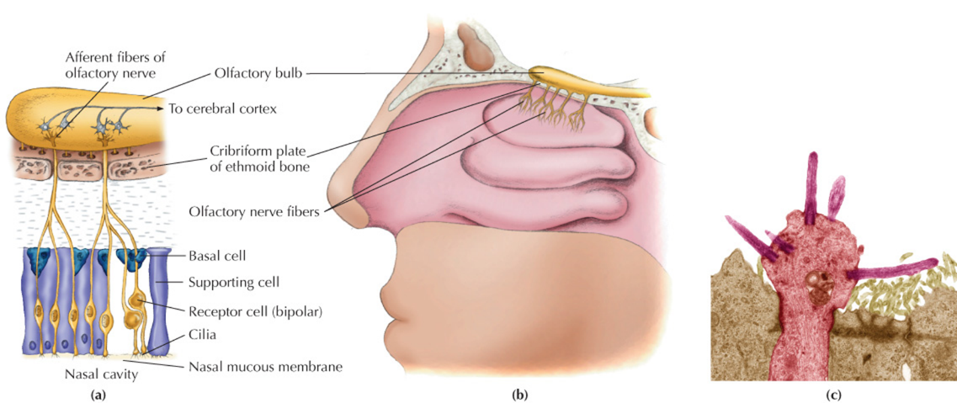
Smell (2 of 2)

Slide 64
Smell (Chemical Sense)
When you smell an odor, you’re actually breathing in tiny molecules. These molecules stimulate specialized nerve cells, called olfactory sensory neurons, high inside the nose. There are a few million of these cells inside your nose. Each makes one of about 500 different types of odor receptor, enabling it to selectively capture a specific set of odor molecules.
Studies using simple odors suggest that when we smell something, a particular combination of neurons are activated. This combination of activity forms a coded message that’s sent to the brain and is then perceived as a particular odor.

Slide 65
Smell cont.
Smell is an important sense. Certain smells, like your dad’s cologne, can help you recall a memory. Other smells, like smoke from a fire, can alert you to danger. When you can’t smell things you enjoy, like your morning coffee or spring flowers, life may seem dull.
As you get older, your sense of smell may fade. Your sense of smell is closely related to your sense of taste. When you can’t smell, food may taste bland. You may even lose interest in eating.

Slide 66
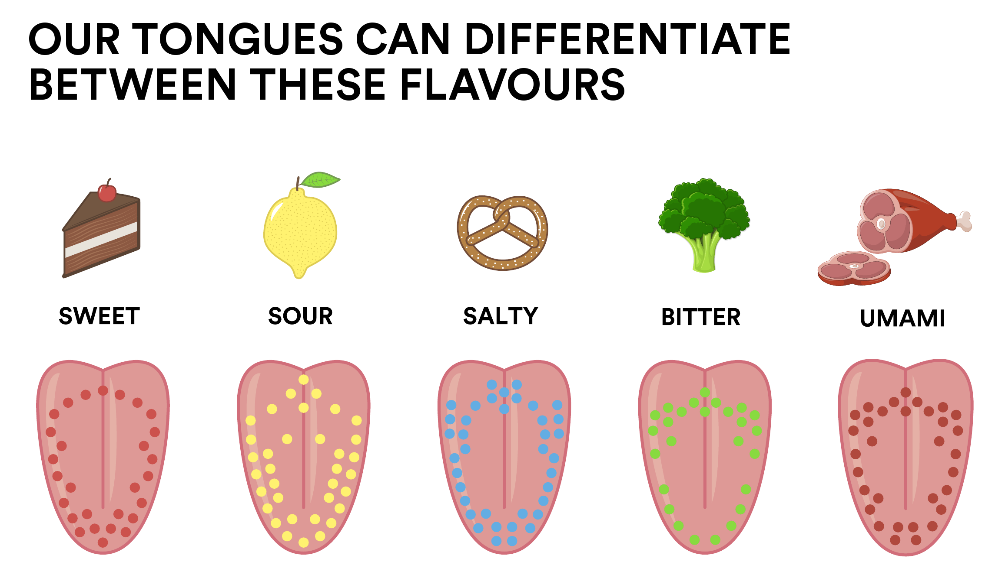
Taste (Chemical Sense)
Five basic taste sensations:
  Sweet
  Salty
  Sour
  Bitter
  Umami (savory or brothy taste)

Slide 67
Taste (1 of 2)
Taste buds: Taste-receptor cells located mainly on the top side of the tongue, especially around the edges
Chemical molecules (caused by chewing food) enter taste buds and set off action potential
Some flavors create sensations of texture, temperature, pain, and smell.
Smell is important in determining flavor.

Slide 68
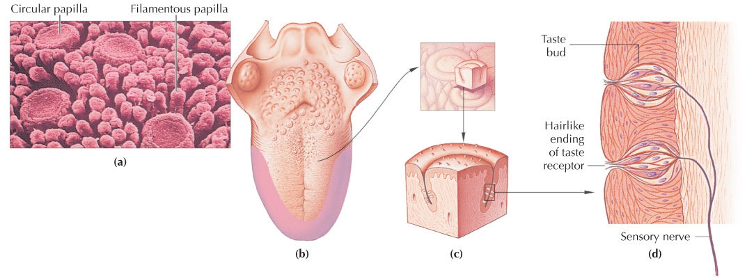
Taste (2 of 2)

Slide 69
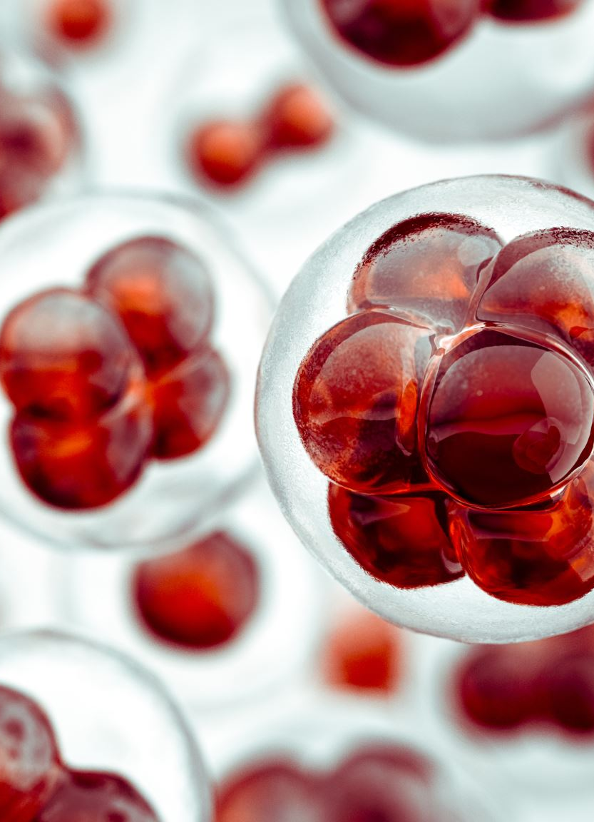
The Process of Transduction on the Tongue
Chemical molecules from food enter the taste buds which send signals to the brain.
Different tastes are matched with molecules and receptors.
Figure 4.22 (page 133) Receptors for the sense of taste.
  Where are most taste buds located?

Slide 70
Touch (1 of 3)
At least five different touch sensations:
Light touch
Pressure
Pain
Cold
Warm
Skin has about 200,000 nerve endings for temperature, 500,000 for touch and pressure, 3 million for pain

Slide 71
Touch (2 of 3)
Some areas have higher density of receptors
Sensitivity generally matches number of receptors in a given area
Areas of higher density of receptors include lips, tongue, face, hands, and genitals
Pain carried by large nerve fibers is sharp, bright, and fast
Serves as the body’s warning system
Pain carried by small nerve fibers is slower and aching
Serves as a reminding system

Slide 72
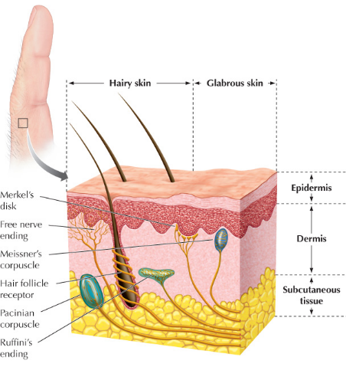
Touch (3 of 3)
Gate control theory: Pain messages from two different types of nerve fibers pass through the same neural gate in the spinal cord.
If the gate is closed by one pain message, the other may not be able to pass through.

Slide 73
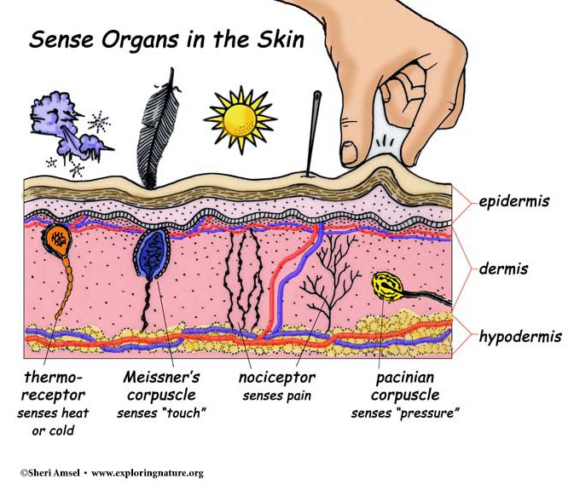
Touch (the skin senses)
Five different sensations are noticeable on the skin.
  Light touch
  Pressure
  Pain
  cold
  Heat/warmth

Slide 74
Pain:
Pain is your body’s way of telling you that something is wrong. Pay attention to pain. This is how we prevent or detect injury.
Gate-control theory: when one type of pain takes precedence over another. This is how acupuncture is used. By inserting small needles and activating small nerves they send signals to the brain to “close the gate” on more intense pain. Giving some temporary relief to chronic, intense pain.
What is another example of people using small pain to mask a larger one?

Slide 75
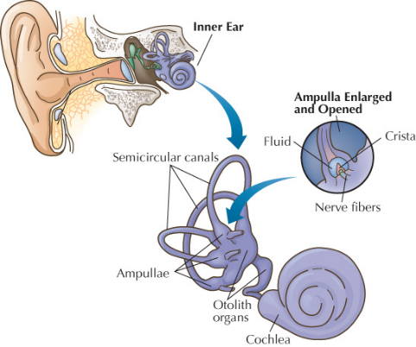
The Kinesthetic and Vestibular Systems
Primarily concerned with position of body in relation to the rest of the world
Kinesthetic transducers located in muscles and joints
Vestibular system related to position of the body as a whole in space, and important in keeping our balance

Slide 76
Sensation in Everyday Life: Motion Sickness
Multimodal integration: Our tendency to integrate the sensory impressions from several modalities
A serious mismatch can occur in the sensory input from different modalities. This may cause disorientation and motion sickness.

Slide 77
The Kinesthetic and Vestibular Systems
Concerned with how your body is positioned in relation to the rest of the world.
The kinesthetic transducers are located in the muscles and joints.
The messages they send to the brain tell what your body is doing such as standing up, sitting, lifting your arm, etc.
Kinesthetic learners are those who require tactile (touching) and movement to learn. They learn by doing not just listening or seeing.

Slide 78
The Kinesthetic and Vestibular Systems cont.
Primary function of the Vestibular system is related to the position of the whole body in space. It helps us keep our balance.
The inner ear is the organ that controls movement, acceleration and gravity.
This is why when you have an inner ear infection you may feel dizzy or out of balance.

Slide 79
Discussion Activity 3
As a class, can you identify the five basic taste sensations?
Which taste sensation are we generally most sensitive to? How and why do you think this sensitivity developed?

Slide 80
Discussion Activity 3 Answer
The five basic taste sensations are:
Sweet
Salty
Sour
Bitter
Umami
We are generally most sensitive to bitter and sour. Going back many generations, this may have helped prevent poisonings when most humans foraged for food because bitter and sour foods are more likely to be inedible.

Slide 81
Attention
Sect. 4.5

Slide 82
Demonstrating the Limits of Attention: Multitasking
Selective attention: Our ability to focus on specific sensory input
Attentional resources are limited:
Attempts to divide can result in poor consequences
Not possible to do multiple things at one time when some focus is required
Requires task-switching: moving attention rapidly between each thing

Slide 83
Selective Attention
Ability to focus on specific sensory input.
Based on the ability of brain structures to select and divert incoming sensory information.
A selective attention example is having a conversation with someone in a crowded, public space. One chooses to focus on what the friend is saying rather than every single noise present in the background.

Slide 84
Four Factors Influencing Selective Attention (1 of 2)
Several factors impact the likelihood that stimuli will attract our attention:
Intensity
Contrast
Personal importance
Goals

Slide 85
Four Factors Influencing Selective Attention
Intensity: We focus more on things that are brighter, louder, larger, sharper. (Think marketing strategies)
Contrast: Difference in light, dark, small, large
Personal Importance: focusing your attention on things that are personally important like your name or number being called.
Goals: Maintaining focus on one thing that you are invested in and ignoring everything else.

Slide 86
Attention in Everyday Life: Mind-Wandering
Mind-wandering: The tendency for attention to stray to things that are internal and unrelated to stimuli
Implications:
Increased likelihood of accidents, impaired memory, difficulties in the workplace
Benefits may include increased creativity and relief from boredom
Intentional and unintentional mind-wandering linked to the executive functions

Slide 87
Discussion Activity 3: Self-Reflection
Move into groups of two or three. Start with some personal self-reflection, then be prepared to share your thoughts with other members of the group.
Consider the following:
Do you ever lose attention or focus in class? Why do you think that might occur?
What types of distractions do you experience in class?
What can you do to improve and maintain your attention in class for longer periods of time?

Slide 88
Perception
Sect. 4.6

Slide 89
Types of Perception:
Illusion: An illusion is a false mental image produced by misinterpretation of things that actually exist.
Hallucination: Hallucinations are where you hear, see, smell, taste or feel things that appear to be real but only exist in your mind.
Synethesis: Synesthesia is when you hear music, but you see shapes. Or you hear a word or a name and instantly see a color. Synesthesia is a fancy name for when you experience one of your senses through another.

Slide 90
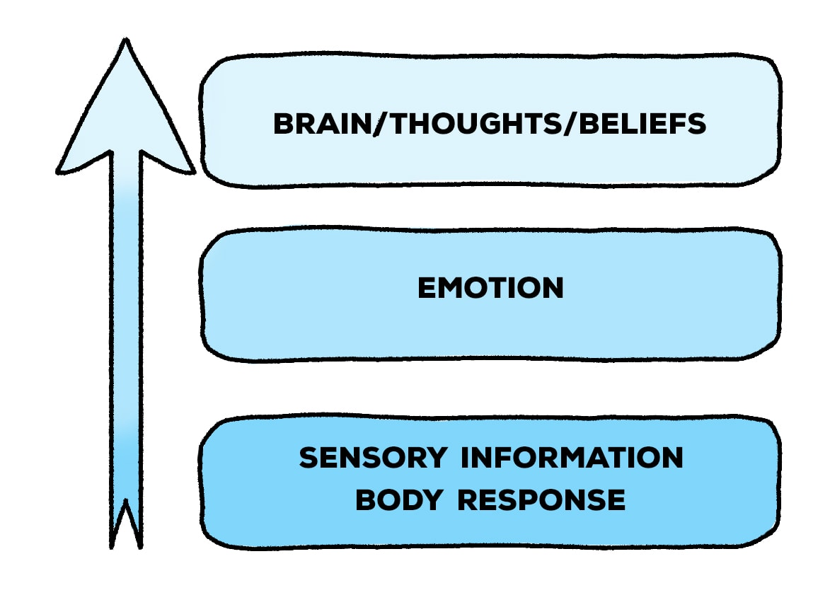
Bottom-up Processing:
Bottom-up: This strategy begins outside of us — with external data like a cool breeze, a flickering light, or a car whizzing by. Then this sensory information travels up to your brain where it gets analyzed.

Slide 91
Top-Down Processing
Top-down: In top-down processing, perceptions begin with the most general and move toward the more specific. These perceptions are heavily influenced by our expectations and prior knowledge.1﻿ Put simply, your brain applies what it knows to fill in the blanks and anticipate what's next.
Our senses are constantly taking in new information. At any given time, we're experiencing a never-ending stream of sights, sounds, smells, tastes, and physical sensations. If we had to focus equally on all of these sensations every second of every day, we would be overwhelmed.
Top-down processing helps simplify our understanding of the world. It allows us to quickly make sense of all the information our senses bring in. As you begin to take in more information about your environment, your initial impressions (which are based on previous experiences and patterns) influence how you interpret the finer details.

Slide 92
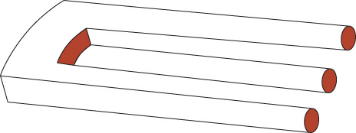
Similarities and Differences in People’s Perceptions (1 of 2)
Transduction: For most people, sensory organs transduce information in the same way.
Experience: Many perceptual experiences are the same because of perceptual constancies developed over years of experience.

Slide 93
Similarities and Differences in People’s Perceptions (2 of 2)
Shape
Size
Brightness
Shape of an object remains stable even though shape of retinal image changes
Perceived size of an object remains the same even though the size of the image on the retina changes
Our brains have learned that relative brightness of objects stays the same even as lighting conditions change

Slide 94
Perceptual Differences Due to Transduction
When sensory organs do not work properly, information sent to the brain may be faulty
Flaws in genetic code for the sense organs
Environmental trauma
Age-related decline

Slide 95
Unit 7
Psychology and Your Skill Set:
Effective Communication

Slide 96
Effective Communication Skills
Communication: Used to persuade people to give us what we need or want, gather information we need, or provide others with information
Verbal communication: Use of words for writing and speaking
Nonverbal communication: Perception of other people’s voice, eye contact, and body language
Two main communication methods: Oral and written
Channel: The way information is shared. Each channel has a different degree of formality.

Slide 97
Receiving Information: Reading and Listening
Good communication depends on our ability to accurately understand information being provided. To improve listening skills:
Don’t interrupt
Show you are listening through nonverbal cues
Keep an open mind while listening
Ask clarifying questions
Focus on what is being said

Slide 98
Providing Information: Writing and Speaking
Thank carefully about the message you want to convey, and the words that will make the message most clear to others.
Understand that others have different tendencies and styles of communication in terms of directness, pacing, and word choices.
Pay attention to communication style:
The tendency to say “I” versus “we”
The tendency to ask questions
The tendency to apologize or admit fault
The tendency to be direct

Slide 99
What’s the Best Communication Style?
The best communication style depends on the needs of the audience in addition to your communication goals.
What is the impression you are trying to convey?
What communication style does your partner prefer?
How will a communication style shape the message?
How will your partner interpret your communication cues?

Slide 100
Self-Assessment
Can you outline what happens in sensory organs during transduction?
Describe the parts of the eye and how they process images?
Can you describe the types of hearing loss and how they occur?
Differentiate between chemical and somesthetic senses.
Describe why we perceive things the way we do, and how transduction and experience both contribute to perception.
Identify how to improve both verbal and nonverbal communication skills.

Slide 101
Summary (1 of 6)
Now that the lesson has ended, you should have learned how to:
Define sensation and transduction, and outline what happens in the sensory organs during transduction.
Distinguish between absolute threshold and difference threshold.
Identify four ways by which the senses reduce the amount of information sent to the brain.
Describe three characteristics of light that are processed by the eye.

Slide 102
Summary (2 of 6)
Now that the lesson has ended, you should have learned how to:
Outline what is meant by accommodation in the eye, and the conditions that result from problems with accommodation.
Describe the process of transduction in the eye, and two problems associated with color vision.
Contrast the trichromatic and opponent-process theories of color vision.
Describe two characteristics of sound that are processed by the ear.

Slide 103
Summary (3 of 6)
Now that the lesson has ended, you should have learned how to:
Describe the process of transduction in the ear, and two associated forms of hearing loss.
Contrast the frequency and place theory of hearing pitch.
Name the two chemical senses and three somesthetic senses.
Describe the process of transduction in the nose.
Describe the process of transduction on the tongue.

Slide 104
Summary (4 of 6)
Now that the lesson has ended, you should have learned how to:
Describe the process of transduction on the skin, including the function of large and small nerve fibers in the sensation of pain.
Describe the process of transduction in the vestibular system.
Define multimodal integration.
Explain what research on multitasking has indicated with respect to the limits on attention.
Identify four factors that influence whether we will pay attention to a stimulus.

Slide 105
Summary (5 of 6)
Now that the lesson has ended, you should have learned how to:
Describe the positive and negative effects of mind-wandering.
Describe the relationship between sensation and perception.
Contrast bottom-up and top-down processing.
Explain how both sensory transduction and experience contribute to similarities and differences in perception.
Describe the effects of culture on the perception of the Müller-Lyer illusion.

Slide 106
Summary (6 of 6)
Now that the lesson has ended, you should have learned how to:
Differentiate between monocular and binocular depth cues, giving examples of each.
Explain how depth cues are used in the world of art and by clinical psychologists using virtual reality to treat clients.
Distinguish between verbal and nonverbal communication.
Outline two verbal communication methods and two verbal communication points of view.
Create a plan to improve your own communication with others.

Slide 107

End of Chapter 4

