Slide 1


Introduction to Psychology
PSY 132
Chapter 5,
16th Edition
Chapter 5: States of Consciousness

Slide 2
Icebreaker: Pair-Share
How do you define “state of consciousness”?
What practices and rituals do you use to prepare yourself mentally for something?
Do you think hypnosis or meditation actually work? Why or why not?

Slide 3
Chapter Objectives (1 of 3)
By the end of this chapter, you should be able to:
5.1.1 Define consciousness.
5.1.2 Distinguish between disordered states of consciousness and altered states of consciousness.
5.2.1 Describe how hypnosis works, distinguishing between state and nonstate theories of hypnosis.
5.2.2 Describe how meditation works, distinguishing between mindfulness and concentrative meditation.
5.3.1 Describe the typical pattern of sleeping and waking.

Slide 4
Chapter Objectives (2 of 3)
By the end of this chapter, you should be able to:
5.3.2 Describe NREM (non-REM) sleep, including its function and four stages.
5.3.3 Describe REM sleep and its function.
5.3.4 Explain why we need to sleep, and the consequences of not sleeping.
5.3.5 Name and briefly describe the three theories of dreaming.
5.3.6 Outline five sleep disorders.
5.4.1 Explain the action of a psychoactive drug, and distinguish between recreational and instrumental drug use.

Slide 5
Chapter Objectives (3 of 3)
By the end of this chapter, you should be able to:
5.4.2 Outline three reasons for drug abuse.
5.4.3 Name five common stimulants.
5.4.4 Name five common depressants.
5.4.5 Name two common hallucinogens.
5.5.1 Define metacognition, and describe its three elements.
5.5.2 Create a plan to improve your own metacognitive skills.

Slide 6
Unit 1
States of Consciousness:
The Many Faces of Awareness

Slide 7
Consciousness
Disorders of Consciousness
Altered States of Consciousness
Waking consciousness: Clear, organized alertness
Disorder of consciousness: A long-term lack of consciousness and responsiveness (coma)
Difficult to diagnose
Persistent vegetative state: Waking state without signs of awareness
Fatigue, delirium, hypnosis, drugs, and euphoria
Everyone experiences some altered states, such as sleep, dreaming, and daydreaming.
Heightened awareness
Marked by changes in quality and pattern of mental activity

Slide 8
What is Consciousness?
Consciousness is the individual awareness of your unique thoughts, memories, feelings, sensations, and environments. Essentially, your consciousness is your awareness of yourself and the world around you.
Notes:
Note to instructor:
There are no correct or incorrect answers. However, altered states have important cultural meaning. All cultures and most religions recognize and accept some alteration of consciousness.
This might include taking drugs to foster a deeper connection with nature and creating improved physical, emotional, and spiritual well-being. Others engage in meditation or dancing rituals.
Some people seek altered states for pleasure or escape, especially from pain.

Slide 9
What is Consciousness?
This awareness is subjective and unique to you. If you can describe something you are experiencing in words, then it is part of your consciousness.
Your conscious experiences are constantly shifting and changing. For example, in one moment, you may be focused on reading this powerpoint. Your consciousness may then shift to the memory of a conversation you had earlier with a classmate. Next, you might notice how uncomfortable your chair is, or maybe you are mentally planning dinner.
Notes:
Note to instructor:
There are no correct or incorrect answers. However, altered states have important cultural meaning. All cultures and most religions recognize and accept some alteration of consciousness.
This might include taking drugs to foster a deeper connection with nature and creating improved physical, emotional, and spiritual well-being. Others engage in meditation or dancing rituals.
Some people seek altered states for pleasure or escape, especially from pain.

Slide 10
What is Consciousness?
The two normal states of awareness are consciousness and unconsciousness. Higher states of consciousness are often associated with spiritual or mystical experiences. It involves an elevated state of awareness where people are able to gain a greater sense of themselves, their role, and the world. Examples of this include transcendence, meditation, mindfulness, a "runner's high," lucid dreaming, and flow states.
Notes:
Note to instructor:
There are no correct or incorrect answers. However, altered states have important cultural meaning. All cultures and most religions recognize and accept some alteration of consciousness.
This might include taking drugs to foster a deeper connection with nature and creating improved physical, emotional, and spiritual well-being. Others engage in meditation or dancing rituals.
Some people seek altered states for pleasure or escape, especially from pain.

Slide 11
What is Consciousness?
Altered levels of consciousness also can occur, which may be caused by medical or mental conditions that impair or change awareness. Altered types of consciousness include:
Coma
Confusion
Delirium
Disorientation
Lethargy
Stupor
Notes:
Note to instructor:
There are no correct or incorrect answers. However, altered states have important cultural meaning. All cultures and most religions recognize and accept some alteration of consciousness.
This might include taking drugs to foster a deeper connection with nature and creating improved physical, emotional, and spiritual well-being. Others engage in meditation or dancing rituals.
Some people seek altered states for pleasure or escape, especially from pain.

Slide 12
Functions of Consciousness
Functions of Consciousness
Consciousness has several biological and social purposes. For example, it allows us to process information, choose our actions, set priorities, learn and adapt to new information, make decisions, and more.
Consciousness is an essential state in philosophy, spirituality, and religion. All of these require self-awareness, which is impossible without consciousness.
Notes:
Note to instructor:
There are no correct or incorrect answers. However, altered states have important cultural meaning. All cultures and most religions recognize and accept some alteration of consciousness.
This might include taking drugs to foster a deeper connection with nature and creating improved physical, emotional, and spiritual well-being. Others engage in meditation or dancing rituals.
Some people seek altered states for pleasure or escape, especially from pain.

Slide 13
Changes in Consciousness
Changes in Consciousness
Understanding different levels of consciousness can help healthcare professionals spot signs that someone might be experiencing a problem. Some of these changes occur naturally; others are the result of factors such as drugs or brain damage. Changes to consciousness also can cause changes to perception, thinking, understanding, and interpretations of the world.
Notes:
Note to instructor:
There are no correct or incorrect answers. However, altered states have important cultural meaning. All cultures and most religions recognize and accept some alteration of consciousness.
This might include taking drugs to foster a deeper connection with nature and creating improved physical, emotional, and spiritual well-being. Others engage in meditation or dancing rituals.
Some people seek altered states for pleasure or escape, especially from pain.

Slide 14
Changes in Consciousness
Changes in consciousness can sometimes be a sign of medical conditions or an emergency. For example, sudden changes in consciousness might be a sign of:
Aneurysm Epilepsy
Brain infections Heart disease
Brain tumor or injury Heat stroke
Dementia or Alzheimer's disease
Lack of oxygen to the brain
Drug use Low blood sugar
Shock Stroke
Notes:
Note to instructor:
There are no correct or incorrect answers. However, altered states have important cultural meaning. All cultures and most religions recognize and accept some alteration of consciousness.
This might include taking drugs to foster a deeper connection with nature and creating improved physical, emotional, and spiritual well-being. Others engage in meditation or dancing rituals.
Some people seek altered states for pleasure or escape, especially from pain.

Slide 15
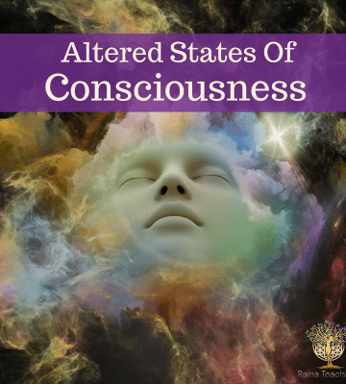
How we Achieve an Altered State of Consciousness
https://www.youtube.com/watch?v=LY_83_wnk20
Notes:
Note to instructor:
There are no correct or incorrect answers. However, altered states have important cultural meaning. All cultures and most religions recognize and accept some alteration of consciousness.
This might include taking drugs to foster a deeper connection with nature and creating improved physical, emotional, and spiritual well-being. Others engage in meditation or dancing rituals.
Some people seek altered states for pleasure or escape, especially from pain.

Slide 16
Unit 2
Hypnosis and Meditation: Relax

Slide 17


Slide 18
How Hypnosis Works
Basic suggestion effect: Tendency to carry out suggested actions as if involuntarily
Focused attention on what is said
Relax and feel tired
Let go and accept suggestions
Use vivid imagination
Hypnotizability: How easily a person can become hypnotized

Slide 19
Hypnosis
A state of consciousness characterized by focused attention, reduced peripheral awareness, and heightened suggestibility
Ernest Hilgard argued:
Hypnosis causes a dissociate state, or split in awareness
The hidden observer is aware of pain but remains in the background
Nonstate theorists argue hypnosis is a blend of conformity, relaxation, imagination, obedience, and role-playing.

Slide 20
How Hypnosis Works
When you think about hypnosis, what do you visualize? For many, it’s a clock-swinging magician or a comedy act that forces an unwitting volunteer to make embarrassing public admissions on stage.
But hypnosis has a surprisingly robust scientific framework. Clinical research has shown that it can help relieve pain and anxiety and aid smoking cessation, weight loss, and sleep.
It can help children and adolescents better regulate their feelings and behaviors. Some people can even use “self-hypnosis” to manage stress, cope with life’s challenges, and improve their physical and emotional health.

Slide 21
How Hypnosis Works
Hypnosis creates “a non-judgmental immersive experience,” says Dr. David Spiegel, a Stanford University psychiatrist and leading researcher of hypnosis.
It’s been used in various forms for centuries, but it wasn’t until 1843 that the Scottish surgeon Dr. James Braid popularized the term “hypnosis.”
Braid’s central discovery—that concentration can guide the brain toward a more suggestible state—was and remains controversial. But physicians have continued to test and teach the technique over the centuries with great success,

Slide 22
How Hypnosis Works
Today, a psychologist, psychiatrist, or other healthcare professional certified in hypnotherapy will first screen a potential client for their ability to be hypnotized using a validated suggestibility scale.
(Not everyone is equally susceptible to hypnosis, but research has found that about two-thirds of adults are.)

Slide 23
How Hypnosis Works
The hypnotherapist will talk with them about what sort of sensory experiences make them feel safe, like a lakeshore retreat or a beach vacation.
Then, the hypnotherapist will conjure that imagery—focusing, for example, on the salt spray of the ocean, seagulls calling overhead, and sun-kissed skin—to help the person go deeper into the calming visualization.
If done right, the patient’s physical surroundings will melt away.

Slide 24
How Hypnosis Works
The result is a powerful combination of dissociation, immersion, and openness to new experiences, which culminates in what was once called a “trance,” but which modern hypnotherapists simply refer to as a “hypnotic state.” It can be achieved in just a few minutes.
During hypnosis, people are more open to the suggestions of the hypnotherapist, whether those ask the patient to detach themselves from a past painful experience or visualize a solution to their problem. For some people, these changes may be catalyzed in a one- or two-hour session. For others, hypnotherapy or self-hypnosis may be a regular part of their mental health care.

Slide 25
How Hypnosis Works
Brain-imaging studies have helped to illuminate what happens inside the hypnotized brain, though much still remains a mystery. During hypnosis, activity in a brain region that helps people switch between tasks quiets down.
This same region seems to disconnect from another area responsible for self-reflection and daydreaming—which may be why hypnotized people aren’t worried about who they are or what they’re doing. Researchers have also found that hypnosis can calm brain regions that help control autonomic functions like heart rate, blood flow, and breathing. This is likely what leads to the physical relaxation that’s a hallmark of hypnosis.

Slide 26
Effects of Hypnosis
Physical ability: May improve some in sports; does not affect physical strength
Memory: Some evidence it can enhance memory, but frequently increases false memories
Amnesia: Brief memory loss seems to occur
Pain relief: Can relieve pain, especially helpful when chemical painkillers are ineffective
Sensory changes: Most effective; possible to alter color vision, hearing sensitivity, time sense, perception of illusion, and other sensory responses

Slide 27

Meditation

Slide 28
Meditation
A mental exercise used to alter consciousness
Heightened awareness and relaxation by interrupting flow of thoughts, worries, and analysis
Mindfulness meditation: Observe own thoughts without reacting to them; achieve total, nonjudgmental awareness of the world
Concentrative meditation: Attending to a single focal point or mantra

Slide 29
Mindfulness Meditation
What is mindfulness?
Mindfulness is the basic human ability to be fully present, aware of where we are and what we’re doing, and not overly reactive or overwhelmed by what’s going on around us.
While mindfulness is something we all naturally possess, it’s more readily available to us when we practice on a daily basis.

Slide 30
Meditation
Whenever you bring awareness to what you’re directly experiencing via your senses, or to your state of mind via your thoughts and emotions, you’re being mindful.
And there’s growing research showing that when you train your brain to be mindful, you’re actually remodeling the physical structure of your brain.

Slide 31
Meditation
Researchers can measure brain changes both as function (how well our brains perform certain actions, and the interactions or connections between different brain regions) and structure (the physical make-up of the brain).
Previous research on brain structure has found an increase in gray matter volume (GMV) and gray matter density (GMD) in various brain regions of participants who have completed the Mindfulness-Based Stress Reduction (MBSR) program.

Slide 32
Concentrative Meditation
Concentrative meditation is the art of staying on one thought.
It is specifically different to contemplative meditation in the sense that no intellectual examination is performed while practicing this meditation.
It is predominantly designed to help you settle your mind and attain stillness of the body.

Slide 33
Concentrative Meditation
During a concentration meditation session, your mind and body focus all your attention on one thing. This usually involves focusing on your deep breathing as it enters and leaves your body.
Some people also like to focus on a saying or mantra to help them concentrate on their meditation. A mantra is a phrase that you silently repeat to yourself. For example, a mantra could be “I am not afraid” or “ Everything is okay.”

Slide 34
Concentrative Meditation
When you repeat the mantra to yourself or focus on your deep breathing, you tend to focus less on other thoughts or feelings that could distract you. These practices help increase the level of calmness and relaxation you feel.

Slide 35
The Relaxation Response
An innate physiological pattern that opposes your body’s fight-or-flight mechanisms
Good for stress control
Physical benefits such as lowered heart rate, blood pressure, muscle tension, and other signs of stress, as well as immune system activity improvement
May foster mental well-being and positive mental skills, such as clarity, concentration, and calm

Slide 36
Unit 3
Sleep: The Nightly Roller Coaster

Slide 37
Sleep Patterns
Sleep is an innate biological rhythm: cannot be completely ignored
Light and dark help tie sleep rhythms to 24-hour days
Normal range of sleep: 7–8 hours per night
Short sleepers: Average 5 hours per night
Long sleepers: Average 9 or more hours

Slide 38

Sleep Patterns
There are two main processes that regulate sleep: circadian rhythms and sleep drive.

Slide 39
Sleep Patterns
Circadian rhythms are controlled by a biological clock located in the brain.
One key function of this clock is responding to light cues, ramping up production of the hormone melatonin at night, then switching it off when it senses light. People with total blindness often have trouble sleeping because they are unable to detect and respond to these light cues.

Slide 40
Sleep Patterns
Sleep drive also plays a key role: Your body craves sleep, much like it hungers for food. Throughout the day, your desire for sleep builds, and when it reaches a certain point, you need to sleep. A major difference between sleep and hunger:
Your body can’t force you to eat when you’re hungry, but when you’re tired, it can put you to sleep, even if you’re in a meeting or behind the wheel of a car. When you’re exhausted, your body is even able to engage in microsleep episodes of one or two seconds while your eyes are open. Napping for more than 30 minutes later in the day can throw off your night’s sleep by decreasing your body’s sleep drive.

Slide 41
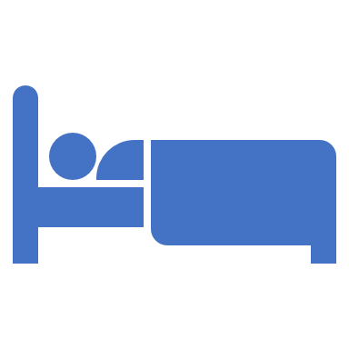
The Stages of Sleep
Changes in electrical activity in the brain waves show that sleep progresses through several stages every night:
Beta waves: Awake and alert
Alpha waves: Immediately before sleep; slower and larger waves
REM sleep: Dreaming and return of high-frequency brain waves
Non-REM sleep: Occurs during all sleep stages

Slide 42
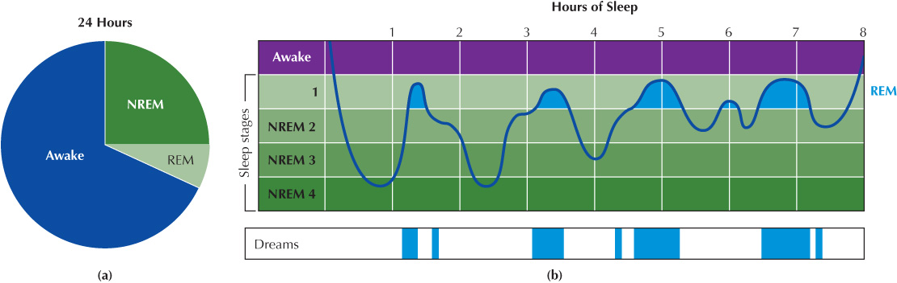
REM and Non-REM Sleep

Slide 43
Non-REM Sleep
Non-REM sleep
Non-REM sleep has three stages, defined by measurements of brain activity taken in sleep studies.
Stage 1. This stage is the transition between wakefulness and sleep.
Stage 2. When you reach stage 2, you are asleep.
Stage 3. This stage is called deep sleep or slow-wave sleep, after a particular pattern that appears in measurements of brain activity. You usually spend more time in this stage early in the night.

Slide 44
Non-REM Sleep
What is stage 1 NREM sleep?
Stage 1 NREM sleep is the lightest stage of sleep. You enter stage 1 right after you fall asleep. This stage usually lasts only a few minutes, making up about 5% of your sleep time. After that, your sleep gets deeper, and you move into stage 2 NREM sleep.

Slide 45
Non-REM Sleep
What is stage 2 NREM sleep?
Stage 2 is still light sleep, but deeper than stage 1. During this stage, your brain waves slow down and have noticeable pauses between short, powerful bursts of electrical activity. Experts think those bursts are your brain organizing memories and information from the time you spent awake.
Stage 2 NREM sleep accounts for about 45% of your time asleep (the most of any stage). You’ll go through multiple rounds of stage 2 NREM sleep, and usually, each one is longer than the last. After stage 2, you move deeper into stage 3 NREM sleep or enter REM sleep.

Slide 46
Non-REM Sleep
What is stage 3 NREM sleep?
The deepest stage of NREM sleep is stage 3. It makes up about 25% of your total sleep time in adults. But babies and children need more stage 3 sleep, and the older you get, the less you need.

Slide 47
Non-REM Sleep
In stage 3, your brain waves are slow but strong. Your body takes advantage of this very deep sleep stage to repair injuries and reinforce your immune system. The same bursts of brain activity that happen in stage 2 can also happen in stage 3, and brain waves specific to stage 3 help regulate those bursts.

Slide 48
Non-REM Sleep
You need stage 3 NREM sleep to wake up feeling rested. Without enough stage 3 sleep, you feel tired and drained even if you slept for a long time. That’s why your body automatically tries to get as much stage 3 sleep into your sleeping period as early as possible. After stage 3 NREM sleep, your body moves into stage 2 NREM, which is the gatekeeper of REM sleep.
Because stage 3 NREM sleep is so deep, it’s hard to wake someone up from it. If they do wake up, they’ll probably have “sleep inertia,” a state of confusion or “mental fog.” Sleep inertia lasts about 30 minutes.

Slide 49
REM Sleep and Dreaming
What is REM sleep?
Rapid eye movement (REM) sleep is the stage of sleep where most dreams happen. Its name comes from how your eyes move behind your eyelids while you’re dreaming. During REM sleep, your brain activity looks very similar to brain activity while you’re awake.
REM sleep makes up about 25% of your total time asleep. Your first REM cycle of a sleep period is typically the shortest, around 10 minutes. Each one that follows is longer than the last, up to an hour.

Slide 50
REM Sleep and Dreaming
Brain areas associated with imagery and emotion more active during REM sleep
Includes:
Rapid eye movement
Irregular heartbeat
Wavering blood pressure and breathing
Sleep paralysis
Sharpening or completing consolidation of memories

Slide 51
The Need for Sleep
Repair/restorative theories of sleep: Replenish and conserve energy and lengthen life
When sleep deprivation occurs:
Susceptibility to microsleeps
Sleep-deprivation psychosis
Confusion, disorientation, delusions, and hallucinations

Slide 52
The Need for Sleep
Why You Need Sleep
If you have ever felt foggy after a poor night’s sleep, it won’t surprise you that sleep significantly impacts brain function.
First, a healthy amount of sleep is vital for “brain plasticity,” or the brain’s ability to adapt to input. If we sleep too little, we become unable to process what we’ve learned during the day and we have more trouble remembering it in the future.
Researchers also believe that sleep may promote the removal of waste products from brain cells—something that seems to occur less efficiently when the brain is awake
.

Slide 53
The Need for Sleep
Sleep is vital to the rest of the body too. When people don’t get enough sleep, their health risks rise.
Symptoms of depression, seizures, high blood pressure and migraines worsen. Immunity is compromised, increasing the likelihood of illness and infection.
Sleep also plays a role in metabolism: Even one night of missed sleep can create a prediabetic state in an otherwise healthy person. “There are many important connections between health and sleep,”
.

Slide 54

Psychodynamic Dream Theory
Emphasizes internal conflicts and unconscious forces
Sigmund Freud's key proposals:
Dream symbols: Images that have deeper symbolic meaning
Manifest content: Obvious, visible meaning
Latent content: Hidden, symbolic meaning

Slide 55
Psychodynamic Dream Theory
Manifest Content
According to the psychoanalyst Sigmund Freud, the manifest content of a dream includes the actual images, thoughts, and content contained within the dream. The manifest content is the elements of the dream that you remember upon awakening.

Slide 56
Psychodynamic Dream Theory
Latent Content
According to Freud, the latent content of a dream is the hidden psychological meaning of the dream. This content appears in disguise symbolically and contains things that are hidden from conscious awareness, often because it may be upsetting or traumatic.

Slide 57
Psychodynamic Dream Theory
According to the Freud, people do not just dream for its sake but to reflect fears, secrets, and desires. Subordinate review, concentration, representability, and supplanting are the four main components of dreams, and they all denote the imagery of the brain's work in reflecting past, future, and imaginary events. Therefore, dreams are the brain's activity in remembering past events, revealing the worst fears of an individual, and, more importantly, revealing desires.

Slide 58
Psychodynamic Dream Theory
Freudian Dream Symbols
Freud wrote about dreams in many different places, most notably in his book The Interpretation of Dreams. According to Freud, the number of things represented by symbols in dreams is not great: The human body, parents, children, siblings, birth, death, nakedness, and a few others.

Slide 59
Psychodynamic Dream Theory
The person as a whole is often represented in the form of a house—houses with smooth walls are men, and those with projections and balconies to which one might cling are women. Parents appear in dreams as kings, queens, or other highly respected persons; children and siblings are symbolized as small animals or vermin.

Slide 60
Psychodynamic Dream Theory
Birth is almost always represented by some reference to water: Either one plunges into water or climbs out of it, rescues someone from water or gets rescued from water (indicating a mother-like relationship to that person).
Death is replaced in dreams by taking a journey; nakedness is symbolized by clothing, especially uniforms.

Slide 61
Psychodynamic Dream Theory
The richest collection of symbols, however, is reserved for the sphere of sexual life. According to Freud, the great majority of symbols in dreams are sex symbols. The number three is a symbolic substitute for the entire male genital, whereas the penis alone is represented by long and upright objects such as sticks, umbrellas, poles, trees, or the Washington Monument.
It can also be symbolized by objects that can penetrate the body and cause injury—think of knives, daggers, lances, swords, and firearms (especially revolvers). Also substituted for male genitalia are objects out of which water flows, such as faucets and fountains, or objects that can be elongated such as telescopes and collapsible pencils.

Slide 62
Dream Theories
Activation-Synthesis Hypothesis
Neurocognitive Dream Theory
Allan Hobson and Robert McCarley
During REM sleep, lower brain centers are activated in random fashion
Brain tries to interpret random information by searching through stored memories and creates dreams
William Domhoff
Dreams have much in common with waking thought
Dreams are conscious expression of REM sleep processes that sort and store daily experiences
No deeper, symbolic meaning to dreams

Slide 63
Insomnia Disorder
Difficulty getting to sleep or staying asleep
Temporary insomnia: Caused by worry, stress, and excitement
Drug-dependency insomnia: Caused by withdrawal from sleeping pills
Alcohol and other depressants may help a person get to sleep but reduce the sleep quality.

Slide 64
Behavioral Remedies for Insomnia
Best to treat with lifestyle changes and behavioral techniques:
Stimulus control
Sleep restriction
Paradoxical intention
Relaxation
Exercise
Food intake
Stimulant avoidance

Slide 65
Other Sleep Disorders
What are sleep disorders, and which of them are more common?
Conditions that disrupt sleep or wakefulness are called sleep disorders. There are six main categories of sleep disorders:
Central disorders of hypersomnolence (like narcolepsy).
Circadian rhythm sleep-wake disorders (such as jet lag or shift work sleep disorder).
Insomnia.
Parasomnias.
Sleep-disordered breathing (such as sleep apnea).
Sleep-related movement disorders (like restless leg syndrome).

Slide 66
Other Sleep Disorders
Parasomnias can vary widely. Some affect NREM sleep only, while others affect REM sleep only. Organized by possible NREM or REM stage, they include:
Stages 1 and 2 NREM sleep
Sleep starts or twitches (sleep myoclonus).
Exploding head syndrome.
Teeth grinding (bruxism).
Periodic limb movement disorder (PLMD).

Slide 67
Other Sleep Disorders
Fact:
Exploding head syndrome (EHS) is a type of sleep disorder in which you hear a loud noise or explosive crashing sound in your head. The sound isn't real or heard by anyone else. The episode typically happens suddenly either when you're beginning to fall asleep or when you wake up during the night.
Along with the loud sound, EHS can occur along with flashes of light and muscle jerks (myoclonic jerks). Unlike its painful-sounding name, the episode is painless.

Slide 68
Other Sleep Disorders
Stage 3 NREM sleep
Night terrors (also known as sleep terrors).
Sleepwalking (somnambulism).
Confusional arousals (partial waking with sleep inertia).
Periodic limb movement disorder (PLMD).
Sleep-related eating disorder.
REM sleep
Nightmares and nightmare disorder.
REM sleep behavior disorder.
Hypnagogic and hypnopompic hallucinations.

Slide 69
Knowledge Check Activity 1
Which of the following is a mismatch between the sleep–wake schedule demanded by a person’s bodily rhythm and the demands of the environment?
Insomnia disorder
Circadian rhythm sleep–wake disorder
REM sleep behavior disorder
Hypersomnolence disorder

Slide 70
Knowledge Check Activity 1: Answer
Which of the following is a mismatch between the sleep–wake schedule demanded by a person’s bodily rhythm and the demands of the environment?
b. Circadian rhythm sleep–wake disorder
This disorder is caused by a mismatch between a person’s natural sleep cycle and the environment. Those who work shift work or rotating schedules might be susceptible to this disorder.

Slide 71
Unit 4
Drug-Altered Consciousness: The High and Low of It

Slide 72
Drug-Altered Consciousness (1 of 2)
Psychoactive Drug
Stimulant
Depressant
Capable of altering attention, emotion, judgment, memory, time sense, self-control, or perception
Type of psychoactive drug that increases activity in the body and nervous system
Type of psychoactive drug that decreases, or slows down, activity in the body and nervous system

Slide 73
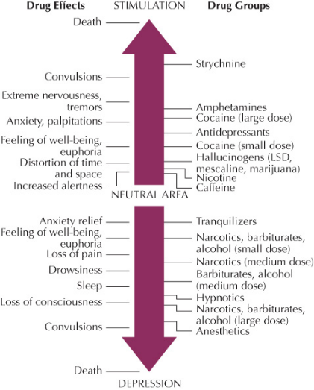
Drug-Altered Consciousness (2 of 2)
Social-recreational use: Pleasure or relaxation
Intensive use: Daily use with elements of dependence
Compulsive use: Intense use and extreme dependence

Slide 74
Reasons for Drug Abuse (1 of 2)
Coping efforts: Self-defeating attempt to cope with life
Effects on the brain: Addictive drugs stimulate the brain’s reward circuitry
Nucleus accumbens release dopamine, a neurotransmitter that intensifies feelings of pleasure
Dependency: To maintain bodily comfort, a physical dependence exists

Slide 75
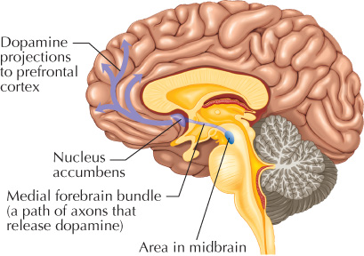
Reasons for Drug Abuse (2 of 2)
Withdrawal symptoms: Physical illness and discomfort from removal of a drug
Drug tolerance: Progressive decrease in responsiveness to a drug
Psychological dependence: Feeling that drug is necessary to maintain well-being

Slide 76
Stimulants Up, Up, and Away (1 of 3)
Amphetamines
Cocaine
Type of synthetic stimulant
Medical use: Treating hyperactivity and overdoses of depressant drugs
Misuse: Staying awake, attempt to improve mental or physical performance
Attention deficit hyperactivity disorder (ADHD)
Feelings of alertness, euphoria, well-being, energy, and pleasure
Affects central nervous system and is more quickly metabolized than amphetamines
Capacity for abuse similar to heroin
Anhedonia: Inability to feel pleasure, typical withdrawal symptom

Slide 77
Stimulants Up, Up, and Away (2 of 3)
MDMA
Caffeine
Ecstasy or molly
Chemically similar to amphetamine
Produces hallucinations
Brain cells release extra dopamine, epinephrine, and serotonin
Users more likely to also abuse alcohol
Long-term effects
Most frequency used psychoactive drug in North America
Blocks chemicals that inhibit nerve activity
Dependence, insomnia, irritability, racing heart, elevated body temperatures
Breast cysts, bladder cancer, heart problems, high blood pressure

Slide 78
Stimulants Up, Up, and Away (3 of 3)
Nicotine, chewing tobacco, snuff
Third most widely used psychoactive drug (after caffeine and alcohol)
Withdrawal causes headaches, sweating, cramps, insomnia, digestive upset, irritability, cravings
Carcinogen: Cancer-causing substance
Best way to quit: Scheduled gradual reduction, which reduces length of time between cigarettes

Slide 79
Depressants: Down and Out (1 of 3)
Opioids
Barbiturates
Sleep and pain relief
Heroin, morphine, codeine, oxycodone, fentanyl
Feeling of euphoria, reduction of anxiety
High levels result in impaired breathing, death
Harm-reduction strategy: Methadone to reduce negative consequences of addiction
Sedatives that depress brain activity
Used to calm people and induce sleep
Low dosages: Similar to alcohol
Higher dosages: Severe mental confusion or hallucinations
Loss of consciousness, severe depression of brain centers that control heartbeat and breathing

Slide 80
Depressants: Down and Out (2 of 3)
Tranquilizers
GHB
Anxiety and tension reduction
Valium, Xanax, Librium
Rohypnol: common date rape drug
Physical dependence, severe depression that may lead to suicide
Central nervous system depressant
Low dosage: Euphoria, desire to socialize, mild loss of inhibition
As doses increases: nausea, loss of muscle control, sleep or loss of consciousness
Potentially fatal doses are only three times normal dose

Slide 81
Depressants: Down and Out (3 of 3)
Alcohol: As a depressant, reduces inhibition, producing relaxation and euphoria
Large amounts: Brain impartment, loss of consciousness
Alcohol myopia: Thinking and perception becomes dulled or shortsighted
Binge drinking: Five (four for women) or more drinks in a short time
Because brain is still developing into the early twenties, binge drinking in young adults results in a loss of as much as 10 percent of brain power

Slide 82
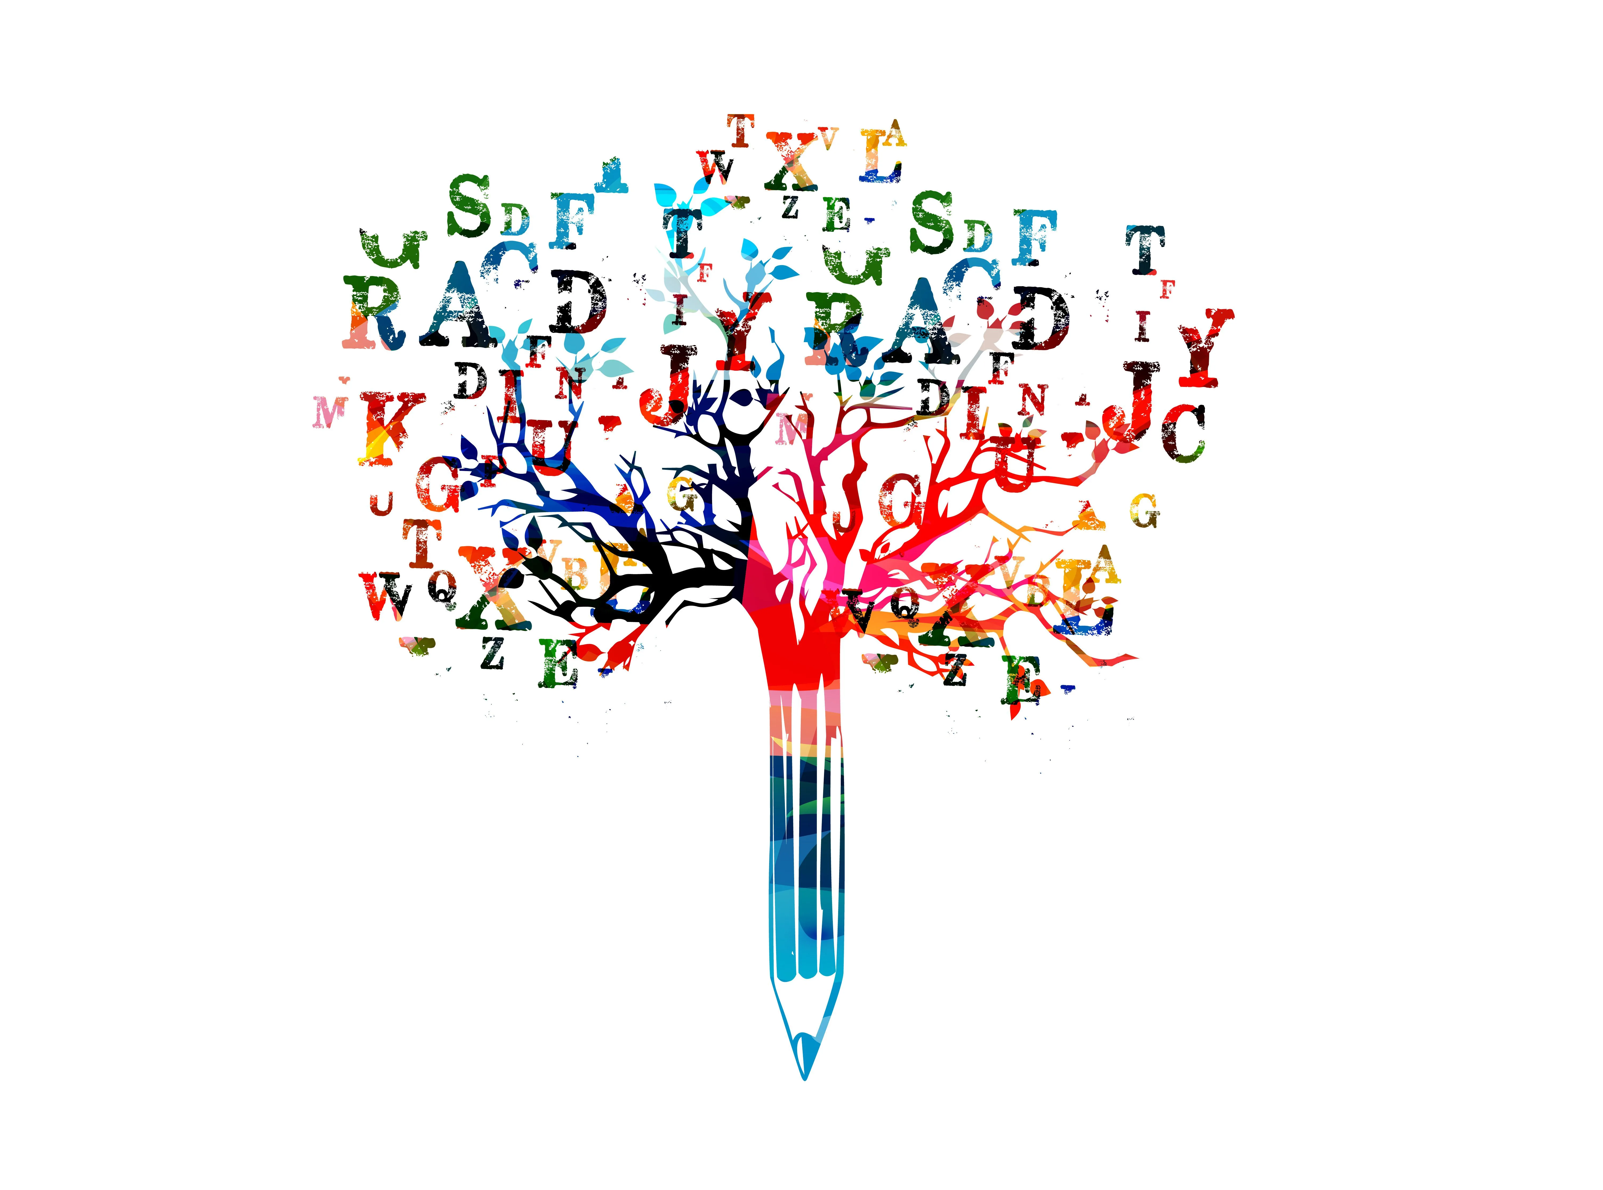
Think and Write
Many college campuses have been in the news because of excessive use of alcohol at parties, binge drinking, and deaths due to alcohol poisoning.
Describe at least 7 different ways to reduce binge drinking on college campuses. Use internet resources like the one below . Reference your sources. Make sure to reference correctly for an internet site using APA style.
This should be at least one page long.
https://www.fortbehavioral.com/addiction-recovery-blog/7-ways-colleges-can-reduce-binge-drinking/#

Slide 83
Hallucinogens: Tripping the Light Fantastic
(1 of 3)
LSD (lysergic acid diethylamide) and PCP (phencyclidine):
LSD is one of the best known hallucinogens.
  Produces mystic type experiences and psychotic-like disturbances
PCP is an anesthetic, and has stimulant and depressant effects.
Both affect neurotransmitter systems that carry messages between brain cells.

Slide 84
Hallucinogens: Tripping the Light Fantastic
(2 of 3)
Cannabis
THC (tetrahydrocannabinol) and CBD (cannabidiol) are two psychoactive chemicals in cannabis.
Sense of euphoria, well-being, relaxation, altered sense of time, and perceptual distortions
In high doses: Paranoia, hallucinations, and delusions
Works by activating neurons with endocannabinoid receptors in the brain
No overdose deaths reported, but still creates harm

Slide 85
Hallucinogens: Tripping the Light Fantastic
(3 of 3)
Cannabis (continued):
Nonusers are reported to be healthier, earn more, and more satisfied with their lives than users
Long-term effects: Interfere with menstrual cycles, ovulation, higher rate of miscarriages, harm to developing fetuses
Medical cannabis: Can impact stress and pain, but like any other drug, can lead to abuse

Slide 86
Think and Write
Many communities, and many states, have legalized the use of cannabis.
What are the advantages of the legalization of cannabis?
Do you think there will be short- or long-term harmful effects of legalization? Why or why not?
What long-term effects do you anticipate based on legalization for recreational use and/or for medical use?

Slide 87
Unit 5
Psychology and Your Skill Set: Metacognition

Slide 88
What Is Metacognition?
The ability to “think about thinking”
Monitoring and evaluating your thought processes, understanding, and performance across different situations
Closely connected to self-regulation
Critical in developing effective plans and evaluating progress
Knowledge, abilities, biases
Monitoring and control

Slide 89
Thinking About Thinking
To improve metacognitive skills:
Develop metacognitive knowledge by becoming more aware of strategies, assumptions, and biases
Develop metacognitive monitoring processes by connecting strategies, biases, and assumptions
Develop metacognitive control strategies by altering thought processes or behavior when you find you are not on track

Slide 90
Self-Assessment
Can you define consciousness and distinguish between disordered and altered states of consciousness?
Describe how mindfulness works, and compare it to meditation.
What are the stages of sleep, and how can you improve your sleep?
Can you compare theories of sleep and describe five sleep disorders?
Can you compare the three major classes of drugs used to alter consciousness and identify common drugs in each category?

Slide 91
Summary (1 of 3)
Now that the lesson has ended, you should have learned how to:
Define consciousness.
Distinguish between disordered states of consciousness and altered states of consciousness.
Describe how hypnosis works, distinguishing between state and nonstate theories of hypnosis.
Describe how meditation works, distinguishing between mindfulness and concentrative meditation.
Describe the typical pattern of sleeping and waking.

Slide 92
Summary (2 of 3)
Now that the lesson has ended, you should have learned how to:
Describe NREM (non-REM) sleep, including its function and four stages.
Describe REM sleep and its function.
Explain why we need to sleep, and the consequences of not sleeping.
Name and briefly describe the three theories of dreaming.
Outline five sleep disorders.
Explain the action of a psychoactive drug, and distinguish between recreational and instrumental drug use.

Slide 93
Summary (3 of 3)
Now that the lesson has ended, you should have learned how to:
Outline three reasons for drug abuse.
Name five common stimulants.
Name five common depressants.
Name two common hallucinogens.
Define metacognition, and describe its three elements.
Create a plan to improve your own metacognitive skills.

Slide 94
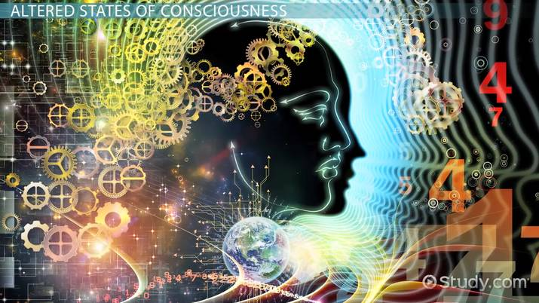
End of Chapter 5

