Slide 1
Adolescence
18th Edition
John W. Santrock
Chapter 2—Puberty, Health, and Biological Foundations
© McGraw Hill LLC. All rights reserved. No reproduction or distribution without the prior written consent of McGraw Hill LLC.

Slide 2
Outline 1
Puberty
Determinants of Puberty.
Growth Spurt.
Sexual Maturation.
Secular Trends in Puberty.
Psychological Dimensions of Puberty.

Slide 3
Outline 2
Health
Adolescence: A Critical Juncture in Health.
Emerging Adults’ Health.
Nutrition.
Exercise and Sports.
Sleep.
Evolution, Heredity, and Environment
The Evolutionary Perspective.
The Genetic Process.
Heredity-Environment Interaction.

Slide 4
Puberty
Puberty: a brain-neuroendocrine process occurring primarily in early adolescence that provides stimulation for the rapid physical changes that take place during this period of development
Puberty is often thought of as the most important marker for the beginning of adolescence; but for virtually everyone, puberty ends long before adolescence is exited.

Slide 5
Puberty
Girls who have high leptin levels -- because they are overweight -- could be more prone to early puberty.
Biological changes in young babies could have a lasting effect, too. Studies have indicated that rapid weight gain during infancy might be related to later obesity and a higher risk of early puberty.

Slide 6
Puberty
About leptin:
Leptin, a hormone produced by fat cells (adipocytes) in the body, has been suggested as one possible mediator of the timing of puberty. In research studies, animals deficient in leptin did not undergo puberty, but puberty began when leptin was administered to the animals. Further, girls with higher concentrations of the hormone leptin are known to have an increased percentage of body fat and an earlier onset of puberty than girls with lower levels of leptin. The concentration of leptin in the blood is known to increase just before puberty in both boys and girls.

Slide 7
Puberty
Leptin’s main function is to help regulate the long-term balance between your body’s food intake and energy use (expenditure). Leptin helps inhibit (prevent) hunger and regulate energy balance so that your body doesn’t trigger a hunger response when it doesn’t need energy (calories).
Leptin mainly acts on your brainstem and hypothalamus to regulate hunger and energy balance, though you have leptin receptors in other areas of your body.

Slide 8
Puberty
Leptin doesn’t affect your hunger levels and food intake from meal to meal but rather acts to alter food intake and control energy expenditure over a longer period of time to help maintain your normal weight.
Leptin has a more profound effect when you lose weight. As your body fat (adipose tissue) decreases, your leptin levels decrease, which signals your body to think that it’s starving. This stimulates intense hunger and appetite and can lead to increased food consumption.

Slide 9
Puberty
Globally, the prevalence of obesity increased in every country between 1975 to 2016 according to a study including BMI trends from 128.9 million children, adolescents and adults around the world.
In the US, 18.5% of children and adolescents were considered obese, a condition associated with increased risk of metabolic complications including disturbances in pubertal development.

Slide 10
Puberty
Puberty is the culmination of a complex interplay between genetics, metabolic, nutritional, and hormonal factors.
Thus, childhood obesity may play a role in pubertal onset and tempo.
In fact, early pubertal development and central precocious puberty have been associated with childhood obesity.

Slide 11
Puberty
Population based studies from around the world have correlated high body mass index (BMI) with earlier pubertal maturation in girls.
The relationship between obesity and early pubertal onset in boys remains controversial.
Furthermore, new mechanistic studies and data suggests that other environmental factors such as socioeconomic status, in utero exposures or endocrine disrupting chemicals maybe additional drivers of early pubertal onset.

Slide 12
Determinants of Puberty
We do not know precisely what initiates puberty.
A number of complex factors are involved, including changes in the endocrine system, weight, and body fat.
We do not know if these are a cause or a consequence of puberty.
There is increased interest in the role that birth weight, rapid weight gain in infancy, obesity, and sociocultural factors might play in pubertal onset and characteristics.

Slide 13
Heredity
Puberty is not an environmental accident.
Programmed into the genes of every human being is the timing for the emergence of puberty.
Puberty takes place between 9 and 16 years of age for most individuals.
Recently, scientists have begun to conduct molecular genetic studies in an attempt to identify specific genes that are linked to the onset and progression of puberty.
Environmental factors can also influence its onset and duration.

Slide 14
Hormones 1
Hormones: powerful chemical substances secreted by the endocrine glands and carried throughout the body by the bloodstream
Androgens: the main class of male sex hormones
Testosterone is an androgen that plays an important role in male pubertal development.
Estrogens: the main class of female sex hormones
Estradiol is an estrogen that plays an important role in female pubertal development.

Slide 15
Hormones 2
Rising levels of the androgen testosterone are associated with a number of physical changes in boys:
Development of external genitals.
Increase in height.
Voice changes.
Also linked to sexual desire and activity.

Slide 16
Hormones 3
With rising levels of the estradiol, physical changes in girls occur:
Breast development.
Uterine development.
Skeletal changes.
The contributions of hormones to sexual desire and activity in adolescent girls is less clear than it is for boys.

Slide 17
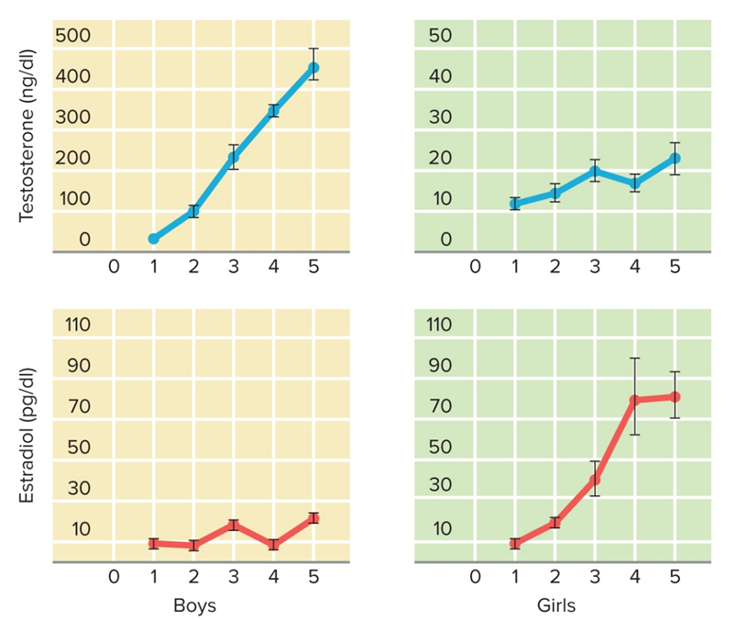
FIGURE 1 HORMONE LEVELS BY SEX AND PUBERTAL STAGE FOR TESTOSTERONE AND ESTRADIOL
Pubertal stage
The five stages range from the early beginning of puberty (Stage 1) to the most advanced stage of puberty (Stage 5). Notice the significant increase in testosterone in boys and the significant increase in estradiol in girls.
Access the text alternative for slide images.

Slide 18
The Endocrine System 1
Puberty onset involves the activation of the hypothalamic-pituitary-gonadal (HPG) axis.
Hypothalamus: a structure in the higher portion of the brain that monitors eating, drinking, and sex.
Gonadotropin-releasing hormone (GnRH), secreted by the hypothalamus, is linked to pubertal timing.
Pituitary gland: the endocrine gland that regulates other glands and secretes follicle-stimulating hormone (FSH) and luteinizing hormone (LH).
LH regulates estrogen secretion and ovum development in females and testosterone production in males.
Gonads: the sex glands.
Testes in males; ovaries in females.

Slide 19
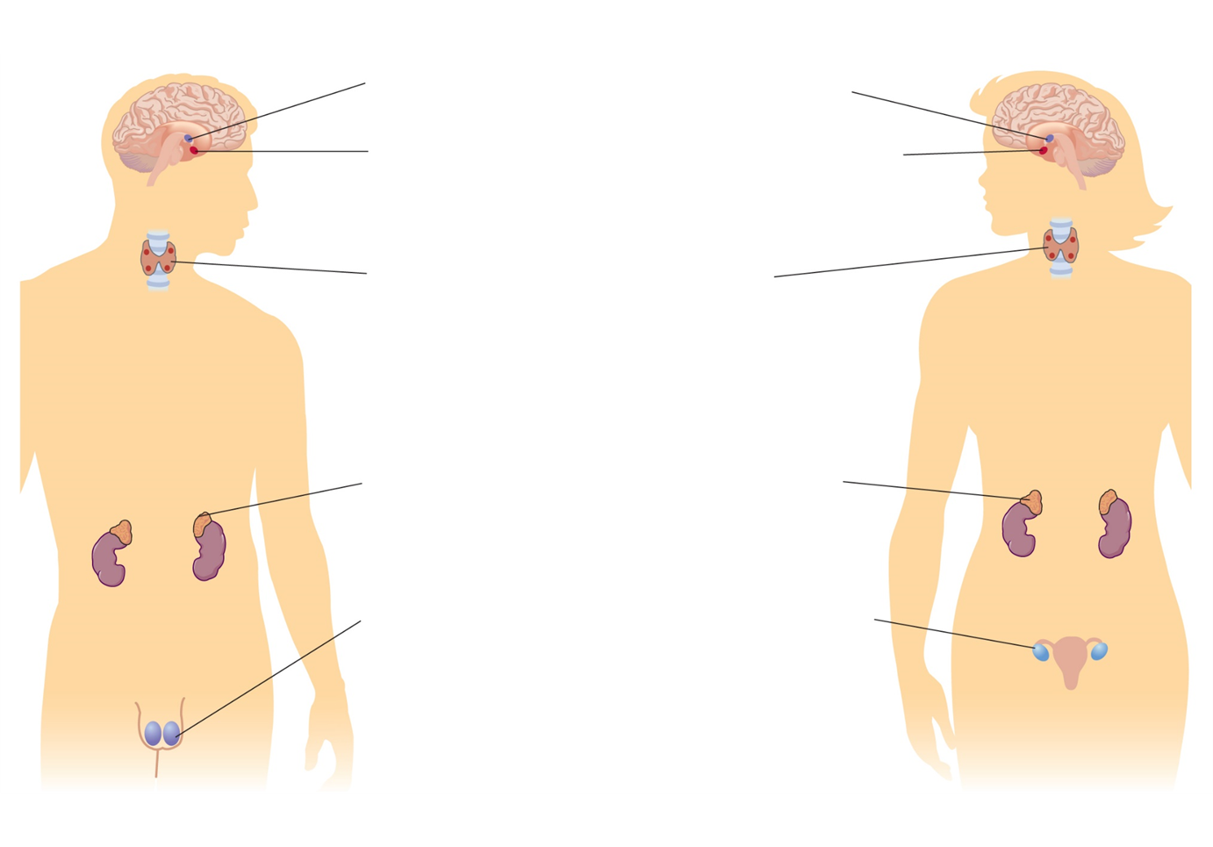
FIGURE 2 THE MAJOR ENDOCRINE GLANDS INVOLVED IN PUBERTAL CHANGE
Hypothalamus: A structure in the brain that interacts with the pituitary gland to monitor the bodily regulation of hormones.
Pituitary: This master gland produces hormones that stimulate other glands. It also influences growth by producing growth hormones; it sends gonadotropins to the testes and ovaries and a thyroid-stimulating hormone to the thyroid gland. It sends a hormone to the adrenal gland as well.
Thyroid gland: It interacts with the pituitary gland to influence growth.
Adrenal gland: It interacts with the pituitary gland and likely plays a role in pubertal development, but less is known about its function than about sex glands. Recent research, however, suggests it may be involved in adolescent behavior, particularly for boys.
The gonads, or sex glands: These consist of the testes in males and the ovaries in females. The sex glands are strongly involved in the appearance of secondary sex characteristics, such as facial hair in males and breast development in females. The general class of hormones called estrogens is dominant in females, while androgens are dominant in males. More specifically, testosterone in males and estradiol in females are key hormones in pubertal development.
Access the text alternative for slide images.

Slide 20
The Endocrine System 2
Hormones are regulated by a negative feedback system.
When sex hormone levels rise too high, the hypothalamus and pituitary gland reduce their stimulation of the gonads, decreasing the production of sex hormones.
In males, when the level of testosterone falls as a result, the hypothalamus produces more GnRH and the cycle starts again.
The negative feedback system operates in a similar way in females, except that LH and GnRH regulate the ovaries and the production of estrogen.

Slide 21
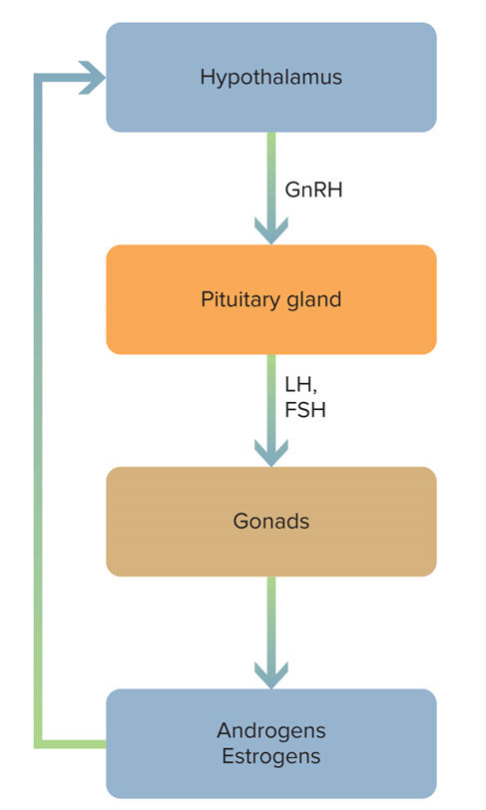
FIGURE 3 THE FEEDBACK SYSTEM OF SEX HORMONES

Slide 22
Growth Hormones
The pituitary gland also secretes growth hormones, which lead to growth and skeletal maturation either directly or through interaction with the thyroid gland, located in the neck region.
At the beginning of puberty, growth hormone is secreted at night.
Later in puberty, it also is secreted during the day, although daytime levels are usually very low.

Slide 23
Adrenarche and Gonadarche 1
Two phases of puberty are linked with hormonal changes: adrenarche and gonadarche.
Adrenarche: puberty phase involving hormonal changes in the adrenal glands
From about 6 to 9 years of age in girls and about 1 year later in boys, before what is generally considered the beginning of puberty.
During adrenarche and continuing through puberty, the adrenal glands secrete adrenal androgens, such as dehydroepiandrosterone (DHEA).

Slide 24
Adrenarche and Gonadarche 2
Gonadarche: puberty phase involving the maturation of primary and secondary sexual characteristics
Follows adrenarche by about 2 years, and is the period most people think of as puberty.
Primary sexual characteristics: ovaries in females, testes in males.
Secondary sexual characteristics: pubic hair, and breast and genital development.
In the United States, begins at approximately 9–10 years of age in non-Latinx white girls and 8–9 years in African American girls.
In boys, begins at about 10–11 years of age.

Slide 25
Adrenarche and Gonadarche 3
Menarche: A girl’s first menstrual period
Occurs in mid- to late gonadarche in girls.
Spermarche: A boy’s first ejaculation of semen
Occurs in early to mid-gonadarche in boys.

Slide 26
Weight and Body Fat
Higher weight, especially obesity, is linked to earlier pubertal development.
A recent study revealed that obesity was associated with earlier pubertal onset in boys.
Some have hypothesized that the onset of menarche is influenced by the percentage of body fat in relation to total body weight.
Both anorexic adolescents whose weight drops dramatically and females who participate in certain sports (such as gymnastics and swimming) may not menstruate.
In boys, undernutrition may delay puberty.

Slide 27
Leptin and Kisspeptins
Reproduction is an energy-demanding function.
Puberty is said to be “metabolically gated” as a way to prevent fertility when energy conditions are very low.
The hormone leptin, which is secreted by fat cells and in abundance stimulates the brain to increase metabolism and reduce hunger, has been proposed to play an important role in regulating puberty, especially in females.
Kisspeptins, which are products of the Kiss 1 gene, have been reported to regulate GnRH neurons and thus play a role in pubertal onset and change.

Slide 28
Weight at Birth and in Infancy
There is increasing evidence for a link between puberty’s onset and characteristics and birth weight and weight gain during infancy.
Low-birth-weight girls experience menarche approximately
5–10 months earlier than normal-birth-weight girls.
Low-birth-weight boys are at risk for small testicular volume during adolescence.

Slide 29
Sociocultural and Environmental Factors 1
Recent research indicates cultural variations and early experiences may be related to earlier pubertal onset.
Adolescents in developed countries and large urban areas reach puberty earlier than their counterparts in less developed countries and rural areas.
Children who have been adopted from developing countries to developed countries often enter puberty earlier than their counterparts who continue to live in developing countries.
In the United States, African American females enter puberty earlier than Latinx and non-Latinx white females, and African American males enter puberty earlier than non-Latinx white males.

Slide 30
Sociocultural and Environmental Factors 2
Early experiences linked to earlier pubertal onset include the following:
Adoption.
Father absence.
Low socioeconomic status.
Family conflict.
Maternal harshness.
Child maltreatment.
early substance use.
The earlier onset of puberty is likely explained by high rates of conflict and stress in these social contexts.

Slide 31
Growth Spurt 1
Growth slows throughout childhood, and then puberty brings forth the most rapid increases in growth since infancy.
This growth spurt occurs approximately 2 years earlier for girls (age 9) than boys (age 11) on average.
The peak of pubertal change occurs at 11½ years for girls and 13½ years for boys.
Girls increase in height by about 3½ inches per year; boys, by about 4 inches.

Slide 32
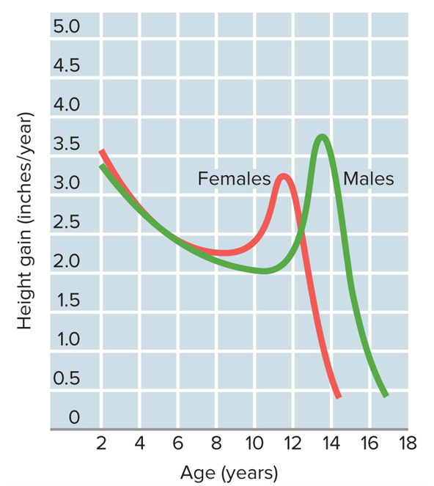
FIGURE 4 PUBERTAL GROWTH SPURT
On average, the peak of the growth spurt that characterizes pubertal changes occurs 2 years earlier for girls (11½) than for boys (13½).
Access the text alternative for slide images.

Slide 33
Growth Spurt 2
For girls, the growth spurt typically begins before menarche and ends earlier.
For boys, it begins later and ends later.
At the beginning of adolescence, girls tend to be as tall as or taller than boys of their age, but by the end of the middle school years most boys have caught up with them and in many cases have even surpassed them in height.

Slide 34
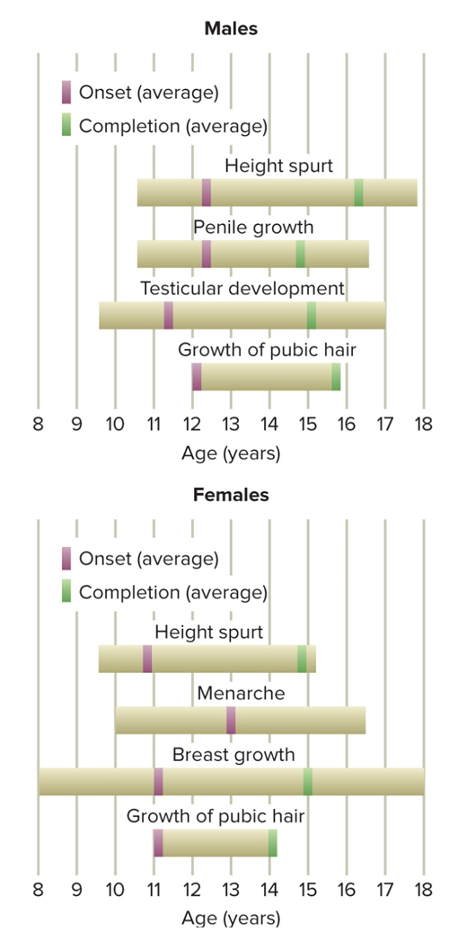
FIGURE 5 NORMAL RANGE AND AVERAGE DEVELOPMENT OF SEXUAL CHARACTERISTICS IN MALES AND FEMALES
Access the text alternative for slide images.

Slide 35
Sexual Maturation 3
There can be wide individual variation in the onset and progression of puberty.
Precocious puberty: very early onset and rapid progression of puberty.
Pubertal onset that occurs before the age of 8 in girls and before the age of 9 in boys.
Occurs approximately 10 times more often in girls than in boys.
Treated by medically suppressing gonadotropic secretions, which temporarily stops pubertal change.
The reason for treatment is that children who experience precocious puberty are ultimately likely to have short stature, early sexual capability, and the potential for engaging in age-inappropriate behavior.

Slide 36
Sexual Maturation 3
All organ systems and the body as a whole undergo major growth during adolescence; breasts in girls and genitals and body hair in both sexes undergo the most obvious changes.
Even when this process goes normally, substantial emotional adjustments are required. If the timing is atypical, particularly in a boy whose physical development is delayed or in a girl whose development occurs early, additional emotional stress is possible.
Most children who grow slowly have a constitutional delay and catch up eventually. Evaluation to exclude pathologic causes and reassurance are needed.

Slide 37
Sexual Maturation 3
Sexual maturation generally proceeds in an established sequence in both sexes. The age at onset and rapidity of sexual development vary and are influenced by genetic and environmental factors.
Sexual maturity begins earlier today than a century ago, probably because of improvements in nutrition, general health, and living conditions—eg, the average age of menarche has decreased by about 3 years over the past 100 years.

Slide 38
Secular Trends in Puberty
Secular trends: patterns of the onset of puberty over historical time, especially across generations
In the United States, where children mature physically up to a year earlier than in European countries, menarche now occurs at about 12½ years of age—compared with over 14 years of age a century ago.
An increasing number of U.S. girls are beginning puberty at 8 and 9 years of age, with African American girls developing earlier than non-Latinx white girls.
Puberty is also occurring earlier in a number of other countries in recent years.

Slide 39
Psychological Dimensions of Puberty: Body Image 1
Preoccupation with body image is one psychological aspect of puberty that is certain for both boys and girls.
Gender differences:
In general, throughout puberty girls are less happy with their bodies and have more negative body images than boys.
As pubertal change proceeds, girls often become more dissatisfied with their bodies, probably because their body fat increases.
In contrast, boys become more satisfied as they move through puberty, probably because their muscle mass increases.

Slide 40
Psychological Dimensions of Puberty: Body Image 2
Various aspects of exposure to the internet and social media are increasing the body dissatisfaction of adolescents and emerging adults, especially females.
A recent study found that higher social media use was linked to more negative body images among adolescents, especially girls.
Studies of U.S. college women found:
More time on Facebook was related to more frequent body and weight concern comparisons with other women.
Exposure to attractive female celebrity and peer images on Instagram was detrimental to their body image.

Slide 41
Psychological Dimensions of Puberty: Body Image 2
Washington — Teens and young adults who reduced their social media use by 50% for just a few weeks saw significant improvement in how they felt about both their weight and their overall appearance compared with peers who maintained consistent levels of social media use, according to research published by the American Psychological Association.

Slide 42
Psychological Dimensions of Puberty: Body Image 2
“Adolescence is a vulnerable period for the development of body image issues, eating disorders and mental illness,” said lead author Gary Goldfield, PhD, of Children’s Hospital of Eastern Ontario Research Institute. “Youth are spending, on average, between six to eight hours per day on screens, much of it on social media. Social media can expose users to hundreds or even thousands of images and photos every day, including those of celebrities and fashion or fitness models, which we know leads to an internalization of beauty ideals that are unattainable for almost everyone, resulting in greater dissatisfaction with body weight and shape.”

Slide 43
Psychological Dimensions of Puberty: Body Image 2
Body image and social media use
https://www.youtube.com/watch?v=38495_N_gd0
Gold’s gym ad
https://www.businessinsider.com/golds-gym-fat-shaming-ad-causes-controversy-2016-8

Slide 44
Psychological Dimensions of Puberty: Body Image 3
An increasing number of adolescents and college students are obtaining tattoos and getting parts of their body pierced or engaging in scarification.
Some studies indicate that tattoos and body piercings are markers for risk-taking in adolescence.
Researchers do not agree whether body art is used to express individuality and self-expression or rebellion.
What do you think?

Slide 45
Psychological Dimensions of Puberty: Body Image 3
In the United States there is no federal law regulating the practice of tattooing.[1] However, all 50 states and the District of Columbia have statutory laws requiring a person receiving a tattoo be at least 18 years old.
This is partially based on the legal principle that a minor cannot enter into a legal contract or otherwise render informed consent for a procedure.
Most states permit a person under the age of 18 to receive a tattoo with permission of a parent or guardian, but some states prohibit tattooing under a certain age regardless of permission, with the exception of medical necessity (such as markings placed for radiation therapy).

Slide 46
Psychological Dimensions of Puberty: Body Image 3
Illinois
- Parent or legal guardian must be present with minors when in a tattoo/piercing shop AT ALL TIMES.
- NO TATTOOS FOR MINORS.
Do you agree with this law? Why or why not? How does brain development and maturation come into play?

Slide 47
Psychological Dimensions of Puberty: Body Image 3
Environmental factors
A nurturing, non-judgmental environment can promote body acceptance and positivity. The opposite is also true. Negative environmental influences may distort a teen’s perception of their body. Risk factors can include:
A cultural background or family environment that emphasizes appearance;
Criticism of appearance or weight;
Exposure to negative attitudes about food and weight;
Trauma, abuse and other experiences that impact self-esteem.

Slide 48
Psychological Dimensions of Puberty: Body Image 3
A prime example of an environment potentially detrimental to your teen’s body image is competitive sports. Many sports like running and ballet place a great deal of emphasis on the athlete’s body and physical appearance, which can lead to teens being hard on themselves for the way they look. Negative environmental factors may also lead to disordered eating habits or the development of an eating disorder.
What other examples can you think of where a teen might feel this way?
Have you ever experienced body-shaming or known someone who was?

Slide 49
Psychological Dimensions of Puberty: Body Image 3
Cultural factors and the effects of the media
Unrealistic portrayals in the media can distort a teen’s view of a healthy body.
They may compare themselves to incredibly thin or muscular celebrities and models and become dissatisfied with their own bodies.
Most of these images have been digitally altered to produce a look that is not natural or attainable. This puts teens at risk as they may try to achieve these impossible appearances.

Slide 50
Psychological Dimensions of Puberty: Body Image 3
Social factors and peer influence
Teens often compare themselves to their peers. They may also discuss body dissatisfaction with friends, which reinforces negative attitudes.
Even if your home environment promotes body positivity, your teenager may be feeling negative peer influences at school or extracurricular activities. If you are noticing a pattern in your child’s group of friends, consider talking to other parents about how you can help reinforce body positivity at this stage in your teens’ lives.

Slide 51
Psychological Dimensions of Puberty: Body Image 3
The effects of a negative body image
Poor body image has a variety of psychological effects. Teens with a negative view of their bodies often experience:
Low self-esteem;
Low self-confidence;
Preoccupation with appearance and weight;
Negative thought patterns;
Unhealthy eating or exercise habits;
Depression, anxiety and other mental health disorders;
Eating disorders or disordered eating habits;
Substance abuse.

Slide 52
Psychological Dimensions of Puberty: Hormones and Behavior 1
Hormonal factors are thought to account for at least part of the increase in negative and variable emotions that characterize adolescents.
In boys, higher levels of androgens are associated with violence and acting-out problems.
There is also some indication that increased estrogen levels are linked to depression in adolescent girls.

Slide 53
Psychological Dimensions of Puberty: Hormones and Behavior 2
Hormonal factors alone are not responsible for adolescent depression or risk-taking behavior.
Many environmental factors influence hormonal activity:
Parent–adolescent relationships.
Stress.
Eating patterns.
Sexual activity.
Depression.

Slide 54
Psychological Dimensions of Puberty: Early and Late Maturation
When adolescents mature earlier or later than their peers, they often perceive themselves differently.
Early maturation in girls increases girls’ vulnerability to a number of problems, including substance use, depression, eating disorders, antisocial behavior, and earlier sexual experiences.
Early maturation often has more favorable outcomes in adolescence for boys, especially in early adolescence.
Later in life, however, boys’ late maturation may be more favorable, especially in terms of identity and career development.

Slide 55
Adolescence: A Critical Juncture in Health 1
Adolescence is a critical juncture in the adoption of behaviors that are relevant to health.
A recent concern is the impact of the COVID-19 pandemic on adolescent health.
Parents were less likely to take children to physicians and emergency departments after the pandemic began.
The pandemic was associated with increased mental health issues in youth.

Slide 56
Adolescence: A Critical Juncture in Health 2
Why might adolescents develop poor health habits?
In adolescence, many individuals reach a level of health, strength, and energy that they will never match during the remainder of their lives.
Experts recognize that health depends on adolescent behavior and propose two goals:
Reduce health-compromising behaviors: drug abuse, violence, unprotected sexual intercourse, and dangerous driving.
Increase health-enhancing behaviors: exercising, eating nutritiously, wearing seat belts, and getting adequate sleep.

Slide 57
Adolescence: A Critical Juncture in Health 3
Increasing adolescents’ awareness of health risks doesn’t always work.
Effective intervention should focus on treating adolescents with respect and according them higher status.
Disparities in health related to poverty and ethnicity:
homelessness, crime and violence, housing insecurity, hunger, malnutrition, lack of health insurance, compromised health and well-being of parents, racism, and discrimination.
Latinx adolescents were 8 times more likely and African American adolescents 5 times more likely to be hospitalized with COVID-19 than non-Latinx white counterparts.

Slide 58
Risk-Factors
The more risk factors adolescents are exposed to, the greater the potential impact on their mental health.
Factors that can contribute to stress during adolescence include exposure to adversity, pressure to conform with peers and exploration of identity.

Slide 59
Risk-Factors
Media influence and gender norms can exacerbate the disparity between an adolescent’s lived reality and their perceptions or aspirations for the future.
Other important determinants include the quality of their home life and relationships with peers. Violence (especially sexual violence and bullying), harsh parenting and severe and socioeconomic problems are recognized risks to mental health.

Slide 60
Risk-Factors
Some adolescents are at greater risk of mental health conditions due to their living conditions, stigma, discrimination or exclusion, or lack of access to quality support and services.
These include adolescents living in humanitarian and fragile settings; adolescents with chronic illness, autism spectrum disorder, an intellectual disability or other neurological condition; pregnant adolescents, adolescent parents, or those in early or forced marriages; orphans; and adolescents from minority ethnic or sexual backgrounds or other discriminated groups.

Slide 61
Risk-Taking Behavior 1
One type of health-compromising behavior that increases in adolescence is risk-taking.
Researchers have found that the more resources there are in the community, such as youth activities and adults as role models, the less likely adolescents are to engage in such behavior.
Parental monitoring and communication skills are linked to a lower level of adolescent risk-taking.

Slide 62
Risk-Taking Behavior 2
Recently, neurobiological explanations of adolescent risk-taking have been proposed.
Later development of the prefrontal cortex combined with the earlier maturity of the amygdala may explain the difficulty younger adolescents have in putting the brakes on their risk-taking adventures.
It is important for parents, teachers, mentors, and other responsible adults to effectively monitor adolescents’ behavior.

Slide 63
Risk-Taking Behavior 2
Adolescents and young adults take more risks than any other age group (Steinberg, 2008).
This risk-taking includes dangerous driving (e.g. texting), drug use, binge drinking, and risky sexual behavior.
Despite educational efforts to provide teens with information about risky behavior, many adolescents continue to engage in risky behavior (Kann, et al., 2014).

Slide 64
Risk-Taking Behavior 2
How do we explain the persistence of teens’ risky behavior, despite the large amount of money being spent on prevention programs? What can we do to reduce the danger?
People often believe that teens engage in risky behavior because they are not very good at evaluating risk.
But early research in this area demonstrated that adolescents are just as good as adults at evaluating risk across a broad range of risky behavior.
Teens know that the behaviors are risky, but they still engage in them. Why?
What do you think the reason is?

Slide 65
Risk-Taking Behavior 2
Research on peer relationships and brain development during the adolescence period may provide an answer.
In recent years, there has been an increase in the availability of magnetic resonance imaging (MRI) and functional magnetic resonance imaging (fMRI).
Using these tools, researchers have found several changes in the brain during puberty that are important in explaining risky behavior.

Slide 66
Risk-Taking Behavior 2
First, during the adolescence period, there is an increased interest in peer relationships, and susceptibility to peer influence increases during the early teen years and peaks at about age 14.
Consistent with these readily observable changes in peer relationships, brain imaging studies have shown that several areas of the brain make adolescents more sensitive to the rewards of peer relationships than adults.
This motivates teens to focus on their peers in decision-making situations that involve risky behavior.

Slide 67
Risk-Taking Behavior 2
Second, adolescents are more distressed than adults when excluded by peers.
A brain region known as the right ventrolateral prefrontal cortex (PFC) might be important in helping people cope with negative evaluations from peers by reducing distress.
Research shows that this brain region is used more heavily by adults when being socially excluded than by adolescents.
When teens do use this area of the brain during peer exclusion, they report lower levels of distress.

Slide 68
Risk-Taking Behavior 2
During the adolescent years, however, this brain region is still developing, so adolescents may not be as effective at controlling distress during peer social exclusion.
This likely contributes to engaging in risky behaviors to prevent being excluded by their peers.

Slide 69
Risk-Taking Behavior 2
Third, another area of the brain, the lateral prefrontal cortex (PFC), is responsible for mature self-regulation and develops gradually over the adolescence period.

Slide 70
Risk-Taking Behavior 2
In one study, early adolescents, late adolescents, and adults behaved similarly on a computerized driving task when they were by themselves.
However, when they were paired with two same-aged friends, clear differences emerged.
Early adolescents were more likely to engage in risky driving when friends were present.
Late adolescents were somewhat more risky in their driving when they were with friends. The presence of friends had no impact on adults’ driving.

Slide 71
Risk-Taking Behavior 2
Using the computerized driving task in conjunction with an fMRI, researchers found that, in contrast to adults, adolescents were more likely to engage in risky driving when they knew that their friends were observing them than when they were alone.
The area of the brain that was used by the adults, the PFC, helps with decision-making and self-regulation in tasks such as driving.
In contrast, adolescents used areas of the brain that are more closely associated with rewards when completing the driving task.

Slide 72
Risk-Taking Behavior 2
So, what does this mean?
We have changes in the brain during early adolescence that make teens more focused on the rewards of peers and being included in peer activities.
This increased focus on peers occurs during a time when the PFC is not yet ready to assist in mature self-regulation. These factors provide a “perfect storm” of opportunities for risky behavior.

Slide 73
Health Services
Adolescents underutilize health care systems.
Many adolescents don’t believe providers can help them.
Professionals who want to provide better health care for adolescents may lack adequate training and/or time during a health care visit.
Of special concern is the low use of health services by high school adolescent males.
Among the chief barriers to better health care for adolescents are cost, poor organization and availability of health services, lack of confidentiality, and reluctance on the part of health care providers to communicate with adolescents about sensitive health issues.

Slide 74
Leading Causes of Death
The three leading causes of death in adolescence are unintentional injuries, suicide, and homicide.
Almost half of all deaths from 15 to 24 years of age are due to unintentional injuries, the majority involving motor vehicle accidents.
In about 50% of motor vehicle fatalities involving adolescents, the driver has a blood alcohol level of 0.10% or higher.
Suicide recently replaced homicide as the second-leading cause of death for adolescents.

Slide 75
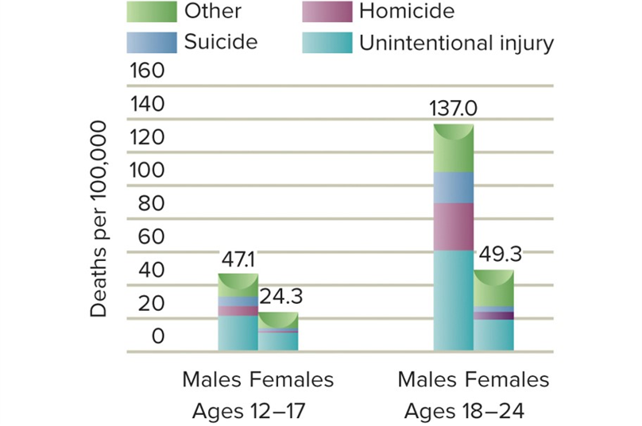
FIGURE 8 MORTALITY RATES OF U.S. ADOLESCENTS AND EMERGING ADULTS
Access the text alternative for slide images.

Slide 76
Emerging Adults’ Health 1
Emerging adults have more than twice the mortality rate of adolescents.
Compared to adolescents, emerging adults engage in more health-compromising behaviors, have more chronic health problems, are more likely to be obese, and are more likely to have a mental health disorder.
Few emerging adults stop to think about how their personal lifestyles will affect their health later in their adult lives.
So stop and think before you engage in risky behaviors.

Slide 77
Emerging Adults’ Health 2
The negative effects of abusing one’s body might not show up in emerging adulthood, instead surfacing later.
Warning signs often ignored by emerging adults:
Breast lumps.
Unexplained weight loss.
Fever for more than a week.
Coughing up blood.
Persistent or severe headaches.
Fainting spells.
Unexplained shortness of breath.

Slide 78
Nutrition 1
Nutrition is an important aspect of health-compromising and health-enhancing behaviors.
The eating habits of many adolescents are health-compromising.
An increasing number of adolescents have an eating disorder.
Eating regular family meals during early adolescence is linked to healthy eating habits 5 years later.
Parents play an important role in adolescents’ nutrition, through the food choices they make available, by serving as role models for healthy or unhealthy nutrition, and by including adolescents in regular family meals.

Slide 79

Nutrition 1
How many of you sit down to dinner with your family…or at least did this while you were growing up? Or did you only have family dinner at holiday time?
Why is this considered
important?
What are the benefits?

Slide 80
Nutrition 2
Schools can also play an important role in adolescents’ eating patterns.
One special concern in American culture is the amount of fat in the diet.
Another special concern is the recent increase in consumption of energy drinks that tend to have high caffeine levels.
Research has found this to be linked to more emergency room visits, adverse cardiovascular effects, alcohol use, reduced sleep duration, and fast food consumption.

Slide 81
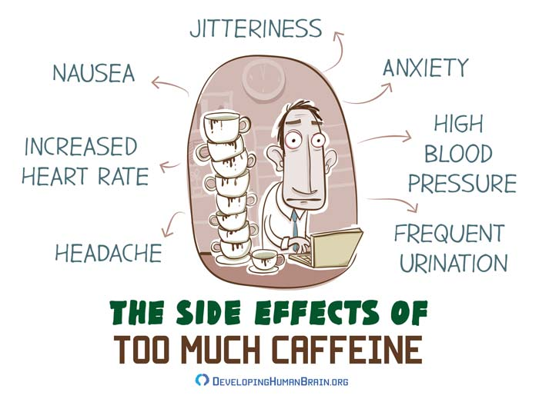
Nutrition 2

Slide 82
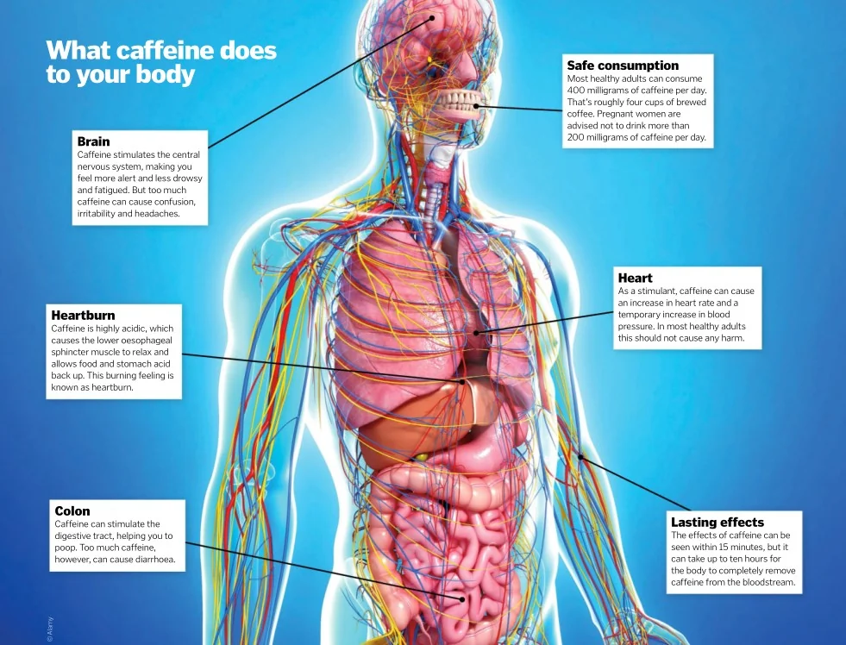
Nutrition 2

Slide 83
Exercise and Sports
Exercise is one of the principal activities that improves the quality of life, both in adolescence and adulthood.
Researchers have found that individuals become less active as they reach and progress through adolescence.
Other research findings include the following:
In 2019, 23% of 9th- through 12th-graders had engaged in physical activity for 60 min or more in each of the last 7 days, compared to 28.7% in 2011.
Adolescent girls were much less likely to engage in physical activity than were boys.

Slide 84
Exercise 1
Ethnic differences in the exercise participation rates of U.S. adolescents also occur; and rates also vary by gender.
A comparison of adolescents in 28 countries found that U.S. adolescents exercised less and ate more junk food.
U.S. adolescents are more likely to eat fried food and less likely to eat fruits and vegetables than adolescents in most other countries studied.

Slide 85
Exercise 2
Exercise is linked to a number of positive outcomes in adolescence.
Benefits of regular exercise for adolescents include:
A positive effect on weight status.
Reduced triglyceride levels, lower blood pressure, and a lower incidence of type 2 diabetes.
Lower levels of alcohol, cigarette, and marijuana use.
Fewer emotional and peer problems.

Slide 86
Exercise 3
Additional positive effects of exercise:
Better connectivity between brain regions than in adolescents who are less fit.
Reduced stress and depression.
Improvement in cognitive skills.
Reduction in the symptoms of attention deficit hyperactivity disorder (ADHD).

Slide 87
Roles of Families, Schools, and Screen-Based Activity in Adolescent Exercise 1
Parents have an important influence on adolescents’ exercise patterns.
One study revealed that 9- to 13-year-olds were more likely to engage in physical activity during their free time if they felt safe, had a number of places to be active, and had parents who participated in physical activities with them.
Peers also often influence adolescents’ physical activity.
Peer/friend support of exercise, presence of peers and friends, friendship quality and acceptance, and peer crowds.

Slide 88
Roles of Families, Schools, and Screen-Based Activity in Adolescent Exercise 2
Some of the blame for the poor physical condition of U.S. children and adolescents falls on U.S. schools.
Many fail to provide physical education on a regular basis.
In a recent national survey, only 51% of U.S. 9th- through 12th-graders participated in one or more physical education classes per week.
Other research concluded that school-based interventions for promoting physical activity can be effective if they focus on the content, quality, duration, and priority of the physical activity.

Slide 89
Roles of Families, Schools, and Screen-Based Activity in Adolescent Exercise 3
Screen-based activity is associated with lower levels of physical fitness in adolescence.
Watching television, using computers, talking on the phone, texting, and instant messaging for long hours.
Adolescents who engage in low physical activity and high screen-based activity are more likely to be overweight/obese.

Slide 90
Sports 1
Sports play an important role in the lives of many adolescents.
In a 2015 assessment:
Boys (62%) were more likely to play on a sports team than girls (53%).
African American boys had the highest participation rate (66.5%) and Latinx girls the lowest participation rate (40.7%).
From 2013 to 2015, the overall girls’ participation rate increased by 4.5%, although the rate for Latinx girls decreased by 4.3%.

Slide 91
Sports 2
Sports can have both positive and negative influences on adolescent development.
Potential positive outcomes:
Many sports activities can improve adolescents’ physical health and well-being, mental health, self-confidence, motivation to excel, and ability to work with others.
Adolescents who participate in sports are less likely to engage in risk-taking behaviors such as using drugs, less likely to be overweight or obese, show a lower cardiovascular risk profile, and have higher self-esteem.

Slide 92
Sports 3
Potential negative outcomes:
Pressure to achieve and win, physical injuries, distraction from academics, and unrealistic expectations for success.
Pressure by parents and coaches to win at all costs, competition anxiety, and self-centeredness.
Injuries are common when adolescents play sports.
Use of performance-enhancing drugs such as steroids.
Coaches who create a performance-oriented motivational climate that is focused on winning, public recognition, and performance relative to others.
Female athlete triad: disordered eating, amenorrhea, and osteoporosis.

Slide 93
Sleep 1
There has been a surge of interest in adolescent sleep.
In a national survey of youth, only 25% of U.S. adolescents got 8 or more hr of sleep on an average school night, 7% less than four years earlier.
Getting too little sleep is linked to academic deficiencies, less efficient information processing, a greater incidence of emotional, mood, and substance abuse problems, and poorer relationships with peers.

Slide 94
Sleep 2
Recent studies document the link between getting too little sleep and having problems during adolescence:
In one study, students who sacrificed sleep time to study had difficulty understanding what was taught in class and were more likely to struggle with class assignments.
In 13- to 19-year-olds, getting less than 7 hr of sleep on school nights was associated with an increased risk of being overweight, having depressive symptoms, being less motivated, difficulty concentrating, high levels of anxiety, and engaging in self-harm/suicidal thoughts.
A recent study indicated that insufficient sleep was associated with alcohol and marijuana use in adolescents.

Slide 95
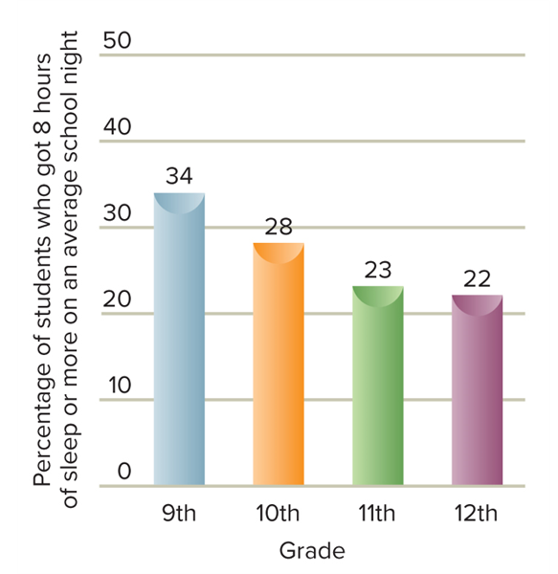
FIGURE 9 DEVELOPMENTAL CHANGES IN U.S. ADOLESCENTS’ SLEEP PATTERNS ON AN AVERAGE SCHOOL NIGHT
Access the text alternative for slide images.

Slide 96
Sleep 3
Why are adolescents getting too little sleep?
Electronic media usage, caffeine, and changes in the brain, coupled with early school start times.
Using electronic devices other than television 5 or more hr a day has been linked to getting inadequate sleep.
Caffeine consumption and daytime sleepiness are also related to lower academic achievement.

Slide 97
Sleep 4
Many adolescents stay up later at night and sleep longer in the morning than when they were children.
Early school starting times may cause grogginess, inattention, and poor performance on tests.
The American Academy of Pediatrics recently advocated that schools shift start times from 8:30 to 9:30 a.m. to improve students’ academic performance and quality of life.

Slide 98
Sleep 5
Sleep patterns are often poor in emerging adulthood.
At about 20–22 years of age, a reverse in the timing of bedtimes and rise times occurs.
Emotional and academic stress negatively affects sleep, as does smartphone dependence and energy drink consumption.
Less sleep is associated with increased suicide risk, lower grade point average, and delayed college graduation.
The National Sleep Foundation recommends emerging adults get 7–9 hr of sleep.
Engaging in more physical activity and maintaining positive social relationships can improve sleep patterns.

Slide 99
Evolution, Heredity, and Environment: The Evolutionary Perspective
In terms of evolutionary time, humans are relative newcomers to the Earth.
As our earliest ancestors left the forest to feed on the savannahs and finally to form hunting societies on the open plains, their minds and behaviors changed.

Slide 100
Natural Selection and Adaptive Behavior
Natural selection: the evolutionary process that favors those individuals of a species who are best adapted to survive and reproduce
Charles Darwin: Over the course of many generations, organisms with the characteristics needed for survival would compose a larger and larger percentage of the population, producing a gradual modification of the species.
Adaptive behavior: a modification of behavior that promotes an organism’s survival in the natural habitat
All organisms must adapt to particular places, climates, food sources, and ways of life in order to survive.

Slide 101
Evolutionary Psychology
Evolutionary psychology emphasizes the importance of adaptation, reproduction, and “survival of the fittest” in explaining behavior.
The process of natural selection favors those behaviors that increase organisms’ reproductive success and their ability to pass their genes on to the next generation.

Slide 102
Evolutionary Development Psychology
There is growing interest in using the concepts of evolutionary psychology to understand human development.
One important concept is that an extended childhood period evolved because humans require time to develop a large brain and learn the complexity of human societies.
Many psychological mechanisms are domain-specific—they apply only to the specific aspect of a person’s makeup.
Evolved mechanisms are not always adaptive in contemporary society—that is, some behaviors that were adaptive for our prehistoric ancestors may not serve us well today.

Slide 103
Evaluating Evolutionary Psychology
Albert Bandura (1998) has criticized the “biologizing” of psychology.
He rejects what he calls “one-sided evolutionism.”
Evolution gave humans body structures and biological potentialities, not behavioral dictates.
Stephen Jay Gould: In most domains, human biology allows a broad range of cultural possibilities.
Natural selection leading to human traits and behaviors is difficult to refute or test because it occurs on a time scale that does not lend itself to empirical study.

Slide 104
The Genetic Process
Our many traits and characteristics that are genetically influenced have a long evolutionary history that is retained in our DNA.
Each of us carries a “genetic code” that we inherited from our parents.

Slide 105
DNA and the Collaborative Gene 1
The nucleus of each human cell contains chromosomes, the threadlike structures that contain DNA.
DNA: a complex molecule that contains genetic information.
Genes, the units of hereditary information: short segments of DNA that direct cells to reproduce themselves and to assemble proteins.
Humans have approximately 20,000–25,000 genes.
Humans appear to have far more proteins than they have genes, so there cannot be a one-to-one correspondence between them.

Slide 106
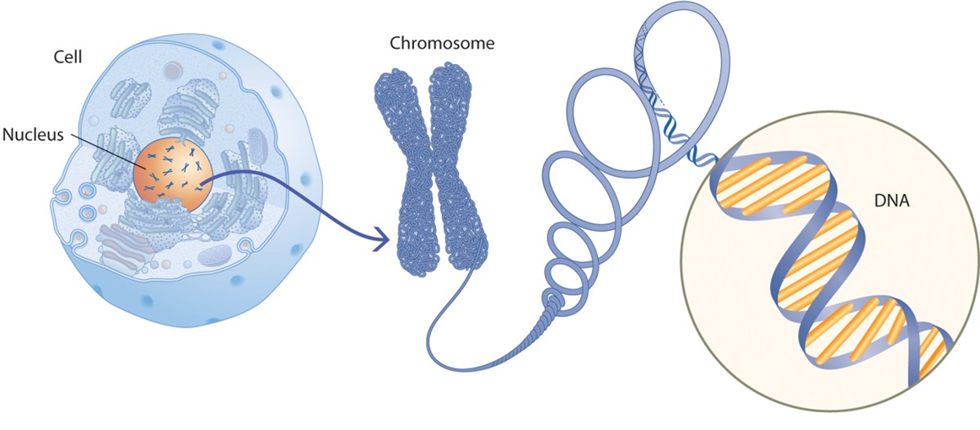
FIGURE 11 CELLS, CHROMOSOMES, GENES, AND DNA
(Left) The body contains trillions of cells, which are the basic structural units of life. Each cell contains a central structure, the nucleus. (Middle) Chromosomes and genes are located in the nucleus of the cell. Chromosomes are made up of threadlike structures composed of DNA molecules. (Right) A gene, a segment of DNA that contains the hereditary code. The structure of DNA is a spiraled double chain.

Slide 107
DNA and the Collaborative Gene 2
Rather than being an independent source of information, DNA collaborates with other sources of information to specify our characteristics.
Numerous studies have shown that external events outside the cell and the person, and internal events inside the cell, can excite or inhibit gene expression.
Stress, exercise, nutrition, respiration, radiation, temperature, sleep, and loneliness can influence gene expression.
Methylation, in which tiny atoms attach themselves to the outside of a gene, makes a gene more or less capable of receiving and responding to biochemical agents from the body.

Slide 108
DNA and the Collaborative Gene 3
A single gene is rarely the source of a protein’s genetic information, much less the source of a person’s inherited trait.
Rather than being a group of independent genes, the human genome consists of many collaborative genes.
The term gene–gene interaction is increasingly used to describe studies that focus on the interdependence of two or more genes in influencing characteristics, behavior, diseases, and development.

Slide 109
Genotype and Phenotype
A person’s genetic heritage—the actual genetic material—is called a genotype.
The way an individual’s genotype is expressed in observed and measurable characteristics is called a phenotype.
Phenotypes include physical traits and psychological characteristics.
For each genotype, a range of phenotypes can be expressed.

Slide 110
Heredity-Environment Interaction 1
Heredity and environment interact to produce development.
Behavior genetics: the field that seeks to discover the influence of heredity and environment on individual differences in human traits and development
To study the influence of heredity on behavior, behavior geneticists use either twin or adoption studies.

Slide 111
Heredity-Environment Interaction 2
Twin study: the behavioral similarity of identical twins is compared with that of fraternal twins
Identical twins are monozygotic twins.
Fraternal twins are dizygotic twins.
Adoption study: a study that aims to discover whether the behavior and psychological characteristics of adopted children are more like those of their adoptive parents or those of their biological parents
Another form involves comparing adopted and biological siblings.

Slide 112
Heredity-Environment Correlations
Sandra Scarr described three ways that heredity and environment are correlated:
Passive genotype-environment correlations occur because biological parents provide the rearing environment.
Evocative genotype-environment correlations occur because an individual’s genetically shaped characteristics elicit certain types of physical and social environments.
Active (niche-picking) genotype-environment correlations occur when children seek out environments they find compatible and stimulating.
The relative influence of the three correlations changes as children develop from infancy through adolescence.

Slide 113
Table 12 EXPLORING HEREDITY-ENVIRONMENT CORRELATIONS
Heredity-Environment Correlation | Description | Examples
Passive | Children inherit genetic tendencies from their parents, and parents also provide an environment that matches their own genetic tendencies. | Musically inclined parents usually have musically inclined children and they are likely to provide an environment rich in music for their children.
Evocative | The child’s genetic tendencies elicit stimulation from the environment that supports a particular trait. Thus genes evoke environmental support. | A happy, outgoing child elicits smiles and friendly responses from others.
Active (niche-picking) | Children actively seek out “niches” in their environment that reflect their own interests and talents and are thus in accord with their genotype. | Libraries, sports fields, and a store with musical instruments are examples of environmental niches children might seek out if they have intellectual interests in books, talent in sports, or musical talents, respectively.

Slide 114
The Epigenetic View 1
The heredity-environment correlation view emphasizes how heredity directs the kind of environmental experiences individuals have.
In line with the concept of the collaborative gene, the epigenetic view emphasizes that development is the result of an ongoing, bidirectional interchange between heredity and the environment.

Slide 115
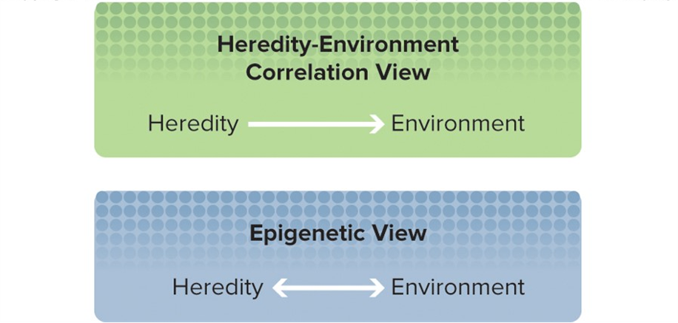
FIGURE 13 COMPARISON OF THE HEREDITY-ENVIRONMENT CORRELATION AND EPIGENETIC VIEWS

Slide 116
The Epigenetic View 2
The epigenetic mechanisms involve the actual molecular modification of the DNA strand as a result of environmental inputs in ways that alter gene functioning.
Example: Adolescents who experienced negative life events drank heavily only when they had a particular variation of the CRHR1 gene.
This type of research is referred to as gene × environment (G × E) interaction—the interaction of a specific measured variation in DNA and a specific measured aspect of the environment.

Slide 117
Conclusions About Heredity-Environment Interaction 1
Heredity and environment operate together.
The relative contributions are not quantifiable; nor is it accurate to say that full genetic expression happens once around conception or birth.
Genes produce proteins throughout the life span, in many different environments.
The emerging view is that many complex behaviors likely have some genetic loading that gives people a propensity for a specific developmental trajectory.
The environment is complex, just like the mixture of genes we inherit.

Slide 118
Conclusions About Heredity-Environment Interaction 2
David Moore: The biological systems that generate behaviors are extremely complex, but too often these systems have been described in overly simplified ways that can be misleading.
It is misleading to talk about “genes for” eye color, intelligence, personality, or other characteristics.
Adolescents are not only the outcomes of their heredity and the environment they experience; they also author a unique developmental path by changing their environment.

Slide 119
Questions?
Determinants, characteristics, and psychological dimensions of puberty
The nature of adolescents’ and emerging adults’ health
The contributions of evolution, heredity, and environment to adolescent development

Slide 120
End of Main Content
© McGraw Hill LLC. All rights reserved. No reproduction or distribution without the prior written consent of McGraw Hill LLC.

Slide 121
Accessibility Content: Text Alternatives for Images

Slide 122
FIGURE 1 HORMONE LEVELS BY SEX AND PUBERTAL STAGE FOR TESTOSTERONE AND ESTRADIOL - Text Alternative
Return to parent-slide containing images.
In boys, testosterone levels rise steadily from around 25 ng/dl in Stage 1 to an average of around 450 in Stage 5. In contrast, estradiol levels remain low, although they fluctuate—averaging about 10 pg/dl at Stages 1 and 2, 20 pg/dl at Stage 3, 10 pg/dl at Stage 4, and 25 pg/dl at Stage 5.
In girls, the rise in estradiol accelerates to Stage 4 and then levels off somewhat. The average levels are about 10 pg/dl at Stage 1, 20 pg/dl at Stage 2, 40 pg/dl at stage 3, 80 pg/dl at Stage 4, and just over 80 pg/dl at Stage 5. Note that the actual levels vary fairly widely in the later stages, especially stage 4. Testosterone in girls, like estradiol in boys, is at low, fluctuating levels—averaging about 12 ng/dl at Stage 1, 15 ng/dl at Stage 2, 20 ng/dl at Stage 3, 17 ng/dl at Stage 4, and 24 ng/dl at Stage 5.
Return to parent-slide containing images.

Slide 123
FIGURE 2 THE MAJOR ENDOCRINE GLANDS INVOLVED IN PUBERTAL CHANGE - Text Alternative
Return to parent-slide containing images.
Illustrations show the locations of the major endocrine glands that are active in pubertal change. The image on the left shows the location of the glands in males; the image on the left shows the location of the glands in females.
Return to parent-slide containing images.

Slide 124
FIGURE 4 PUBERTAL GROWTH SPURT - Text Alternative
Return to parent-slide containing images.
A line graph shows height gain in inches per year by age in years. The line for females declines from 3.5 to 2.25 in. per year between ages 2 and 8, then rises to 3.25 by age 11.5 before declining steeply to 0.5 by age 14.
The line for males declines from 3.3 to 2 in. per year between ages 2 and 10, then rises to 3.75 by age 13.5 before declining to 0.5 by age 17.
Return to parent-slide containing images.

Slide 125
FIGURE 5 NORMAL RANGE AND AVERAGE DEVELOPMENT OF SEXUAL CHARACTERISTICS IN MALES AND FEMALES - Text Alternative
Return to parent-slide containing images.
Growth spurt in males:
Height spurt occurs between the ages of 10.5 and 18; the average onset is just over 12 years of age, and the average completion is just over 16.
Penile growth, age 10.5–16.5; average onset just over 12; average completion, just under 15.
Testicular development, age 9.5–17; average onset just under 11.5; average completion just over 15.
Growth of pubic hair, age 12–16; average onset and completion dates at just about those ages.
Growth spurt in females:
  Height spurt occurs between the ages of 9.5 and just over 15; average onset is just under 11 years of age; average completion, just under 15.
  Menarche occurs between 10 and 16.5; average onset is 13.
  Breast growth occurs between 8 and 18; average onset 11; average completion 15.
  Growth of pubic hair occurs between 11 and 14; average onset and completion dates at just about those ages.
Return to parent-slide containing images.

Slide 126
FIGURE 7 MEDIAN AGES AT MENARCHE IN SELECTED NORTHERN EUROPEAN COUNTRIES AND THE UNITED STATES FROM 1845 TO 1969 - Text Alternative
Return to parent-slide containing images.
Norway: from just over 17 years of age in the 1840s to just under 13 ½ in the late 1940s, with the average age then remaining at 13 ½ into the 1970s
Finland: from 16 ½ in 1860 to 13 in 1970
Sweden: from nearly 16 in the 1880s to 14 in 1950
U.S.A.: from just over 14 in the first decade of the 1900s to just over 12 ½ in the 1960s
U.K.: from 13 ½ in the 1940s to 13 in the late 1950s, with the average age then remaining at 13
Return to parent-slide containing images.

Slide 127
FIGURE 8 MORTALITY RATES OF U.S. ADOLESCENTS AND EMERGING ADULTS - Text Alternative
Return to parent-slide containing images.
A bar graph shows deaths per 100,000 for males and females ages 12–17 and ages 18–24. The bars are broken into different sections for suicide, homicide, unintentional injury, and other.
Of 47.1 deaths in males ages 12–17, almost half are from unintentional injury, about a quarter from other causes, and the remaining are evenly split between suicide and homicide. Of 24.3 deaths in females ages 12–17, about half are unintentional injury, a little less than half are from other causes, and very few from suicide and homicide.
Of 137 deaths in males ages 18–24, almost half are from unintentional injury, a little less than a quarter from other causes, a little less than a quarter from homicide, and the remainder from suicide. Of 49.3 deaths in females ages 18–24, a little less than half are from unintentional injury, a little less than half are from other causes, and about 2–3 each from suicide and homicide.
Return to parent-slide containing images.

Slide 128
FIGURE 9 DEVELOPMENTAL CHANGES IN U.S. ADOLESCENTS’ SLEEP PATTERNS ON AN AVERAGE SCHOOL NIGHT - Text Alternative
Return to parent-slide containing images.
Graph illustrates the number of high school students who got 8 or more hr of sleep on an average school night. A blue bar represents 9th graders at 34%, a yellow bar represents 10th graders at 28%, a green bar represents 11th graders at 23%, and a purple bar represents 12th graders at 22%.
Return to parent-slide containing images.

Slide 129
FIGURE 10 THE BRAIN SIZES OF VARIOUS PRIMATES AND HUMANS IN RELATION TO THE LENGTH OF THE JUVENILE PERIOD - Text Alternative
Return to parent-slide containing images.
A line graph illustrates how brain size relates to the length of the juvenile period in primates. Lemurs have the smallest brain size and a juvenile period of less than 2 years. Rhesus and Gibbons have brains around 200 ml and juvenile periods of about 6 years. Orangutans, chimpanzees, and gorillas have brain sizes between 400 and 500 ml and juvenile periods around 7 years. Lastly, humans have brain sizes around 1,250 ml and juvenile periods around 13–14 years.
Return to parent-slide containing images.

