Slide 1
Adolescence
18th Edition
John W. Santrock
Chapter 1—Introduction
© McGraw Hill LLC. All rights reserved. No reproduction or distribution without the prior written consent of McGraw Hill LLC.

Slide 2
Outline 1
The Historical Perspective
Early History.
The 20th and 21st Centuries.
Stereotyping of Adolescents.
A Positive View of Adolescence.
Today’s Adolescents in the United States and Around the World
Adolescents in the United States.
The Global Perspective.

Slide 3
Outline 2
The Nature of Development
  Processes and Periods.
  Developmental Transitions.
  Developmental Issues.
The Science of Adolescent Development
  Science and the Scientific Method.
  Theories of Adolescent Development.
  Research in Adolescent Development.

Slide 4
The Historical Perspective: Early History
What have the portraits of adolescence been like at different points in history?
In early Greece, Plato and Aristotle commented on the nature of youth.
In the Middle Ages, children and adolescents were viewed as miniature adults, subject to harsh discipline.
In the 18th century, Jean-Jacques Rousseau restored the belief that being a child or an adolescent is not the same as being an adult and that development has distinct phases.
Not until the beginning of the 20th century did the scientific exploration of adolescence begin.

Slide 5
The Historical Perspective: Early History
Plato thought that children should spend their time in arts and music.
Adolescents should study science and mathematics.
Do you agree with this philosophy? Why or why not?

Slide 6
The Historical Perspective: Early History
Plato devotes much attention to the education of the child as a future citizen. As such, he believes that the child belongs to the state and its education is the responsibility of the state (Republic, bk. 2, 376.)
Education must be compulsory for all. State funds should pay for gymnasiums and for instructors, officials, and superintendents in charge of education, both cultural and physical (Laws, bk. 7, 764, 804, 813).
Are these the basics of our current educational system?

Slide 7
The Historical Perspective: Early History
Plato is not concerned with training children for a trade but rather with giving them an education in virtue, which is to produce "a keen desire to become a perfect citizen who knows how to rule and be ruled" in turn (Laws, bk. 1, 643). Reason is man's true nature, but it has to be nurtured from childhood by irrational means.
Education is thus the correct channeling of pains and pleasures (Laws, bk. 2, 653), aiming at establishing "a nature in which goodness of character has been well and truly established" so as to breed a familiarity with reason (Republic, bk. 3, 398, 401).

Slide 8
The Historical Perspective: Early History
Storytelling is the main tool for the formation of character in Plato's view, and begins at an earlier age than physical training.
Stories should provide models for children to imitate, and as ideas taken in at an early age become indelibly fixed, the creation of fables and legends for children, true or fictional, is to be strictly supervised.
How are fairytales used to educate children and even young adults?

Slide 9
The Historical Perspective: Early History
Fairy Tales foster imagination.
Yes, this is obvious, but it really has far reaching effects. Children use their imagination to learn about the world around them. They make connections using the knowledge that they have and fill in the gray areas with their own ideas of what "might be." Their creative thoughts not only help build their ideas about their world but also about themselves. They use comparisons to stories to see what things they have in common as well as in contrast to the characters. These skills help them build their own character strengths and may even begin to spark ideas in the type of education, career and life that they want to build for themselves.

Slide 10
The Historical Perspective: Early History
So, can this concept be seen in the reading of adolescent fiction?
What happens with the adolescent mind when they read fictional stories? Are the skills the same as when reading or being told fairytales?

Slide 11
The Historical Perspective: Early History
Fiction designed for adolescents can deal with issues that are especially difficult for the young person to comprehend on his or her own. This is where your research project for the semester comes in.
Look at the content section on D2L. There is a module that is titled “Research Project”.
You need to look at the book and subsequent chapters to decide on a topic or issue that you would like to explore. You need to find a FICTION book that deals with this issue. This needs to be done SOON…like this week so you can read the book and be prepared to write the different parts of the project. We will do this in sections so please get your book this week if possible.

Slide 12
The Historical Perspective: Early History
Back to Plato….
In Plato's educational system, a child, beginning at the age of ten, will spend three years on reading, writing, and the poets, and another three learning the lyre, and will study elementary mathematics up to the age of seventeen or eighteen, all with as little compulsion as possible, in order to learn "enough to fight a war and run a house and administer a state" (Republic, bk. 7, 535-541). Neither child nor father are to be allowed to extend or curtail that period, either out of enthusiasm or distaste

Slide 13
The Historical Perspective: Early History
Children must work on their letters until they are able to read and write, but any whose natural abilities have not developed sufficiently by the end of the prescribed time to make them into quick or polished performers should not be pressed (Laws, bk. 7, 810). The child's lessons should take the form of PLAY, and this will also show what they are naturally fit for. Enforced exercise does no harm to the body, but enforced learning will not stay in the mind (Laws, bk. 7, 536).

Slide 14
The Historical Perspective: Early History
If you would like to further study Plato’s Republic….
https://classics.mit.edu/Plato/republic.html

Slide 15
The 20th and 21st Centuries 1
G. Stanley Hall’s storm-and-stress view is attributed with beginning the scientific study of adolescence.
Adolescence is a turbulent time charged with conflict and mood swings.
Margaret Mead’s sociocultural view: The basic nature of adolescence is not biological but rather sociocultural.
In cultures that provide a smooth, gradual transition from childhood to adulthood, she found little storm and stress.
Criticisms over biased and error-prone findings cause this to be a controversial view.

Slide 16
The 20th and 21st Centuries 1
G. Stanley Hall’s storm-and-stress view is attributed with beginning the scientific study of adolescence.
Adolescence is a turbulent time charged with conflict and mood swings.
Development is controlled primarily by biological factors.

Slide 17
The 20th and 21st Centuries 1
G. Stanley Hall’s storm-and-stress view:
The storm and stress view of adolescence is characterized by the adolescent years, which take place between approximately the ages of 11 and 19. It is a time of upheaval and difficulty in which adolescents experience emotional and behavioral challenges such as increased conflicts with parents and other authority figures, disruptions in mood, and increased participation in risk-taking activities.
Does this sound familiar?

Slide 18
The 20th and 21st Centuries 1
What Are the Components of Storm and Stress?
While adolescent storm and stress can consist of many emotional and behavioral issues, such as challenges with self-image, scholars consistently discuss three key components:
Conflict with parents (Have you ever experienced this?)
Mood disruptions (How about mood swings?)
Risk-taking behavior (Have you ever done something that looking back, probably wasn’t the best idea?)

Slide 19
The 20th and 21st Centuries 1
Margaret Mead’s sociocultural view: The basic nature of adolescence is not biological but rather sociocultural.
In cultures that provide a smooth, gradual transition from childhood to adulthood, she found little storm and stress.
Criticisms over biased and error-prone findings cause this to be a controversial view.

Slide 20
The 20th and 21st Centuries 1
Margaret Mead’s sociocultural view:
Based on her study of 68 girls in three villages in the western part of Ta'u island, Mead reported that adolescence was not a stressful time, compared with the expectation of adolescent “storm and stress” in Western societies. She attributed this difference to cultural factors.

Slide 21
The 20th and 21st Centuries 1
Margaret Mead’s sociocultural view:
In 1925, Mead observed, interviewed, and interacted with 68 girls between the ages of 9 and 20 living in three villages on the island of Ta‘ū in American Samoa. After 9 months of study, Mead concluded that unlike stressed American girls, the well-balanced and carefree nature of sexually-active Samoan girls was due to the cultural stability of their society free of conflicting values, expectations, and shameful taboos. Largely relieved of the baby-tending responsibilities that had burdened them as little girls, Samoan adolescents reveled in their freedom and deferred marriage during this "best period" in their lives.

Slide 22
The 20th and 21st Centuries 2
The inventionist view: Adolescence is a sociohistorical creation.
Schools, work, and economics are important dimensions.
Some scholars argue that the concept of adolescence was invented mainly as a by-product of the movement to create a system of compulsory public education.
Historians now call the period between 1890 and 1920 the “age of adolescence.”

Slide 23
The 20th and 21st Centuries 3
Further changes in the 20th century and 21st century:
Cohort: a group of people who are born at a similar point in history and share similar experiences as a result.
Cohort effects: influences attributed to a person’s year of birth, era, or generation but not to actual chronological age.
By 1950, the developmental period referred to as adolescence encompassed not only physical and social identities but also a legal identity.
In the 1960s to 1970s, adolescence was shaped anew by
ethnic and racial conflict, antiwar protests, and the feminist movement.

Slide 24
The 20th and 21st Centuries 3
Unspoken rules about adolescent behavior in the 50’s…..yes this was before my time!
https://www.youtube.com/watch?v=Q7nOuZYh5us
How is this different from today’s word?
Were their struggles easier or harder than adolescents today? Why or why not?

Slide 25
The 20th and 21st Centuries 4
Millennials: the generation born after 1980; the first to come of age and enter emerging adulthood in the new millennium
Because of increased ethnic diversity, many millennial adolescents and emerging adults are more tolerant and open-minded than previous generations.
Another characteristic is their dramatically increased use of media and information/communication devices—likely with both positive and negative effects.
The Pew Research Center has restricted millennials to anyone born between 1981 and 1996; anyone born in 1997 or later is referred to as Generation Z.

Slide 26
The 20th and 21st Centuries 5
Millennials, continued
Far too many millennials are not transitioning to adulthood successfully.
Issues with low academic performance, college graduation rates, alcohol abuse, teenage pregnancy, and obesity.
Generation Z is the best educated generation yet.
They are more likely to go to college and to have a college-educated parent.

Slide 27
The 20th and 21st Centuries 5
Most of you would be considered to be Generation Z. Are the problems that this generation faces different than those of earlier generations or are there other things in play that make them seem more difficult?
What would you say to your children or grandchildren about your generation when they say you had it easy.

Slide 28
The 20th and 21st Centuries 5
But there is a new concept called the I-Gen.
These are individuals who were born in 1995 and later…
Grew up with cell phones, had an Instagram page before they started high school, and do not remember a time without the internet.
The oldest members of the I-gen were early adolescents when the IPhone was introduced in 2007 and high school students when the IPad entered the scene in 2010.
How old were you in 2007?

Slide 29
The 20th and 21st Centuries 5
The complete dominance of the smartphone among teens has had ripple effects across every area of Igen’s lives, from their social interactions to their mental health.
They are the first generation for whom Internet access has been constantly available, right there in their hands.
Do you remember a time when there wasn’t internet access?
Probably not. But how does it make you feel when the internet is down for a while?

Slide 30
The 20th and 21st Centuries 5
Did you know the average teen checks their phone more than 80 times a day?
How many times do you check your phone? Is it in your pocket, in your bag, or in front of you?
What would you do if I said I want all phones on the table in front of the room during class….so you could see them but not touch?
Would you complain?
What about in a restaurant….is it rude to be on your phone during dinner? Or standing in line at Walmart?

Slide 31

The 20th and 21st Centuries
But technology is not the only change shaping this generation. The “I” in I-gen represents the individualism its members take for granted, a broad trend that grounds their bedrock sense of equality as well as the rejection of traditional social rules.

Slide 32
The 20th and 21st Centuries 5
This generation socializes in completely new ways, reject once sacred social taboos, and want different things from their lives and careers.
They are obsessed with safety and fearful of their economic futures,
They have no patience for any quality based on gender, race, or sexual orientation
They are at the forefront of the worst mental health crisis in decades, with rates of teen depression and suicide skyrocketing since 2011.

Slide 33
The 20th and 21st Centuries 5
From four nationally representative surveys of more than 11 million American there are ten important trends that are shaping this generation.
In no hurry – the extension of childhood into adolescence
Internet – how much time they are actually spending on their phones, and what that has replaced
In-person no more – the decline of in-person interactions
Insecure – the sharp rise in mental health issues

Slide 34
The 20th and 21st Centuries 5
Irreligious – the decline in religion
Insulated but not intrinsic – the interest in safety and thee decline in civil involvement
Income insecurity – new attitudes toward work
Indefinite – new attitudes toward sex, relationships, and children
Inclusive – acceptance equality, and free speech debates
Independent – their political views

Slide 35
The 20th and 21st Centuries 5
Let’s see where you stand…
Take this 15-item quiz to find out how “I-Gen” you are: Answer each question with a yes or no….number your paper from 1-15.
1. In the past 24 hours, did you spend at least half an hour total texting or checking your cell phone?
2. Do you have a snapchat or other similar accounts?
3. Do you consider yourself a religious person?

Slide 36
The 20th and 21st Centuries 5
4. Did you get your driver’s license by the time you turned 17?
5. Do you think same-sex marriage should be legal?
6. Did you ever drink alcohol )mor than a few sips) by the time you turned 16?
7. Did you fight with your parents a lot when you were a teen?
8. Were more than one-third of the other students at your high school a different race than you?

Slide 37
The 20th and 21st Centuries 5
9. When you were in high school, did you spend nearly every weekend night out with your friends?
10. Did you have a job during the school year when you were in high school?
11. Do you agree that safe spaces and trigger warnings are good ideas and that efforts should be made to reduce microaggressions?
12. Are you a political independent?

Slide 38
The 20th and 21st Centuries 5
13. Do you support the legalization of marijuana?
14. Is having sex without much emotion involved desirable?
15. When you were in high school, did you feel left out and lonely fairly often?

Slide 39
The 20th and 21st Centuries 5
Scoring…
Give yourself 1 point for answering “yes” to questions 1, 2, 5, 8, 11, 12, 13, 14, and 15.
Give yourself 1 point for answering “no” to questions 3, 4, 6, 7, 9, and 10.
The higher your score, the more “I-Gen” you are in your behaviors, attitudes and beliefs.
Does your score surprise you?

Slide 40
Stereotyping of Adolescents
What are some stereotypes about adolescents that you have encountered? How does it make you feel to be put into that category.
Ex.
All adolescents are messy
You are an adolescent; therefore, you must be messy.
You can substitute any adjective, such as lazy, rebellious, etc.

Slide 41
Stereotyping of Adolescents
Stereotype: a generalization that reflects our impressions and beliefs about a broad category of people
Stereotypes of adolescents are plentiful.
They are all lazy.
All they think about sex.
They are so self-centered.
Adolescent generalization gap: coined by Joseph Adelson, refers to generalizations that are based on information about a limited, often highly visible group of adolescents.

Slide 42
A Positive View of Adolescence 1
The negative stereotyping of adolescents is overdrawn.
For much of the last century in Western cultures, adolescence was perceived as a problematic period of the human life span in line with Hall’s storm-and-stress portrayal.
Research indicates a large majority of adolescents are not nearly as disturbed and troubled as popular stereotypes suggests.

Slide 43
A Positive View of Adolescence 2
Adults’ perceptions of adolescents emerge from a combination of personal experiences and media portrayals, neither of which produces an objective picture of how typical adolescents develop.
In matters of taste and manners, the youth of every generation have seemed radical, unnerving, and different from adults.
Acting out and boundary testing are time-honored ways in which adolescents move toward accepting, rather than rejecting, parental values.

Slide 44
A Positive View of Adolescence 3
Reflecting the positive psychology approach, positive youth development (PYD) emphasizes positive qualities and developmental trajectories.
The “Five Cs” of PYD:
Competence.
Confidence.
Connection.
Character.
Caring/compassion.
To develop these, youth need access to positive social contexts and competent adults.
PYD characteristics can reduce the likelihood of developing mental health problems from traumatic situations such as the COVID-19 pandemic.

Slide 45
A Positive View of Adolescence 3
Do you think that this point of view will result in better well-adjusted adults or…
Adults who expect other people to accept them without any social boundaries?
Adults who expect the people in their life to just let them do what they want without consequences? Like not getting a job and living off their parents.
Adults who are depressed and dejected because “society does not follow “their ideas”

Slide 46
A Positive View of Adolescence 3
How do adolescents move from those four “c’s” to becoming a part of society that does not coddle but has expectations of its members?

Slide 47
Adolescents in the United States 1
Growing up has never been easy.
The developmental tasks today’s adolescents face are no different from those of adolescents 50 years ago.
For a large majority of youth, adolescence is not a time of rebellion, crisis, pathology, and deviance.
Rather it is a time of evaluation, decision making, commitment, and finding a place in the world.
Most adolescents successfully negotiate the lengthy path to adult maturity, but a substantial minority do not. Why are these youth different from their peers?

Slide 48
Adolescents in the United States 2
Social contexts influence adolescent development
Contexts: settings—influenced by historical, economic, social, and cultural factors—in which development occurs.
Family, peers, school, religion, neighborhood, community, region, and nation, each with its cultural legacies.
The sociocultural context for U.S. adolescents is changing with the dramatic increase in immigration.
More research is needed to include the ethnically diverse population and its effects in adolescence.

Slide 49

Part 2
Today’s Adolescents in the United States and Around the World

Slide 50
Adolescents in the United States 2
Social contexts influence adolescent development
Specifically, how does the type of parenting practices influence adolescent development?
Remember those parenting types? Let’s review.
https://www.verywellfamily.com/types-of-parenting-styles-1095045

Slide 51
Adolescents in the United States 3
Social policy: the course of action designed by the national government to influence the welfare of its citizens
Researchers argue that the United States has a fragmented social policy for youth that too often focuses only on negative developmental deficits and not enough on positive, strength-based approaches.
Research indicates that youth benefit enormously when they have caring adults in their lives in addition to parents or guardians.
Coaches, neighbors, teachers, mentors, and after-school leaders serving as role models, confidantes, advocates, and resources.

Slide 52

Reflection Question
How have the social changes of the twentieth century, as described in the text, influenced society’s views of adolescence?
Answer this question and add it to your notes.

Slide 53
Adolescents in the United States 4
Children and adolescents who grow up in poverty represent a special concern.
In 2019, 14.3% of U.S. children under age 18 were living in families below the poverty line, a figure much higher than in other developed countries.
For example, Canada has a child and adolescent poverty rate of 9%, and Sweden has a rate of 2%.
African American (26.4%) and Latinx (20.9%) families with children have especially high rates of poverty.

Slide 54
Adolescents in the United States 4
Gender issues: Gender refers to the characteristics of people as males and females. This is what you are assigned at birth…it is not a choice.
But being transgender is a choice….individuals who ADOPT a different gender identity than was assigned to them at birth.

Slide 55
Adolescents in the United States 4
Social Policy: policies enacted by the national government to influence the welfare of its citizens.
In an attempt to make better policies regarding adolescents…what do you think new policies should address? How do you promote the good rather than focusing on the bad?

Slide 56
Adolescents in the United States 4
Counseling Not Criminalization in Schools Act (CNC) (H.R.4011/S.2125)
CNC “prohibits the use of federal funds for law enforcement officers in schools. It also establishes a grant program to replace law enforcement officers in schools with personnel and services that support mental health and trauma-informed services.”
In the House, this bill is sponsored by Rep. Ayanna Pressley (D-MA) and cosponsored by 16 Democratic Representatives. It has been referred to the House Education and Labor Committee and the Judiciary Committee.
In the Senate, the bill is sponsored by Sen. Christopher Murphy (D-CT) and is cosponsored by 10 Democratic Senators. It has been referred to the Senate HELP Committee.
CNC is supported by numerous organizations, including CLASP’s New Deal for Youth Changemakers, Children’s Defense Fund, The Leadership Conference on Civil and Human Rights, and Young Voices.

Slide 57
Adolescents in the United States 4
This is one bill that is up for discussion in congress.
https://www.congress.gov/bill/117th-congress/senate-bill/2125
What do you think about this bill?
Research other policies on adolescents….health policies, education policies, etc. It could be a federal or state policy. Find one and add it to the discussion board as an assignment.

Slide 58
The Global Perspective 1
Every generation of teens is shaped by the social, political, and economic events of the day. Today’s teenagers are no different—and they’re the first generation whose lives are saturated by mobile technology and social media.
Do you have a cell phone…a tablet….a laptop…if these were not available how would you communicate?
If the technology was taken away, do you know what it would take to survive? Can you grow your own food…cook….can vegetables, write a letter, live off the grid? Be realistic and think of all the things you rely on technology for.

Slide 59
The Global Perspective 1
In her new book, psychologist Jean Twenge uses large-scale surveys to draw a detailed portrait of ten qualities that make today’s teens unique and the cultural forces shaping them. Her findings are by turn alarming, informative, surprising, and insightful, making the book—iGen:Why Today’s Super-Connected Kids Are Growing Up Less Rebellious, More Tolerant, Less Happy—and Completely Unprepared for Adulthood—and What That Means for the Rest of Us—an important read for anyone interested in teens’ lives.

Slide 60
The Global Perspective 1
Twenge names the generation born between 1995 and 2012 “iGens” for their ubiquitous use of the iPhone, their valuing of individualism, their economic context of income inequality, their inclusiveness, and more.
We talked about this already…remember this concept?

Slide 61
The Global Perspective 1
She identifies their unique qualities by analyzing four nationally representative surveys of 11 million teens since the 1960s. Those surveys, which have asked the same questions (and some new ones) of teens year after year, allow comparisons among Boomers, Gen Xers, Millennials, and iGens at exactly the same ages. In addition to identifying cross-generational trends in these surveys, Twenge tests her inferences against her own follow-up surveys, interviews with teens, and findings from smaller experimental studies. Here are just a few of her conclusions.

Slide 62
The Global Perspective 1
iGens have poorer emotional health thanks to new media. Twenge finds that new media is making teens more lonely, anxious, and depressed, and is undermining their social skills and even their sleep.
iGens “grew up with cell phones, had an Instagram page before they started high school, and do not remember a time before the Internet,” writes Twenge. They spend five to six hours a day texting, chatting, gaming, web surfing, streaming and sharing videos, and hanging out online. While other observers have equivocated about the impact, Twenge is clear: More than two hours a day raises the risk for serious mental health problems.

Slide 63
The Global Perspective 1
How many hours a day are you engaged with technology?
Try to track it for a week and see where you are.
We all rely on technology…even me, and I am not from your generation.

Slide 64
The Global Perspective 1
She draws these conclusions by showing how the national rise in teen mental health problems mirrors the market penetration of iPhones—both take an upswing around 2012.
This is correlational data, but competing explanations like rising academic pressure or the Great Recession don’t seem to explain teens’ mental health issues. And experimental studies suggest that when teens give up Facebook for a period or spend time in nature without their phones, for example, they become happier.
Do you think you would be happier without your technology?
Maybe not right away..but over time?

Slide 65
The Global Perspective 1
Note…
You would have to learn to rely on yourself and take more responsibility for your own actions.
Remember Maslow and self-actualization? Becoming your own individual self? Can you do this without technology?

Slide 66
The Global Perspective 1
The mental health consequences are especially acute for younger teens, she writes. This makes sense developmentally, since the onset of puberty triggers a cascade of changes in the brain that make teens more emotional and more sensitive to their social world.

Slide 67
The Global Perspective 1
Social media use, Twenge explains, means teens are spending less time with their friends in person. At the same time, online content creates unrealistic expectations (about happiness, body image, and more) and more opportunities for feeling left out—which scientists now know has similar effects as physical pain. Girls may be especially vulnerable, since they use social media more, report feeling left out more often than boys, and report twice the rate of cyberbullying as boys do.
Social media is creating an “epidemic of anguish,” Twenge says.
Do you agree with this?

Slide 68
The Global Perspective 1
iGens grow up more slowly. iGens also appear more reluctant to grow up. They are more likely than previous generations to hang out with their parents, postpone sex, and decline driver’s licenses.
Twenge floats a fascinating hypothesis to explain this—one that is well-known in social science but seldom discussed outside academia. Life history theory argues that how fast teens grow up depends on their perceptions of their environment: When the environment is perceived as hostile and competitive, teens take a “fast life strategy,” growing up quickly, making larger families earlier, and focusing on survival. A “slow life strategy,” in contrast, occurs in safer environments and allows a greater investment in fewer children—more time for preschool soccer and kindergarten violin lessons.

Slide 69
The Global Perspective 1
“Youths of every racial group, region, and class are growing up more slowly,” says Twenge—a phenomenon she neither champions nor judges.
However, employers and college administrators have complained about today’s teens’ lack of preparation for adulthood. In her popular book, How to Raise an Adult, Julie Lythcott-Haims writes that students entering college have been over-parented and as a result are timid about exploration, afraid to make mistakes, and unable to advocate for themselves.
What do you think about this concept?

Slide 70
The Global Perspective 1
Twenge suggests that the reality is more complicated. Today’s teens are legitimately closer to their parents than previous generations, but their life course has also been shaped by income inequality that demoralizes their hopes for the future.
They see other people making more money, having more things, and they want them…but do not see the path that they have to take to get them.
Compared to previous generations, iGens believe they have less control over how their lives turn out. Instead, they think that the system is already rigged against them—a dispiriting finding about a segment of the lifespan that is designed for creatively reimagining the future.

Slide 71
The Global Perspective 1
iGens exhibit more care for others. iGens, more than other generations, are respectful and inclusive of diversity of many kinds.
Yet as a result, they reject offensive speech more than any earlier generation, and they are derided for their “fragility” and need for “trigger warnings” and “safe spaces.” (Trigger warnings are notifications that material to be covered may be distressing to some. A safe space is a zone that is absent of triggering rhetoric.)

Slide 72
The Global Perspective 1
Today’s colleges are tied in knots trying to reconcile their students’ increasing care for others with the importance of having open dialogue about difficult subjects. Dis-invitations to campus speakers are at an all-time high, more students believe the First Amendment is “outdated,” and some faculty have been fired for discussing race in their classrooms. Comedians are steering clear of college campuses, Twenge reports, afraid to offend.

Slide 73
The Global Perspective 1
Some experts argue that adolescence is typically thought of in a “Eurocentric” way.
Others note that advances in transportation and telecommunication are spawning a global youth culture.
A study of more than 11,000 adolescents from 18 countries living mainly in middle- and upper-income families found that adolescents are experiencing considerable stress about their future.

Slide 74
The Global Perspective 2
Cultural differences among adolescents have by no means disappeared.
Depending on the culture being observed, adolescents have many different experiences depending on their health and well-being, gender, family, school, and peers.

Slide 75
The Global Perspective 3
Rapid global change is altering the experience of adolescence.
Fewer adolescents around the world die from infectious diseases and malnutrition now than in the past.
The experiences of male and female adolescents continue to be quite different.
Family is still important, but there are large differences in the kinds of family units and the levels of support they provide.
Worldwide, not all adolescents have opportunities for education.
Peer relationships, like families, are varied and are valued differently, providing different levels of support.

Slide 76
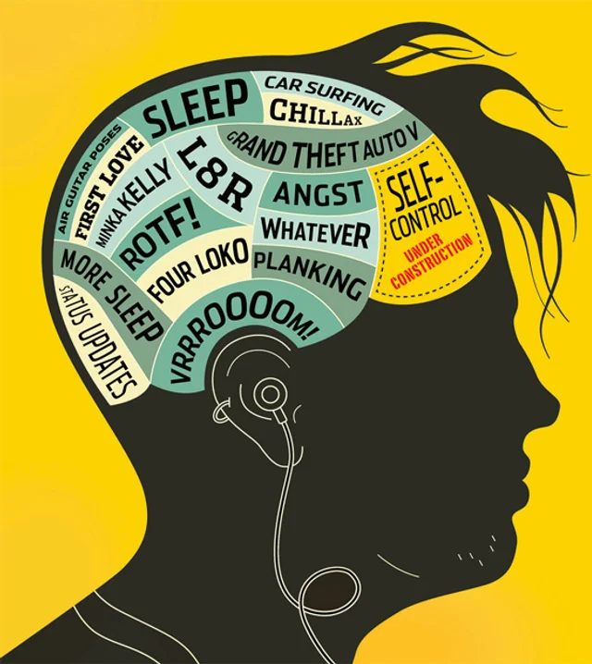
Part 3
The Nature of Development

Slide 77
The Nature of Development
In certain ways, each of us develops like all other individuals; in other ways, each of us is unique.
Development: the pattern of change that begins at conception and continues through the life span
Most involves growth, although it also includes decay.

Slide 78
Processes and Periods: Biological, Cognitive, and Socioemotional Processes
Human development is determined by biological, cognitive, and socioemotional processes.
Biological processes: physical changes in an individual’s body.
Cognitive processes: changes in an individual’s thinking and intelligence.
Socioemotional processes: changes in an individual’s emotions, personality, relationships with others, and social contexts.
Biological, cognitive, and socioemotional processes are intricately interwoven.

Slide 79
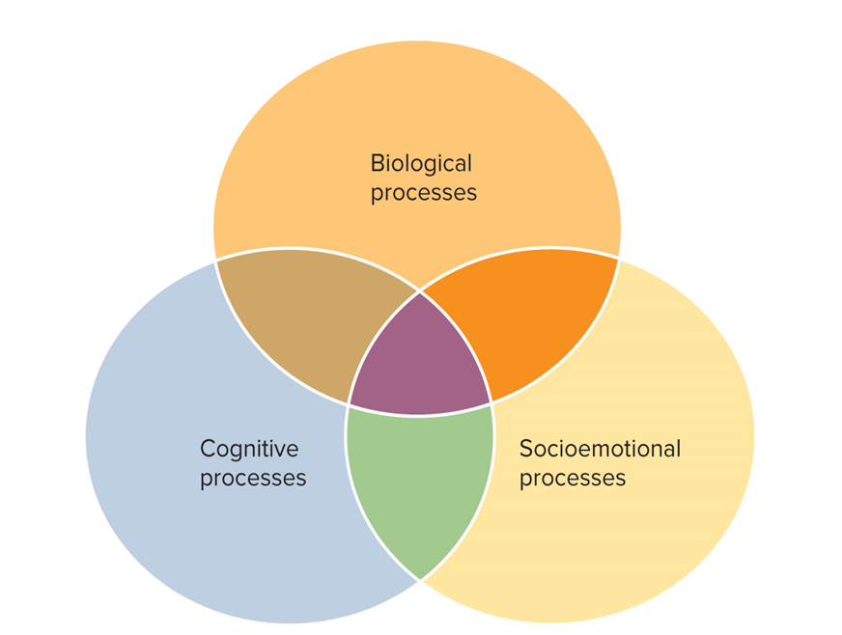
FIGURE 1 DEVELOPMENTAL CHANGES ARE THE RESULT OF BIOLOGICAL, COGNITIVE, AND SOCIOEMOTIONAL PROCESSES.
These processes interact as individuals develop.

Slide 80
Periods of Development: Childhood
Human development is commonly described in terms of periods.
Childhood includes the prenatal period, infancy, early childhood, and middle and late childhood.
Prenatal period: the time from conception to birth.
Infancy: birth to 18 or 24 months of age.
Early childhood: the period from about 2–5 years of age.
Middle and late childhood: from the age of about 6–11 years of age.

Slide 81
Periods of Development: Adolescence 1
Adolescence is the period of transition between childhood and adulthood that involves biological, cognitive, and socioemotional changes.
A key task is preparation for adulthood.
In the United States and most other cultures today, adolescence begins at approximately 10–13 years of age and ends in the late teens.
Early adolescence: corresponds roughly to the middle school or junior high school years and includes most pubertal change.
Late adolescence: refers approximately to the latter half of the second decade of life.

Slide 82
Periods of Development: Adolescence 2
Remember…puberty and adolescence are NOT the same thing…they should not be used interchangeably in discussions.

Slide 83
Periods of Development: Adolescence 2
Today, developmentalists do not believe that change ends with adolescence.
Though it has some unique characteristics, what takes place during adolescence is connected with development and experiences in both childhood and adulthood.

Slide 84
Periods of Development: Adulthood
Like childhood and adolescence, adulthood is not a homogeneous period of development.
Early adulthood: begins in the late teens or early 20s and lasts through the 30s.
Middle adulthood: begins at approximately 35–45 years of age and ends at some point between approximately 55 and 65 years of age.
Late adulthood: lasts from approximately 60 or 70 years of age until death.

Slide 85
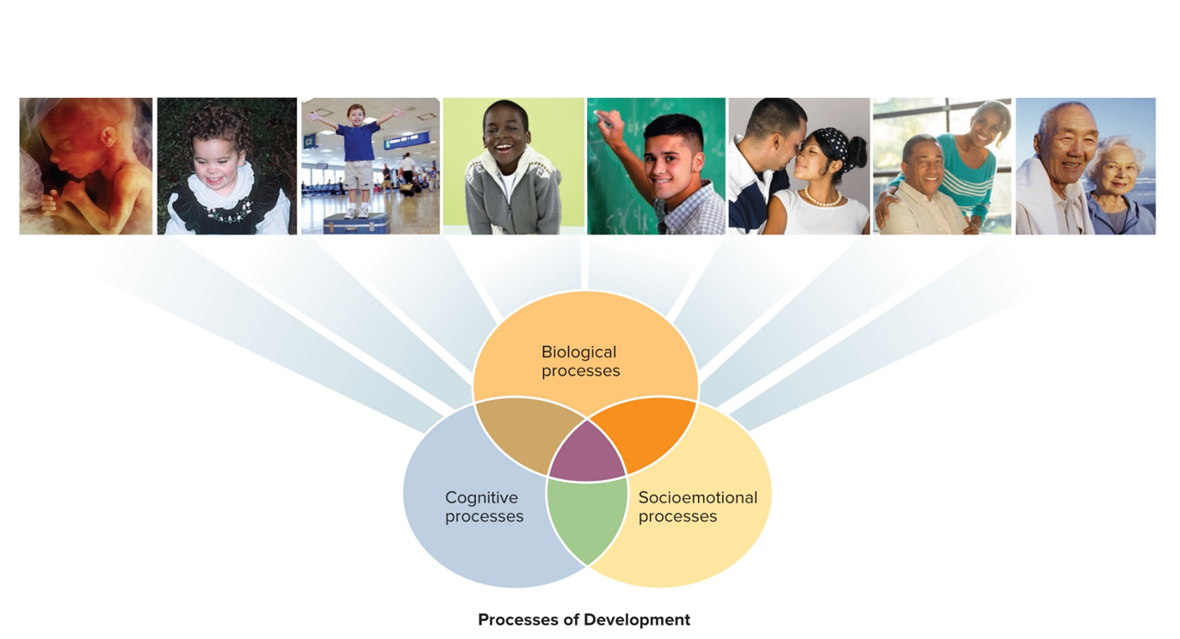
FIGURE 2 PROCESSES AND PERIODS OF DEVELOPMENT
Periods of Development
Prenatal period (conception to birth)
Infancy (birth to 18–24 months)
Early childhood (2–5 years)
Middle and late childhood (6–11 years)
Adolescence (10–13 to late teens)
Early adulthood (20s to 30s)
Middle adulthood (35–45 to 55–65)
Late adulthood (60s–70s to death)
The unfolding of life’s periods of development is influenced by the interaction of biological, cognitive, and socioemotional processes.
(left to right) Steve Allen/Brand X Pictures/Getty Images; Dr. John Santrock; Digital Vision/Alamy; Digital Vision/Photodisc/Getty Images; Comstock/Getty Images; Blue Moon Stock/Alamy Stock Photo; Sam Edwards/CaiaImage/Glow Images; Ronnie Kaufman/Blend Images LLC.
Access the text alternative for slide images.

Slide 86
Developmental Transitions: Childhood to Adolescence
Developmental transitions are often important junctures in people’s lives.
The transition from childhood to adolescence involves many biological, cognitive, and socioemotional changes.
Puberty; increases in abstract, idealistic, and logical thinking; and a quest for independence.
Complex and multidimensional, involving change in many different aspects of an individual’s life.
Negotiating this transition successfully requires considerable adaptation and thoughtful, sensitive support from adults.

Slide 87
Developmental Transitions: Childhood to Adolescence
What are the physical changes of adolescence?
Physical development in adolescence includes changes that occur through a process called puberty. During puberty, the child’s brain releases certain hormones. The hormones cause the child’s body to physically change and their sexual organs to mature.

Slide 88
Developmental Transitions: Adolescence to Adulthood 1
Adolescence begins in biology and ends in culture.
Whereas the transition from childhood to adolescence begins with the onset of pubertal maturation, the transition from adolescence to adulthood is determined by cultural standards and experiences.
Recently, the transition from adolescence to adulthood has been referred to as emerging adulthood, from approximately 18 to 25 years of age.

Slide 89
Developmental Transitions: Adolescence to Adulthood 2
Five key features characterize emerging adulthood:
Identity exploration.
Instability.
Self-focused.
Feeling in-between.
The age of possibilities—an opportunity to transform their lives.
Although emerging adulthood does not characterize development in all cultures, it does appear to occur in those in which assuming adult roles and responsibilities is postponed.

Slide 90
Developmental Transitions: Adolescence to Adulthood 3
Determining just when an individual becomes an adult is difficult.
In the United States, the most widely recognized marker of entry into adulthood is holding a more or less permanent full-time job.
Economic independence is one marker of adult status, but achieving it is often a long process.
A longitudinal study found extensive variability in the individual trajectories of adult roles across 10 years from 17 to 27 years of age; many of the participants moved back and forth between increasing and decreasing economic dependency.

Slide 91
Developmental Transitions: Adolescence to Adulthood 4
Other studies show that taking responsibility for oneself is likely an important marker of adult status for many.
At some point in the late teens through the early 20s, then, individuals reach adulthood.
They accept responsibility for themselves, become capable of making independent decisions, and gain financial independence from their parents.
How do you see yourself in being more responsible? Do you own up to your mistakes or do you still want someone else to fix your problems for you?

Slide 92
Developmental Transitions: Adolescence to Adulthood 5
In developing countries, marriage is often a more significant marker for entry into adulthood.
It usually occurs much earlier than in the United States.
Contextual variations in emerging adulthood also may occur in cultures and subcultures within a country.
Three types of assets are especially important in making a competent transition
Intellectual.
Psychological/emotional.
Social.

Slide 93

FIGURE 3 PERSONAL ASSETS THAT FACILITATE POSITIVE YOUTH DEVELOPMENT
Intellectual development
Psychological and emotional development
Social development
Knowledge of essential life and vocational skills
Rational habits of mind—critical thinking and reasoning skills
Good decision-making skills
In-depth knowledge of more than one culture
Knowledge of skills necessary to navigate through multiple cultures
School success
Good mental health including positive self-regard
Good emotional self-regulation and coping skills
Good conflict resolution skills
Mastery motivation and positive achievement motivation
Confidence in one’s personal efficacy
Planfulness
Sense of personal autonomy/responsibility for self
Optimism coupled with realism
Coherent and positive personal and social identity
Prosocial and culturally sensitive values
Spirituality and/or a sense of purpose in life
Strong moral character
Connectedness—perceived good relationships and trust with parents, peers, and some other adults
Sense of social place/integration—being connected and valued by larger social networks
Attachment to prosocial/conventional institutions such as school, church, out-of-school youth development centers
Ability to navigate in multiple cultural contexts
Commitment to civic engagement

Slide 94
Developmental Transitions: Resilience
Resilience: adapting positively and achieving successful outcomes in the face of significant risks and adverse circumstances
Project Competence examined the resilience of individuals from childhood through adulthood.
Adults who experienced considerable adversity but became competent young adults were characterized by:
Greater intelligence.
Having experienced higher parenting quality.
Having lower likelihood of growing up in poverty or low-income circumstances.

Slide 95
Developmental Transitions: The Changing Landscape of Emerging and Early Adulthood
Individuals are now taking much longer to reach expected developmental milestones.
Finishing college, obtaining a full-time job, establishing their own households.
What will you do when you are finished with your degree..and you are looking for a job but haven’t found one yet…will you move back home…will you try to make it on your own….everyone’s situation is different.

Slide 96
Developmental Transitions: The Changing Landscape of Emerging and Early Adulthood
However, today’s emerging and young adults are better educated than their counterparts in the 1970s.
A gender change has been seen both in education and in terms of work—with more young women than men obtaining degrees and more women in the workforce.

Slide 97
Developmental Transitions: Is Adolescence Taking Too Long?
Joseph and Claudia Allen argue that in recent decades adolescents have experienced a world that has made it more difficult to become a competent adult.
They suggest:
Providing opportunities to contribute—moving from being consumers to being contributors. (Should this be part of high school requirements?)
Giving candid, quality feedback—real-world experiences rather than just praise and overprotection. (Has the world become a trophy world?)

Slide 98
Developmental Transitions: Is Adolescence Taking Too Long?
Joseph and Claudia Allen argue that in recent decades adolescents have experienced a world that has made it more difficult to become a competent adult.
They suggest:
Creating positive adult connections—adolescents need to be connected to parents and other adults in positive ways to be able to handle autonomy maturely.
Challenging adolescents to become more competent. (Encouraging mastery and not just accepting that “it is good enough.”)

Slide 99
Developmental Transitions: A Longer Emerging Adulthood and Established Adulthood
Proposals advocate that the age range of emerging adulthood be expanded to 18−29 years of age.
Individuals are entering a stable work trajectory later than before.
Another stage, early adulthood or established adulthood, is being proposed to describe the delay of stable work and family patterns until 30−40 years of age.
Do you think that this is too old? At what age do you think you should have your life on track? What happens when people aren’t expected to “grow up”?

Slide 100
Developmental Issues: Nature and Nurture
Nature–nurture issue: the debate about whether development is primarily influenced by nature (biological inheritance) or nurture (environmental experiences)
The nature approach argues that evolutionary and genetic processes produce commonalities in growth and development.
Other psychologists emphasize the importance of nurture, or environmental experiences, in development.
Experiences run the gamut from the individual’s biological environment to the social environment.

Slide 101
Developmental Issues: Continuity and Discontinuity
The continuity–discontinuity issue focuses on the extent to which development involves gradual, cumulative change (continuity) or distinct stages (discontinuity).
For the most part, developmentalists who emphasize experience have described development as a gradual, continuous process.
Those who emphasize nature have described development as a series of distinct stages.

Slide 102

FIGURE 4 CONTINUITY AND DISCONTINUITY IN DEVELOPMENT
Is human development like a seedling gradually growing into a giant oak? Or is it more like a caterpillar suddenly becoming a butterfly?
Access the text alternative for slide images.

Slide 103
Developmental Issues: Early and Later Experience
The early–later experience issue focuses on the degree to which early experiences (especially early in childhood) or later experiences are the key determinants of development.
The emphasis on the importance of early experience rests on the belief that each life is an unbroken trail on which a psychological quality can be traced back to it origin.
Later-experience advocates argue that children and adolescents are malleable throughout development and later sensitive caregiving is just as important.

Slide 104
Evaluating the Development Issues
Most developmentalists consider it unwise to take an extreme position on these developmental issues.
Nature and nurture, continuity and discontinuity, and early and later experience all affect our development throughout the life span.
Developmental issues are still strongly debated.

Slide 105
Science and the Scientific Method 1
Science is not defined by what it investigates but by how it investigates.
In taking a scientific path to adolescent development, it is important to follow the scientific method:
Conceptualize a process or problem to be studied.
Collect research information (data).
Analyze data.
Draw conclusions.

Slide 106
Science and the Scientific Method 2
When researchers are formulating a problem to study, they often draw on theories and develop hypotheses.
Theory: an interrelated, coherent set of ideas that helps to explain phenomena and make predictions
Hypothesis: a specific assertion or prediction that can be tested

Slide 107
Theories of Adolescent Development
Four theoretical orientations to development:
Psychoanalytic.
Cognitive.
Behavioral and Social Cognitive.
Ecological.
Each contributes an important piece to the adolescent developmental puzzle.
Although the theories disagree about certain aspects of development, many of their ideas are complementary rather than contradictory.

Slide 108
Psychoanalytic Theories 1
Psychoanalytic theories describe development as primarily unconscious and heavily colored by emotion.
Emphasize that behavior is merely a surface characteristic and that a true understanding of development requires analyzing the symbolic meanings of behavior and the deep inner workings of the mind.
Stress that early experiences with parents extensively shape development.

Slide 109
Psychoanalytic Theories 2
Freud’s theory:
Five stages of psychosexual development.
Adult personality is determined by the way we resolve conflicts between sources of pleasure at each stage and the demands of reality.
Personality is divided into three structures: the id, the ego, and the superego.
Most of our personality exists below our level of awareness.
Defense mechanisms: unconscious methods of distorting reality that the ego uses to protect itself from the anxiety produced by the conflicting demands of the three personality structures.

Slide 110

FIGURE 5 FREUDIAN STAGES
Oral stage
Infant’s pleasure centers on the mouth.
Birth to 1½ Years
Anal stage
Child’s pleasure focuses on the anus.
1½ to 3 Years
Phallic stage
Child’s pleasure focuses on the genitals.
3 to 6 Years
Latency stage
Child represses sexual interest and develops social and intellectual skills.
6 Years to Puberty
Genital stage
A time of sexual reawakening; source of sexual pleasure becomes someone outside the family.
Puberty Onward

Slide 111
Psychoanalytic Theories 3
Erikson’s psychosocial theory:
Erikson recognized Freud’s contributions but argued that Freud misjudged some important dimensions of human development.
We develop in psychosocial stages rather than in psychosexual stages.
The primary motivation for human behavior is social rather than sexual, reflecting a desire to affiliate with other people.
Developmental change occurs throughout the life span—in contrast with Freud’s view that basic personality is shaped in the first 5 years of life.

Slide 112
Psychoanalytic Theories 4
According to Erikson’s theory, eight stages of development unfold as we go through life.
At each stage, a unique developmental task confronts individuals with a crisis that must be resolved.
The more successfully an individual resolves the crises, the healthier development will be.

Slide 113
Table 6 ERIKSON’S EIGHT LIFE SPAN STAGES
Erikson’s Stages | Developmental Period
Integrity versus despair | Late adulthood (60s onward)
Generativity versus stagnation | Middle adulthood (40s, 50s)
Intimacy versus isolation | Early adulthood (20s, 30s)
Identity versus identity confusion | Adolescence (10 to 20 years)
Industry versus inferiority | Middle and late childhood (elementary school years, 6 years to puberty)
Initiative versus guilt | Early childhood (preschool years, 3 to 5 years)
Autonomy versus shame and doubt | Infancy (1 to 3 years)
Trust versus mistrust | Infancy (first year)

Slide 114
Evaluating Psychoanalytic Theories
Contributions of psychoanalytic theories include an emphasis on a developmental framework, family relationships, and unconscious aspects of the mind.
Criticisms:
A lack of scientific support.
Too much emphasis on sexual underpinnings.
An image of people that is too negative.

Slide 115
Cognitive Theories 1
Whereas psychoanalytic theories stress the importance of the unconscious, cognitive theories emphasize conscious thoughts.

Slide 116
Cognitive Theories 2
Piaget’s cognitive developmental theory:
According to Piaget’s theory, individuals actively construct their understanding of the world as they go through four stages of cognitive development.
To make sense of our world, adolescents:
Organize their experiences.
Adapt, adjusting to new environmental demands.
Each of Piaget’s stages is age-related and consists of a distinct way of thinking.
Cognition is qualitatively different in one stage compared with another.

Slide 117

FIGURE 7 PIAGET’S FOUR STAGES OF COGNITIVE DEVELOPMENT
Sensorimotor stage
Preoperational stage
Concrete operational stage
Formal operational stage
The infant constructs an understanding of the world by coordinating sensory experiences with physical actions. An infant progresses from reflexive, instinctual action at birth to the beginning of symbolic thought toward the end of the stage.
The child begins to represent the world with words and images. These words and images reflect increased symbolic thinking and go beyond the connection of sensory information and physical action.
The child can now reason logically about concrete events and classify objects into different sets.
The adolescent reasons in more abstract, idealistic, and logical ways.
Birth to 2 Years of Age
2 to 7 Years of Age
7 to 11 Years of Age
11 Years of Age Through Adulthood

Slide 118
Cognitive Theories 3
Vygotsky’s sociocultural cognitive theory:
Like Piaget, Russian developmentalist Lev Vygotsky emphasized that individuals actively construct their knowledge.
However, Vygotsky (1962) gave social interaction and culture far more important roles in cognitive development than Piaget did.
Vygotsky’s theory emphasizes how culture and social interaction guide cognitive development.
Vygotsky portrayed development as inseparable from social and cultural activities.
Children’s and adolescents’ social interaction with adults and peers who are more skilled is indispensable to their cognitive development.

Slide 119
Cognitive Theories 4
Information processing theory:
Information processing theory emphasizes that individuals manipulate information, monitor it, and strategize about it.
Unlike Piaget’s theory but like Vygotsky’s theory, information processing theory does not describe development as stage-like.
Individuals develop a gradually increasing capacity for processing information, which allows them to acquire increasingly complex knowledge and skills.

Slide 120
Evaluating Cognitive Theories
Contributions:
A positive view of development.
Emphasis on the active construction of understanding.
Criticisms:
Skepticism about the pureness of Piaget’s stages.
Too little attention to individual variations.

Slide 121
Behavioral and Social Cognitive Theories 1
Behaviorism essentially holds that we can study scientifically only what we can directly observe and measure.
Out of this tradition grew the belief that development is observable behavior that can be learned through experience with the environment.
These theories emphasize continuity in development.

Slide 122
Behavioral and Social Cognitive Theories 2
Skinner’s operant conditioning:
Through operant conditioning, the consequences of a behavior produce changes in the probability of the behavior’s occurrence.
A behavior followed by a rewarding stimulus is more likely to recur.
A behavior followed by a punishing stimulus is less likely to recur.
In Skinner’s view, such rewards and punishments shape development.

Slide 123
Behavioral and Social Cognitive Theories 3
Bandura’s social cognitive theory:
Some psychologists agree with the behaviorists’ notion that development is learned and is influenced strongly by environmental interactions.
Unlike Skinner, they argue that cognition is also important in understanding development.
Social cognitive theory holds that behavior, environment, and person/cognition are the key factors in development.
Albert Bandura is the leading architect of social cognitive theory, emphasizing that cognitive processes have important links with environment and behavior.
Bandura’s most recent model includes three elements: behavior, the person/cognition, and the environment.

Slide 124
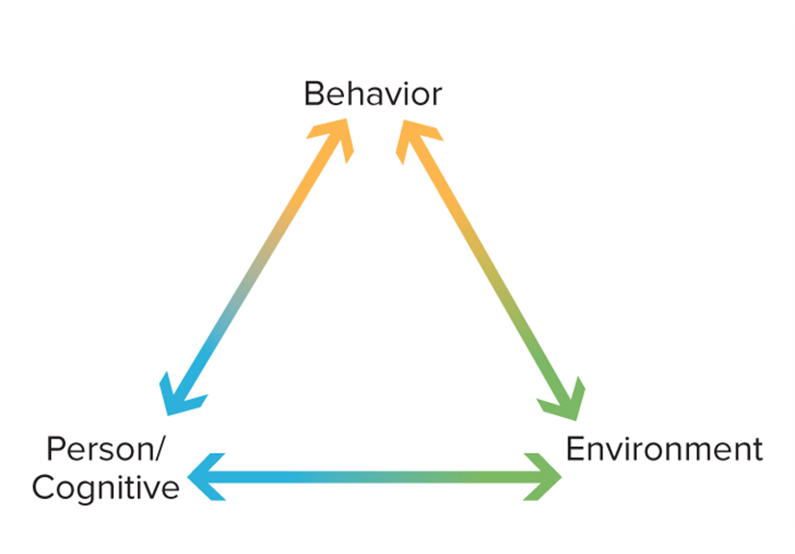
FIGURE 8 BANDURA’S SOCIAL COGNITIVE THEORY
Bandura’s social cognitive theory emphasizes reciprocal influences of behavioral, environmental, and person/cognitive factors.

Slide 125
Evaluating Behavioral and Social Cognitive Theories
Contributions:
An emphasis on scientific research.
An emphasis on environmental determinants of behavior.
Criticisms:
Too little emphasis on cognition in Skinner’s views.
Inadequate attention given to developmental changes.

Slide 126
Ecological Theory 1
Bronfenbrenner’s ecological theory: development reflects the influence of five environmental systems:
Microsystem: the setting in which the adolescent lives.
Mesosystem: relations between microsystems or connections between contexts.
Exosystem: links between a social setting in which the adolescent does not have an active role and the individual’s immediate context.
Macrosystem: the culture in which adolescents live.
Chronosystem: the patterning of environmental events and transitions over the life course, as well as sociohistorical circumstances.

Slide 127
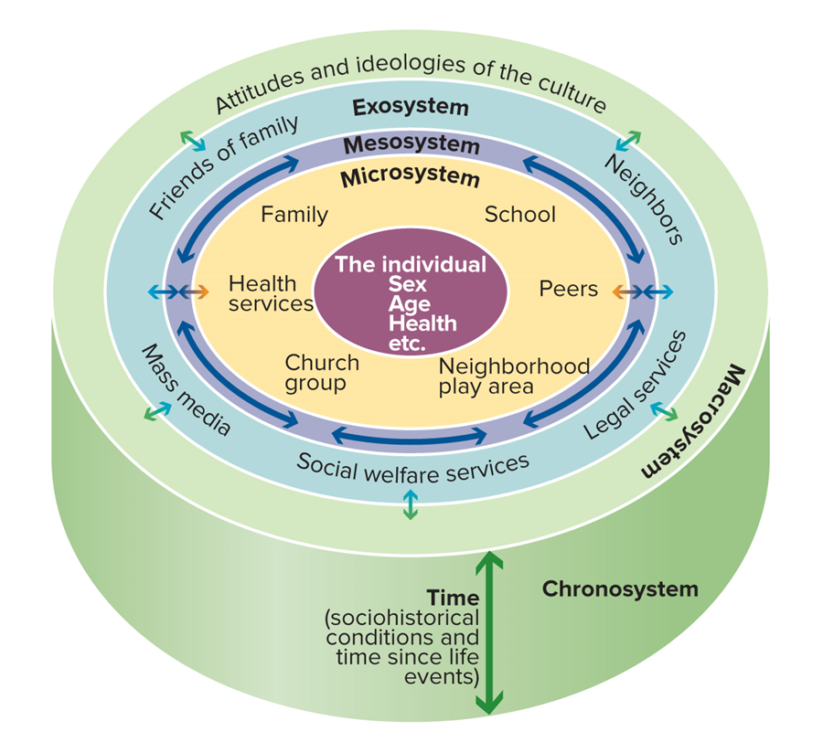
FIGURE 9 BRONFENBRENNER’S ECOLOGICAL THEORY OF DEVELOPMENT
Bronfenbrenner’s ecological theory consists of five environmental systems: microsystem, mesosystem, exosystem, macrosystem, and chronosystem.
Access the text alternative for slide images.

Slide 128
Ecological Theory 2
Bronfenbrenner has added biological influences to his theory and describes the newer version as bioecological theory.
Ecological, environmental contexts still predominate.
Contributions of the theory:
A systematic examination of macro and micro dimensions of environmental systems.
Attention to connections between environmental systems.
Criticisms of the theory:
Inadequate attention to biological and cognitive factors.

Slide 129
An Eclectic Theoretical Orientation
No single theory can entirely explain the rich complexity of adolescent development, but each has contributed to our understanding of development.
Although theories are helpful guides, relying on a single theory to explain adolescent development is probably a mistake.
Eclectic theoretical orientation: an orientation that does not follow any one theoretical approach but rather selects from each theory whatever is considered its best features

Slide 130
Research in Adolescent Development
Generally, research in adolescent development is designed to test hypotheses, which in some cases are derived from the theories just described.
Through research, theories are modified to reflect new data, and occasionally new theories arise.
In the 21st century, research on adolescent and emerging adult development has expanded a great deal.
Research has increasingly examined applications to the real worlds of adolescents.
Current research trends are searching for ways to improve the health and well-being of adolescents.

Slide 131
Methods for Collecting Data: Observation 1
To be effective, observations have to be systematic.
When we observe scientifically, we often need to control certain factors that determine behavior but are not the focus of our inquiry.
For this reason, some research is conducted in a laboratory, a controlled setting with many of the complex factors of the “real world” removed.

Slide 132
Methods for Collecting Data: Observation 2
Drawbacks to observation:
It is almost impossible to conduct research without the participants knowing they are being studied.
The laboratory setting is unnatural and can cause participants to behave unnaturally.
People who are willing to come to a university laboratory may not fairly represent groups from diverse cultural backgrounds.
Naturalistic observation: observing behavior in real-world settings, making no effort to manipulate or control the situation
Provides insights sometimes not possible in the laboratory.

Slide 133
Methods for Collecting Data: Survey and Interview
Sometimes the best and quickest way to get information from adolescents is to ask them, and one technique is to interview them directly.
The survey (or questionnaire) is especially useful when information from many people is needed .
Surveys and interviews can be used to study a wide range of topics.
One problem is the tendency of participants to answer questions in a way they think is socially acceptable or desirable rather than sharing what they truly think or feel.

Slide 134
Methods for Collecting Data: Standardized Test
Standardized test: a test with uniform procedures for administration and scoring
Many standardized tests provide information about individual differences among people because they allow a person’s performance to be compared with the performance of others.
One criticism is that they assume a person’s behavior is consistent and stable, yet personality and intelligence—two primary targets of standardized testing—can vary with the situation.

Slide 135
Methods for Collecting Data: Physiological Measures
Physiological measures are increasingly used to study development at different points in the life span.
One type involves an assessment of hormones in the bloodstream.
Body composition is also a focus of physiological assessment.
Until recently, little research had focused on the brain activity of adolescents.
The development of neuroimaging techniques has led to a flurry of research studies.
In magnetic resonance imaging (MRI), radio waves are used to construct images of a person’s brain tissue and biochemical activity.

Slide 136
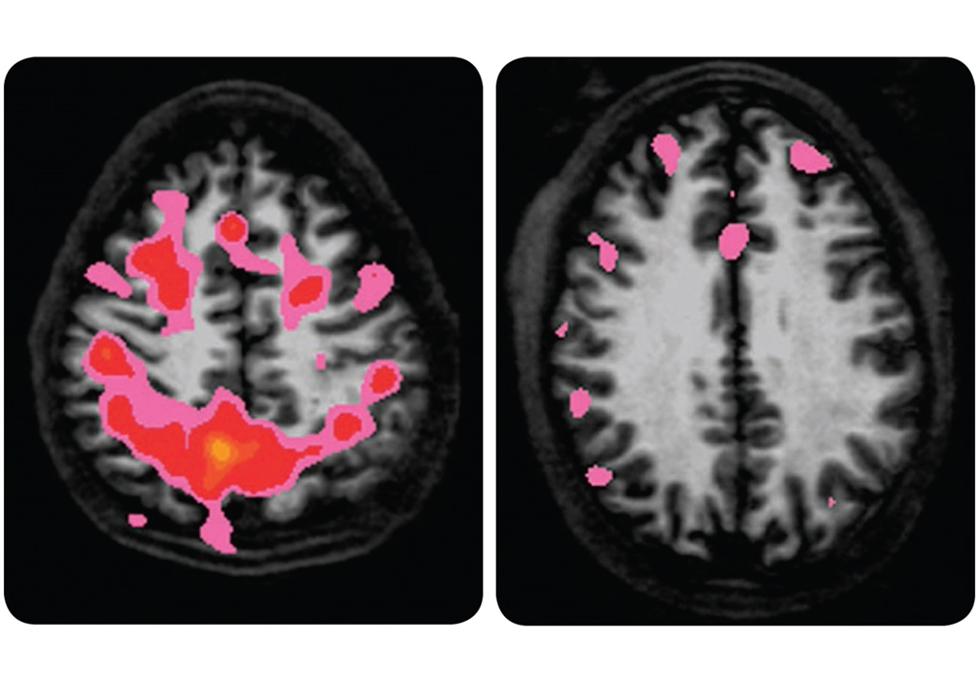
FIGURE 10 BRAIN IMAGING OF 15-YEAR-OLD ADOLESCENTS
The two brain images indicate how alcohol can influence the functioning of an adolescent’s brain. Notice the pink and red coloring (which indicates effective brain functioning involving memory) in the brain of the 15-year-old nondrinker (on the left) while engaging in a memory task, and the lack of those colors in the brain of the 15-year-old under the influence of alcohol (on the right).
Access the text alternative for slide images.
(both): Dr. Susan F. Tapert, University of California, San Diego

Slide 137
Methods for Collecting Data: Experience Sampling
In the experience sampling method (ESM), participants in a study are given electronic pagers, and researchers “beep” them at random times.
When beeped, participants report on various aspects of their immediate situation, including where they are, what they are doing, whom they are with, and how they are feeling.
Using this method, Reed Larson and Maryse Richards found that, across the thousands of times they reported their feelings, adolescents experienced emotions that were more extreme and more fleeting than those of their parents.

Slide 138
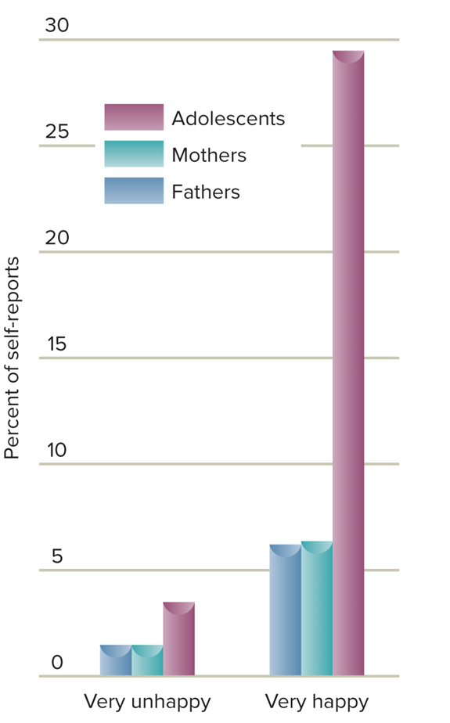
FIGURE 11 SELF-REPORTED EXTREMES OF EMOTION BY ADOLESCENTS, MOTHERS, AND FATHERS USING THE EXPERIENCE SAMPLING METHOD
Access the text alternative for slide images.

Slide 139
Methods for Collecting Data: Case Study
A case study is an in-depth look at a single individual.
Performed mainly by mental health professionals, when for practical or ethical reasons the unique aspects of an individual’s life cannot be duplicated and tested in others.
Although they provide dramatic, in-depth portrayals of people’s lives, we must be cautious in generalizing from them.
The subject of a case study is unique, with a genetic makeup and personal history that no one else shares.
Case studies involve judgments of unknown reliability.
Psychologists who conduct case studies rarely check to see whether other psychologists agree with their observations.

Slide 140
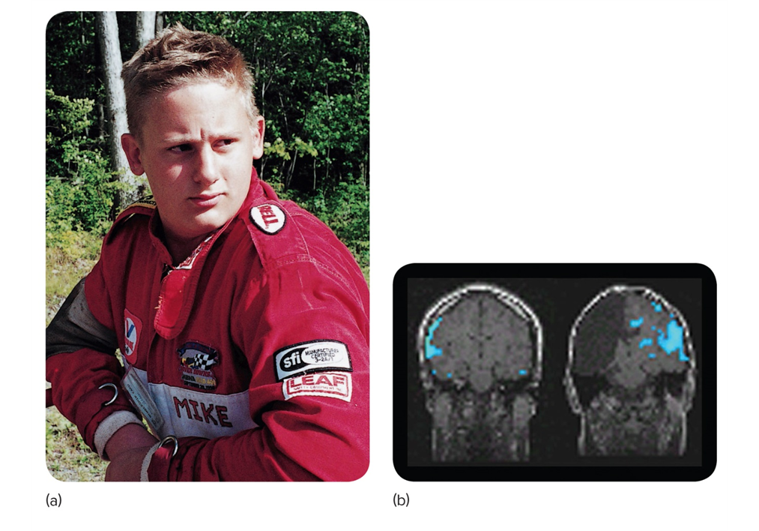
FIGURE 12 PLASTICITY IN THE BRAIN’S HEMISPHERES
(a) Michael Rehbein at 14 years of age. To stop his uncontrollable seizures, doctors had removed the left hemisphere of his brain.
(b) Michael’s right hemisphere (right) has reorganized to take over the language functions normally carried out by corresponding areas in the left hemisphere of an intact brain (left). However, the right hemisphere is not as efficient in processing speech as the left, and more areas of the brain are recruited to process speech.
Access the text alternative for slide images.
(both): Courtesy of The Rehbein Family

Slide 141
Research: Descriptive and Correlational 1
All the data collection methods discussed so far can be used in descriptive research, which aims to observe and record behavior.
By itself, descriptive research cannot prove what causes some phenomena, but it can reveal important information about people’s behavior.

Slide 142
Research: Descriptive and Correlational 2
Correlational research: research whose goal is to describe the strength of the relationship between two or more events or characteristics
In contrast with descriptive research, correlational research goes beyond describing phenomena to provide information that will help us to predict how people will behave.
The more strongly two events or characteristics are correlated, the more effectively we can predict one event from the other.

Slide 143
Research: Descriptive and Correlational 3
Correlation coefficient: a number based on a statistical analysis that is used to describe the degree of association between two variables
The correlation coefficient ranges from −1.00 to +1.00.
A negative number means an inverse relationship.
A positive number means a direct relationship.
The higher the correlation coefficient (whether positive or negative), the stronger the association between the two variables.
A correlation of 0 means there is no correlation.
Correlation does not equal causation.

Slide 144
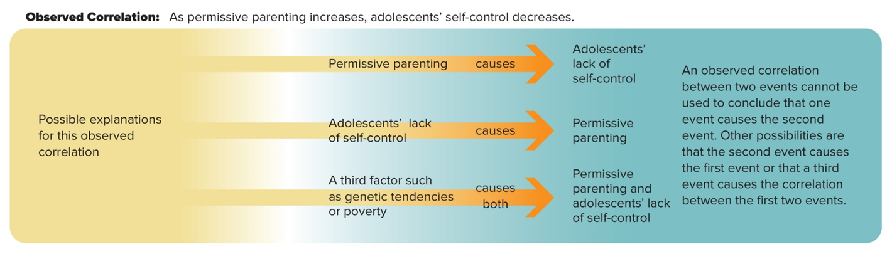
FIGURE 13 POSSIBLE EXPLANATIONS OF CORRELATIONAL DATA
Access the text alternative for slide images.

Slide 145
Research: Experimental 1
To study causality, researchers turn to experimental research: a carefully regulated procedure in which one or more factors believed to influence the behavior being studied are manipulated, while all other factors are held constant
Experiments demonstrate cause and effect.
Nonexperimental research methods (descriptive and correlational) cannot establish cause and effect because they do not involve manipulating factors in a controlled way.

Slide 146
Research: Experimental 2
All experiments involve at least one independent variable and one dependent variable.
Independent variable: the factor that is manipulated.
Dependent variable: the factor that is measured.
Researchers manipulate the independent variable by giving different experiences to one or more experimental groups and one or more control groups.
Experimental group: a group whose experience is manipulated.
Control group: a group that is treated like the experimental group in every other way except for the manipulated factor.

Slide 147
Research: Experimental 3
An important principle in experimental research is random assignment: assigning participants to experimental and control groups by chance.
Random assignment reduces the likelihood that the results will be affected by preexisting differences between the groups.

Slide 148
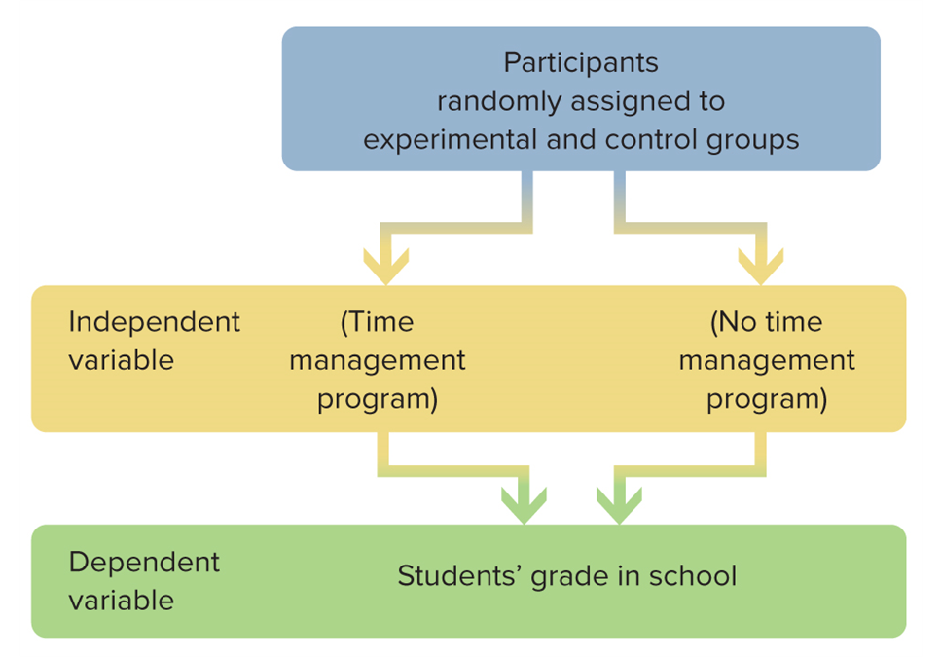
FIGURE 14 RANDOM ASSIGNMENT AND EXPERIMENTAL DESIGN
This figure applies the experimental research method to the problem of whether a time management program can improve adolescents’ grades.
Access the text alternative for slide images.

Slide 149
Time Span of Research 1
A special concern of developmentalists is the time span of a research investigation.
Studies that focus on the relation of age to some other variable are common.
In these cases, researchers have two options:
Study different individuals of varying ages and compare them.
Study the same individuals as they age over time.

Slide 150
Time Span of Research 2
Cross-sectional research: studying people all at one time
Advantages: researchers do not have to wait for the individuals to grow older
Drawbacks:
Gives no information about how individuals change or about the stability of their characteristics.
Increases and decreases of development can become obscured.

Slide 151
Time Span of Research 3
Longitudinal research: studying the same individuals over a period of time
Advantage: provides a wealth of information about such important issues as stability and change in development and the importance of early experiences for later development
Drawbacks:
Such studies are expensive and time-consuming.
The longer the study lasts, the more participants drop out.
Participants can bias the outcome of a study because those who remain may be dissimilar to those who drop out.

Slide 152
Conducting Ethical Research 1
Ethics in research pertain to the rights of the participant and the responsibilities of researchers to assure that these rights are safeguarded.
Proposed research at colleges and universities must pass the scrutiny of a research ethics committee.

Slide 153
Conducting Ethical Research 2
The American Psychological Association (APA) has developed ethics guidelines that instruct psychologists to protect their participants from mental and physical harm.
Four important issues are addressed:
Informed consent.
Confidentiality.
Debriefing.
Deception.

Slide 154
Minimizing Bias 1
Studies of adolescent development are most useful when they are conducted without bias or prejudice toward any particular group of people.
Gender bias: a preconceived notion about the abilities of females and males that prevents individuals from pursuing their own interests and achieving their potential
Too often researchers have drawn conclusions about females’ attitudes and behaviors from research conducted with males as the only participants.
When gender differences are found, they are sometimes unduly magnified.

Slide 155
Minimizing Bias 2
Researchers are also increasingly aware of the problems of cultural and ethnic bias.
Historically, members of ethnic minority groups have been discounted from most research in the United States and simply thought of as variations from the norm or average.
It could be concluded that adolescents’ real lives are perhaps more varied than research data have indicated in the past.
Researchers have tended to overgeneralize about ethnic groups.
Ethnic gloss: using an ethnic label such as African American or Latinx in a superficial way that portrays an ethnic group as being more homogeneous than it really is.

Slide 156
Minimizing Bias 3
Future research needs to take into account the acculturation level and generational status of minority children and families in the United States.
More attention needs to be given to biculturalism, because many immigrant children and adolescents identify with two or more ethnic groups.

Slide 157
Questions?
Historical perspectives on adolescence
The experiences of adolescents in the United States and around the world
The developmental processes, periods, transitions, and issues related to adolescence
The science of adolescent development

Slide 158
End of Main Content
© McGraw Hill LLC. All rights reserved. No reproduction or distribution without the prior written consent of McGraw Hill LLC.

