Slide 1


Psychology
132
M. Hines
Professor of Psychology
Chapter 2

Slide 2
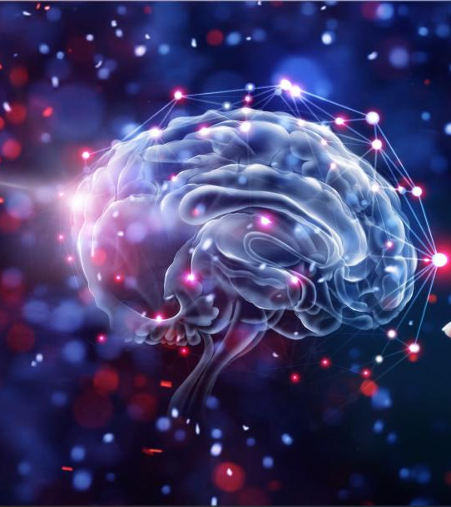
Brain and Behavior

Slide 3
Icebreaker
Do you know someone who has had a concussion? More than one?
What are the long-term ramifications of repeated concussions and other brain injuries?
Do you feel the opportunity to play a professional sport is worth the chance of sustaining such an injury? Why or why not?

Slide 4
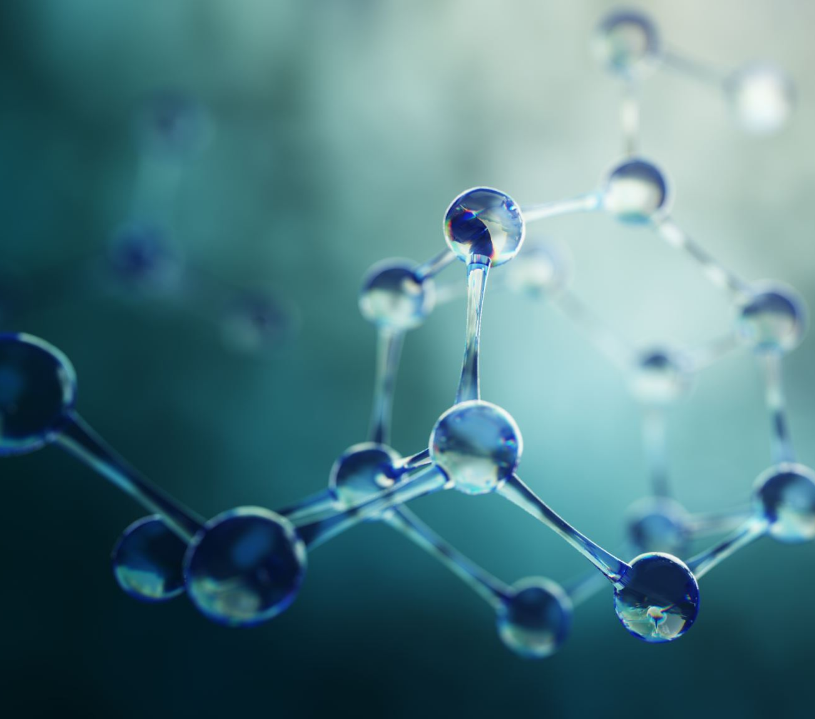
The Nervous System
Sect. 2.1

Slide 5
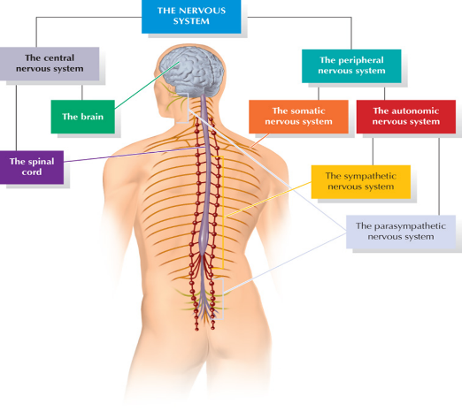
The Nervous System—An Overview
Two main branches:
The central nervous system consists of the brain, which contains the majority of your neurons, and the spinal cord, which transmits information.
The peripheral nervous system is composed of the nerves connecting the body to the central nervous system.

Slide 6
Branches of the Nervous System
Both the brain and the spinal cord are protected by bone: the brain by the bones of the skull, and the spinal cord by vertebrae , a set of ring-shaped bones. They're both cushioned by layers of membranes (called meninges) and cerebrospinal fluid. The fluid flows through hollow spaces in the brain called ventricles and around the spine in the spinal column. It protects the central nervous system, nourishes it, and takes away waste products.

Slide 7
Branches of the Nervous System
Central Nervous System:
  Brain
    Neurons:
      single cells that are responsible for receiving sensory input from the external world,
      for sending motor commands to our muscles
      for transforming and relaying the electrical signals at every step in between.
  Spinal Cord:
    Column of spinal nerves
    Carries messages from the brain to the rest of the body

Slide 8
Branches of the Nervous System
What Does the Central Nervous System Do?
The brain is like a central computer that controls all the body's functions. It is in charge of what we think and feel, how we learn and remember, and the way we move and talk. It also controls things we're less aware of — like the beating of our hearts and the digestion of our food. The brain sends messages back and forth with the body. These messages travel through the spinal cord.

Slide 9
Branches of the Nervous System
What Are the Parts of the Spinal Cord?
The spinal cord is a long bundle of nerve tissue. In an adult, it's about 18 inches long and 1/2-inch thick. It extends from the lower part of the brainstem down the back.
The spinal cord has three sections that run the length of the spine. Each section's name describes the part of the spine it passes through: cervical (SER-vih-kul), thoracic (theh-RAH-sik), and lumbar-sacral (LUM-ber SAK-rul). They send off smaller nerves to parts of the body nearby:

Slide 10
Branches of the Nervous System
Neurons
Neurons are the building blocks of the central nervous system. Billions of these nerve cells can be found throughout the body and communicate with one another to produce physical responses and actions.
Most neurons are divided into three basic sections: dendrites, cell body, and axon. These cells also differ in terms of function. The three types of neurons are afferent neurons, efferent neurons, and interneurons.
Efferent neurons are motor neurons that carry signals from the brain to the peripheral nervous system. Afferent neurons are sensory neurons that bring information from the senses to the brain. Interneurons are association neurons that connect efferent and afferent neurons to the central nervous system.

Slide 11
Neurons: The Building Blocks of the Nervous System
Neurons have four basic parts:
Dendrites: Neuron fibers that receive messages
Cell body (soma): Receives information from dendrites
Axon: Fiber that carries information from cell body of a neuron
Axon terminals: Located at ends of axons to form synapses with the dendrites and cell bodies of other neurons

Slide 12
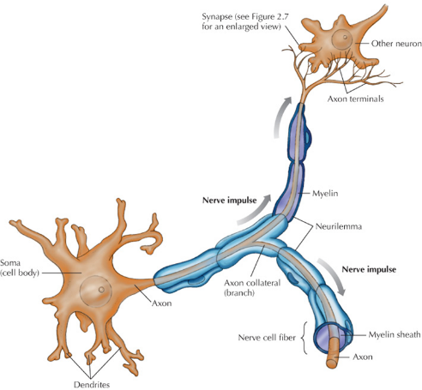
How Neurons Work: Action Potentials (1 of 2)
Electrically charged molecules (ions) found in and outside of each neuron
Some have positive charge, others negative
When neuron is inactive, more positive charges exist outside the neuron and more negative charges exist inside

Slide 13
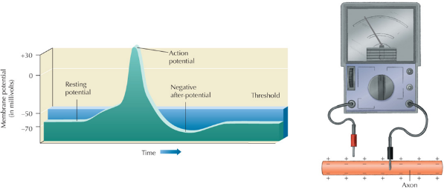
How Neurons Work: Action Potentials (2 of 2)
Myelin sheath: Insulating material that coats some axons to help neurons move rapidly down the axon
Ion channel: Functions like tiny gate in the axon membrane
Resting potential
Threshold
Action potential

Slide 14
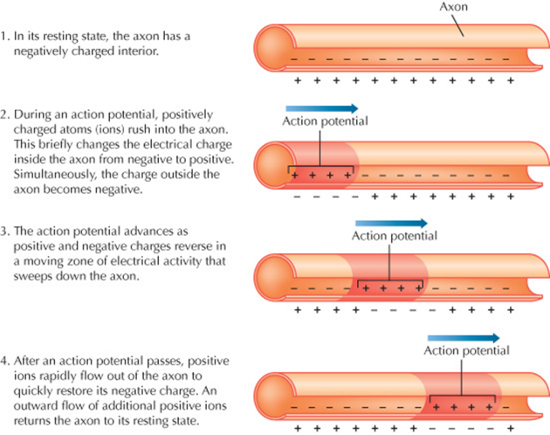
The Action Potential

Slide 15
Neurotransmitters
Can change likelihood of action potential by exciting or inhibiting neurons
Variations in function may be related to temperament differences in infancy and personality differences in adulthood.
Neuropeptides: Regulate activity of other neurons
Affect memory pain, emotion, and other basic processes
Enkephalins: Neural regulators that relieve pain and stress
Endorphins: Released by pituitary gland to reduce pain

Slide 16
Branches of the Nervous System
Peripheral Nervous System:
  Nervous systems outside of the brain and spinal cord
    Somatic Nervous System
      Connects the spinal cord with sense organs.
      Controls voluntary behavior
  Nerves inside the Spinal Cord:
    Column of spinal nerves
    Carries messages from the brain to the rest of the body

Slide 17
Branches of the Nervous System
Your peripheral nervous system (PNS) is one of two main parts of your body’s nervous system.
Your PNS feeds information into your brain from most of your senses. It carries signals that allow you to move your muscles.
Your PNS also delivers signals that your brain uses to control vital, unconscious processes like your heartbeat and breathing.

Slide 18
Branches of the Nervous System
What does the peripheral nervous system do?
Your peripheral nervous system has two main subsystems: autonomic and somatic.
Autonomic: These are nervous system processes your brain runs automatically and without you thinking about them.
Somatic: These are functions you manage by thinking about them.

Slide 19
Branches of the Nervous System
Those two subsystems are how your peripheral nervous system does its three main jobs:
Senses: Your PNS is a key part of how your brain gets information about the world around you. This job falls under the somatic nervous system.
Movement: Your peripheral nerves deliver command signals to all the muscles in your body that you can consciously control. This job also falls under the somatic nervous system.
Unconscious processes: This is how your brain runs critical processes that don’t depend on your thinking about them. Examples of this include heartbeat and blood pressure. This job depends on your autonomic nervous system.

Slide 20
Branches of the Nervous System
Senses
Your peripheral nervous system is how your brain gets information about the outside world. Most of your peripheral nervous system travel to the rest of your body by exiting or entering your spinal cord. Your cranial nerves are unlike other peripheral nerves in that these very special nerves connect directly to your brain. These nerves carry signals from your nose, ears and mouth, as well as many other organs. Your cranial nerves also give you a sense of touch in the skin of your face, head and neck.
Other peripheral nerves intertwine throughout every part of your body. They stretch out everywhere, including to the tips of your fingers and toes. The sensory nerves in your hands and feet are also part of your brain’s ability to get information from the outside world. The motor nerves allow you to move various parts of your body.

Slide 21
Branches of the Nervous System
Movement
Your peripheral nerves that branch outward throughout your body deliver command signals from your brain to your muscles. That allows you to move around and do all kinds of tasks, ranging from simple ones, like scratching your nose, to complicated ones, like juggling.

Slide 22
Branches of the Nervous System
Unconscious processes
Your autonomic nervous system functions without you thinking about it. Part of your brain is always working, managing processes that keep you alive. Your brain needs your peripheral nervous system to control those functions. Examples of these processes include your heart rate, breathing, blood pressure and your gut’s digestion of food.

Slide 23
Neuroplasticity and Neurogenesis
Neuroplasticity: Capacity of nervous system to change in response to experience
Neurogenesis: Production of new brain cells
New cells link up with other cells
Involved in learning, memory, and ability to adapt to changing circumstances

Slide 24
Neuroplasticity and Neurogenesis
Neuroplasticity: Neuroplasticity is the brain’s capacity to continue growing and evolving in response to life experiences. Plasticity is the capacity to be shaped, molded, or altered; neuroplasticity, then, is the ability for the brain to adapt or change over time, by creating new neurons and building new networks.
The importance of neuroplasticity can’t be overstated: It means that it is possible to change dysfunctional patterns of thinking and behaving and to develop new mindsets, new memories, new skills, and new abilities.

Slide 25
Neuroplasticity and Neurogenesis
Neurogenesis: Neurogenesis is the process by which new neurons are formed in the brain through pre-natal development and as adults.
Neurogenesis was traditionally believed to only occur during embryonic development, which is now understood not to be the case.

Slide 26

Think and Write
Describe the central and peripheral systems and what they are responsible for.

Slide 27
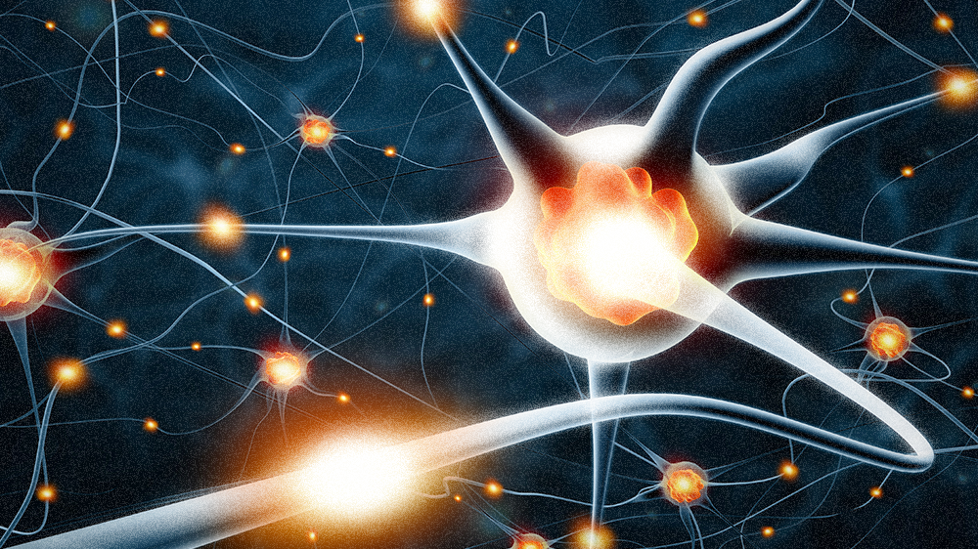

Slide 28
Brain Research
Sect. 2.2

Slide 29
Brain Research
CT Scans: Takes images of the brain from different angles.
A CT scan is a diagnostic imaging procedure that uses a combination of X-rays and computer technology to produce images of the inside of the body. It shows detailed images of any part of the body, including the brain, bones, muscles, fat, organs and blood vessels.
MRI Scans: Provides a detailed image inside the body including the brain without radiation.
Uses magnetic fields and computer generated radio waves.

Slide 30
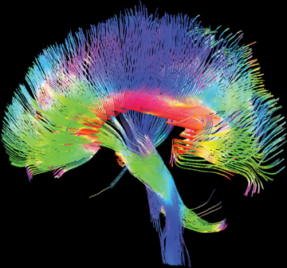
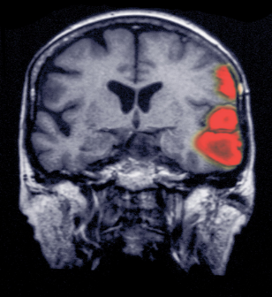
Exploring Brain Structure
Computed tomography (CT) scans: Computer enhanced X-ray image
Magnetic resonance imaging (MRI): Three-dimensional images are produced

Slide 31
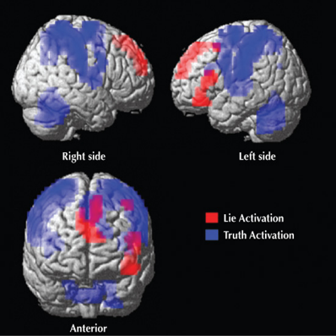
Exploring Brain Function
Electroencephalography (EEG): Measure waves of electrical activity near surface of brain
Positron emission tomography (PET): Uses radioactive particles to capture brain activity
Functional MRI (fMRI): Shows whether a person is lying

Slide 32
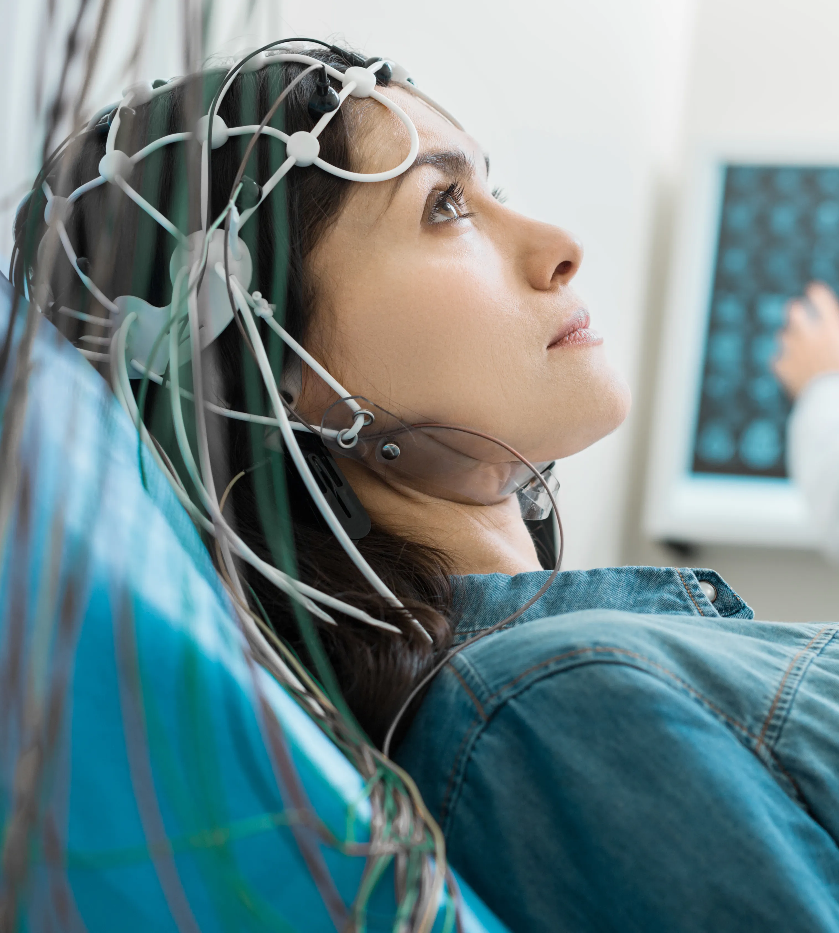
EEG
The electroencephalogram (EEG) is a medical test used to measure the electrical activity of the brain. A number of electrodes are applied to your scalp. EEG can help diagnose a number of conditions including epilepsy, sleep disorders and brain tumors.

Slide 33
EEG
An EEG might also be helpful for diagnosing or treating:
Brain tumors.
Brain damage from head injury.
Brain dysfunction that can have a variety of causes (encephalopathy)
Sleep disorders.
Inflammation of the brain (herpes encephalitis)
Stroke.
Sleep disorders.
Creutzfeldt-Jakob disease.

Slide 34
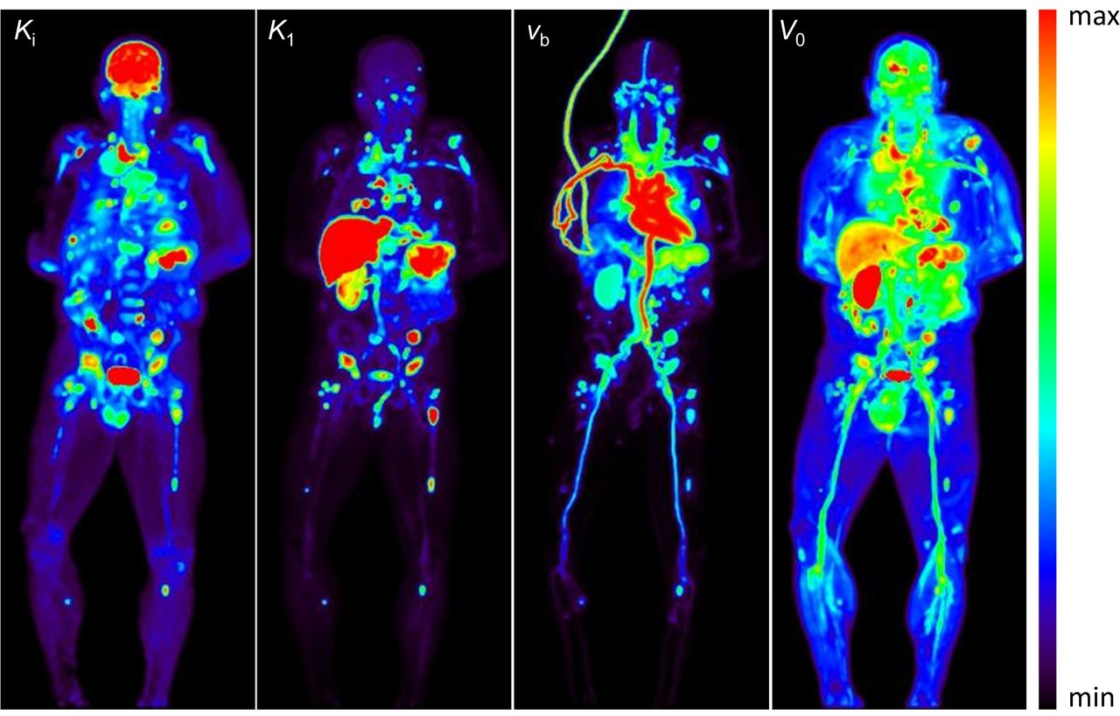
PET Scan
A positron emission tomography (PET) scan is a type of imaging test. It uses a radioactive substance called a tracer to look for disease in the body. A PET scan shows how organs and tissues are working. This is different than MRI and CT scans. These tests show the structure of, and blood flow to and from organs.

Slide 35
PET Scan
A PET scan is an effective way to help discover a variety of conditions, including cancer, heart disease and brain disorders. Your health care provider can use this information to help diagnose, monitor or treat your condition

Slide 36
MRI
What is MRI? Magnetic resonance imaging, or MRI, is a noninvasive medical imaging test that produces detailed images of almost every internal structure in the human body, including the organs, bones, muscles and blood vessels. MRI scanners create images of the body using a large magnet and radio waves.

Slide 37
The Cerebral Cortex
Sect. 2.3

Slide 38
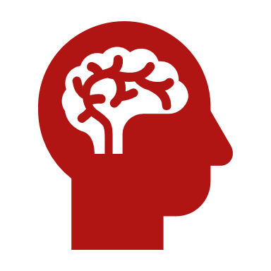
The Cerebral Cortex: the thin outer covering of the brain. It is responsible for higher level thinking skills.

Slide 39
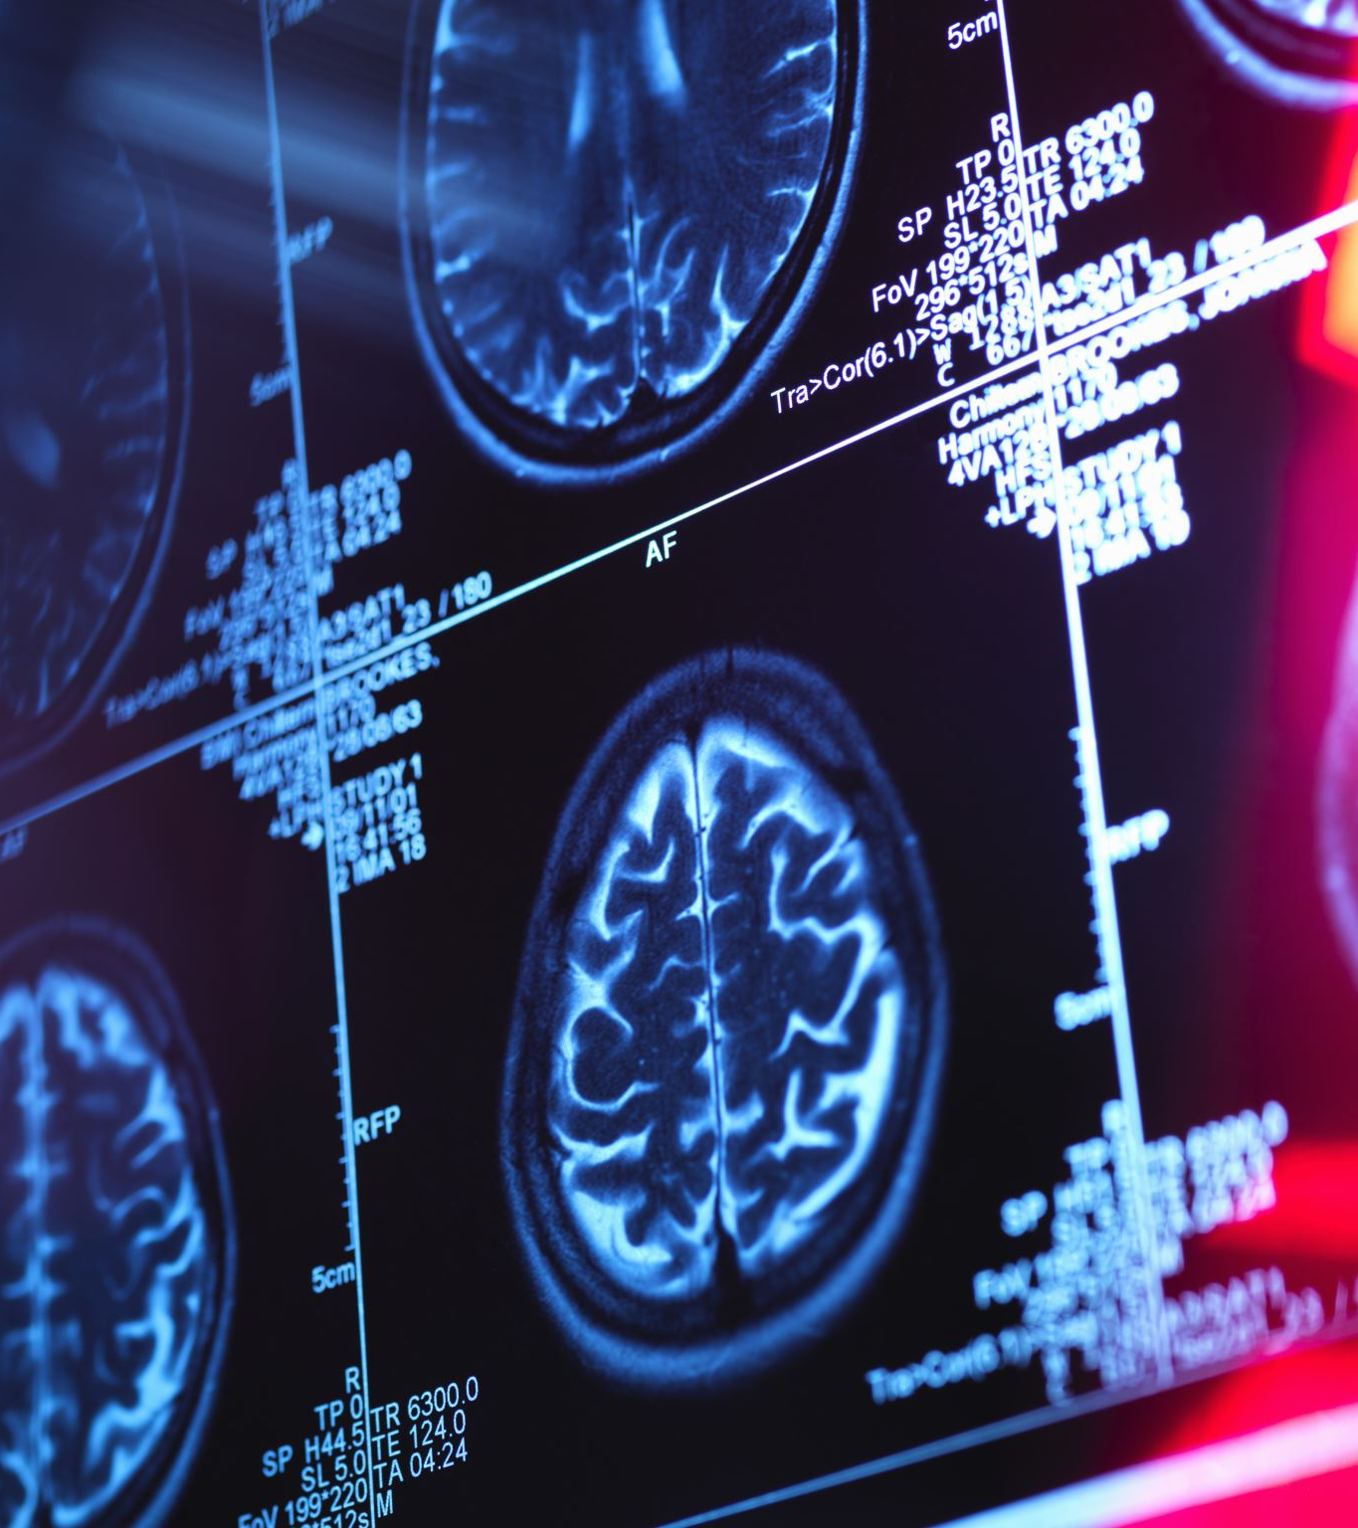
Your cerebral cortex consists of six layers of nerve cells that contain between 14 billion and 16 billion nerve cells. It’s two millimeters (mm) to four mm (0.08 inches to 0.16 inches) thick.
Your cerebral cortex is responsible for the higher-level processes of the human brain, including language, memory, reasoning, thought, learning, decision-making, emotion, intelligence and personality.

Slide 40
FYI
Why is the cerebral cortex called gray matter?
The gray matter found in the outer layer of your brain consists of nerve cell bodies, including the end portion of nerves called dendrites. Dendrites are the part of a nerve cell that receives the chemical message from another cell. Your cerebral cortex is gray because that section of the nerve lacks the fatty covering material called myelin.
White matter in your brain is made up of bundles of axons, the long center section of a nerve cell that’s wrapped in myelin. The myelin gives the tissue its whitish color.

Slide 41
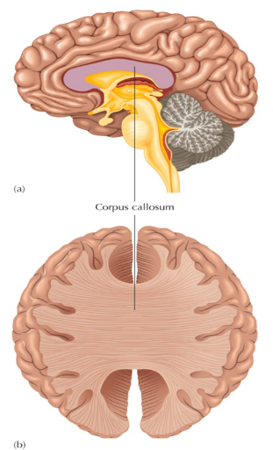
The Cerebral Hemispheres
Cerebral cortex is composed of two hemispheres
Cerebral hemispheres connected by thick axon fibers called corpus callosum
Lateralization: Specialization in abilities of the left and right hemisphere

Slide 42
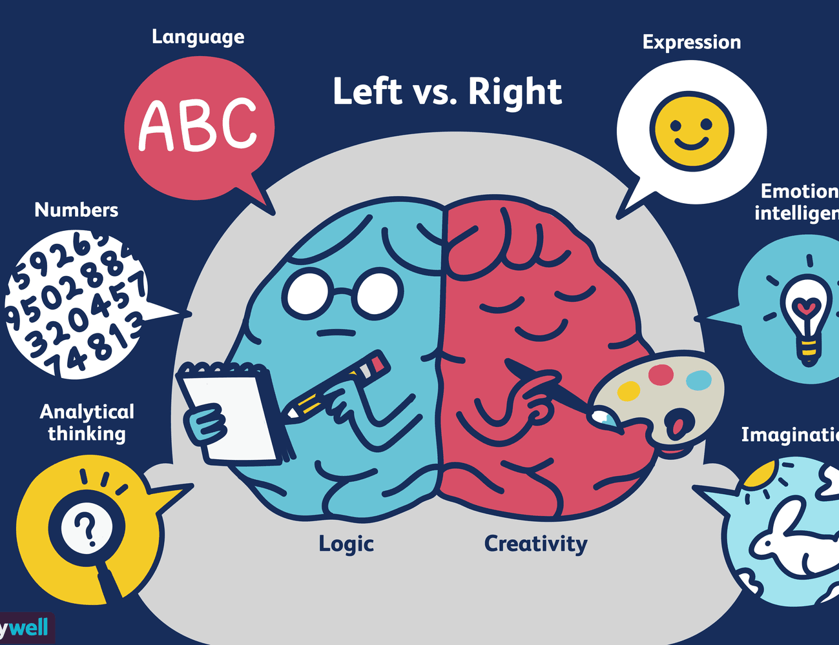
The Cerebral Hemispheres
Left hemisphere
Right Hemisphere

Slide 43
Hemispheric Lateralization
There are two sides to the brain. The left and right hemispheres.
The left hemisphere controls movement on the right side of the body.
The right hemisphere controls movement on the left side of the body.

Slide 44
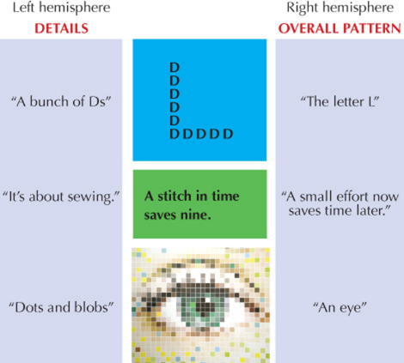
Hemispheric Lateralization (1 of 2)
Lateralization: One hemisphere controls physical movement of the opposite side of the body.
Left hemisphere (analysis): About 95 percent use for language, math, judging time and rhythm, order of small complex movements
Right hemisphere (world view): Big picture, perceptual skills

Slide 45
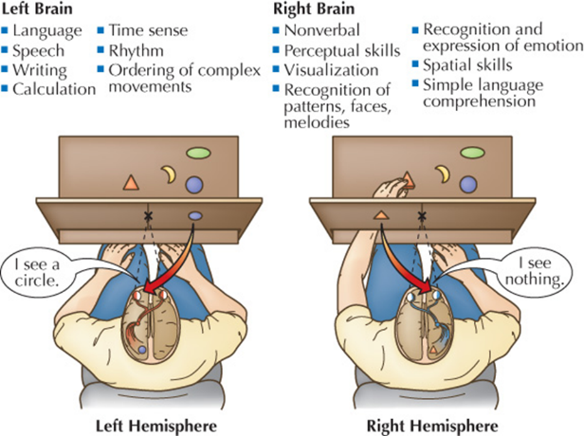
Hemispheric Lateralization (2 of 2)
Split-brain operation
Some tasks make more use of one hemisphere or the other.
For most real-world activities, the hemispheres share the work.

Slide 46
Hemispheric Dominance
Creates handedness (left- or right-hand preference)
70 percent of left-handers process speech in same manner as right-handers
Mixed dominance is common
People also have mixed preference for using left or right feet, eyes, and ears

Slide 47
Left brain
Most people use their left brain for speaking, writing and understanding.
Analyzing information
The left side of the brain often contains language-processing regions such as Broca’s Area, which produces understandable sentences, as well as Wernicke’s area, which understands speech.

Slide 48
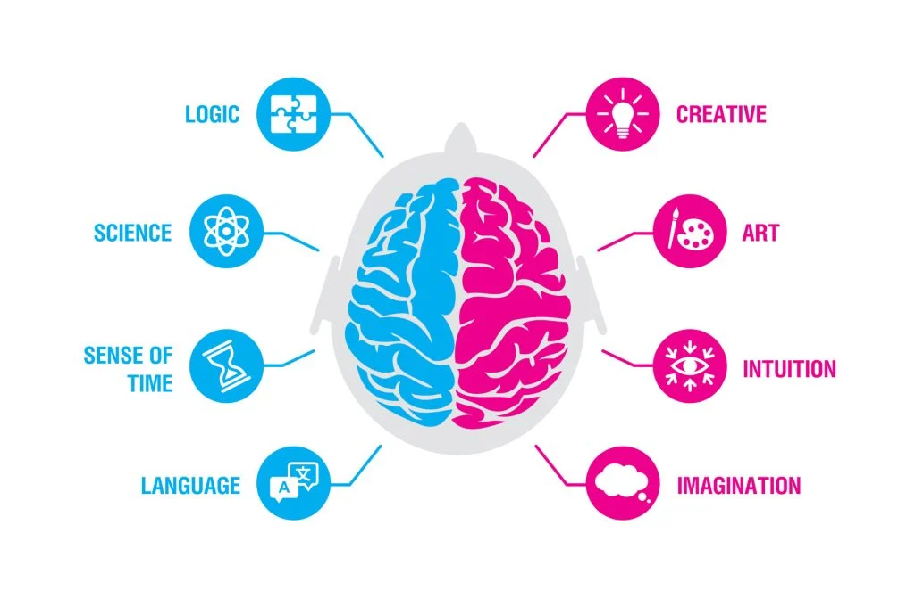
Right brain
Produces only simple language
Utilizes non-verbal responses
Used for seeing the big picture
Better at visual and spatial processing

Slide 49
Train Your Brain
Right Brain: How to Apply
If you’re right-handed (like most people are), take a pen in your left hand. If you are already left-handed, you can apply this exercise to your right hand as a left brain stimulation.
Write a question down with your dominant hand.
Answer the question with your non-dominant hand. Don’t worry about keeping your lines neat.
Benefits
This activity performs as a left or right brain stimulation depending on your handedness. It forces you to use both sides, so it is one of the best brain exercises to connect the left and right brains.

Slide 50
Train Your Brain
Left Brain: How to Apply
Left Brain Exercises
Left brain development methods often remind us of the lessons we take in schools. Math, science or grammar classes are usually good to improve the left side of the brain.
Here are some of the left brain exercises:
1. Puzzles
Sudoku, crossword, scavenger hunt, you name it! These brain puzzle games are perfect for left-brain stimulation!
How to Apply
Each puzzle will have its own set of rules. Try to solve a puzzle a day!
Benefits
Puzzle solving requires logical thinking which the left side of the brain is responsible for. Plus, these activities are perfect for enhancing attention skills

Slide 51
Think and Write
Research other activities to train the different sides of the brain, Use the internet for ideas. Be specific and include the benefits.

Slide 52
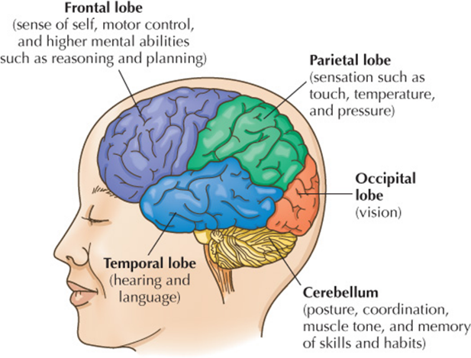
Lobes of the Cerebral Cortex

Slide 53
Frontal Lobes
Associated with movement, sense of self and higher mental functions

Slide 54
The Frontal Lobes (1 of 2)
Associated with movement, sense of self, and higher mental functions
Prefrontal cortex: Responsible for the executive function; higher-level mental processes that allow for regulation and coordination of thought processes
Association areas: Combine and process information
Damage may result in aphasia, including the Broca’s area, which causes motor, or expressive aphasia. Broca’s area relates to grammar and pronunciation.
***aphasia - loss of ability to process and understand speech

Slide 55
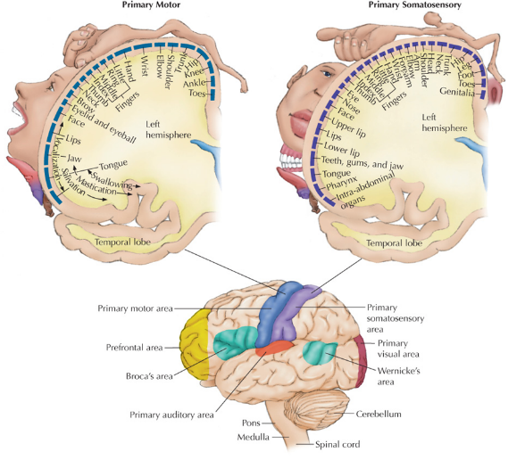
The Frontal Lobes (2 of 2)
Primary motor area: Directs body’s muscles, controls movement
Mirror neurons: Active when we perform an action and when observing others doing same action

Slide 56
Lobes of the Cerebral Cortex
Located at the front of the forehead
Associated with ‘higher’ cognitive functions, including decision-making, problem-solving, thought, and attention.
Also associated with movement, personality, emotions, self control, motor control
The frontal lobe does not fully develop until the age of around 23-24 years.

Slide 57
Frontal Lobes..cont.
delayed development is held responsible for neurobehavioral excitement including euphoria and risk-taking behavior.
Dopamine emission, particularly in the prefrontal area, is developmentally regulated by sex hormones and is implicated in drug-seeking behavior during adolescence.
Thus, brain development in critical areas is an ongoing process during adolescence.

Slide 58
Frontal Lobes..cont.
Special areas of note within this lobe are the motor cortex, the prefrontal cortex and Broca’s area. Your motor cortex is responsible for body movement. Your prefrontal cortex is in charge of “executive functions,” such as thinking and problem-solving. It also supervises and directs other areas of your brain. Broca’s area is a part of your frontal lobe that’s involved with speech production.

Slide 59
Parietal Lobes
Associated with movement, sense of self and higher mental functions

Slide 60
Parietal Lobe
Located just behind the frontal lobe.
Responsible for sensations such as touch, temperature, pressure.
Sends sensory information to your brain so you can respond.

Slide 61
Parietal Lobe
Self-perception
Your parietal lobe is a processing center for sensations you can feel with your sense of touch. These include temperature (hot and cold), pressure, vibration and pain.
Self-perception also uses your sense of touch to tell you where parts of your body are without needing to see them (the technical term for this is “proprioception”). A good way to test this is to close your eyes and bring the palm of your hand up to your face. Even with your eyes closed, you can usually tell the approximate position of your hand (and avoid smacking yourself in the face).

Slide 62
Parietal Lobe
Learned movements
Your parietal lobe also helps you learn each time you plan and carry out complex, precise movements. A big example of this is writing. That’s why writing gets easier with practice. The same is true of similar activities like doing math by hand.
Location awareness
Your parietal lobe plays a key role in how you understand where things are around you. Knowing if something is on your left or right side, for example, is a function that relies on your parietal lobe.

Slide 63
Parietal Lobe
Functions of the parietal lobe
Your parietal lobe is located between your frontal and occipital lobes and above your temporal lobe. Functions of your parietal lobe include:
Sensory information (touch, pressure, pain, position, vibration, temperature) processing.
Spatial processing and spatial manipulation. This is the ability to understand where you are in three-dimensional space, such as how to navigate around your home or town.

Slide 64
Parietal Lobe
Special areas of note within this lobe are the somatosensory cortex. It receives sensory information (“feeling” information) from all over your body. Here’s an example of how brain lobes work together:
The motor cortex in your brain’s frontal lobe sends the message that directs the muscles in your arm and hand to reach out toward a cup of soup on your kitchen table. The somatosensory cortex of your parietal lobe assesses the information delivered through your touch of the cup, including judgment of its temperature. Spatial processing in your parietal lobe allows you to grasp the cup, flawlessly navigating hand-to-cup distance relative to the table and other surrounding objects.

Slide 65
Temporal Lobes
Associated with LANGUAGE, MEMORY, HEARING, SOUND PRODUCTION, LEARNING

Slide 66
Temporal Lobe
Functions of the temporal lobe
Your temporal lobe is located between your frontal and occipital lobes and below your parietal lobe. Functions of your temporal lobe include:
Language comprehension, speech formation, learning.
Memory.
Hearing.
Nonverbal interpretation.
Sound-to-visual image conversion.
A special area of note within this lobe is Wernicke’s area. This area was more recently discovered to be involved in language comprehensive based on speech tones and sounds, linking them to previously learned sounds.

Slide 67
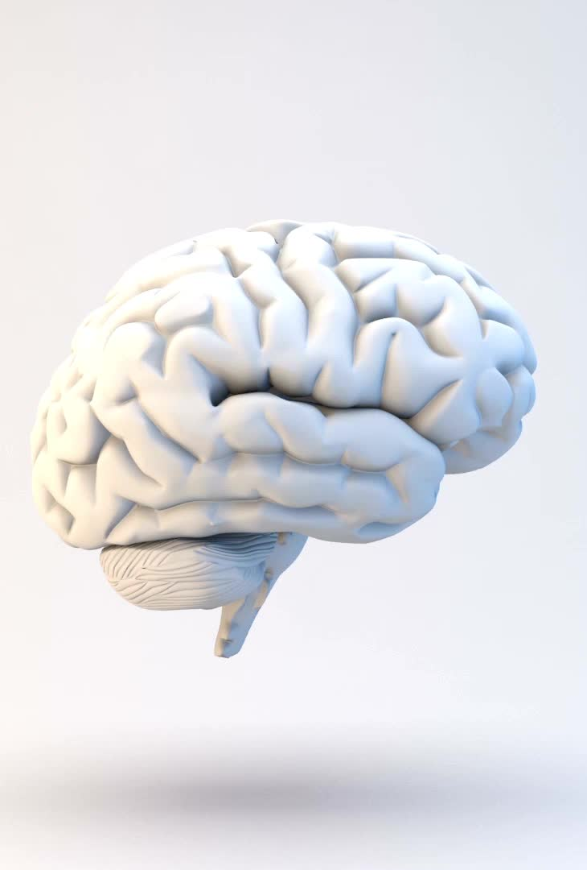
Temporal Lobe
Where is the temporal lobe located?
Like all lobes of your brain, your temporal lobe has left and right sides. The sides of your temporal lobes are the farthest apart of the brain lobes. Each temporal lobe is right behind the temple area on each side of your head, and the lobe extends backward along the side of your brain to a point just behind your ears.

Slide 68
OCCIPITAL LOBES
Associated with VISUAL PERCEPTION

Slide 69
Occipital Lobes
Functions of the occipital lobe
Your occipital lobe is at the back of your brain. Functions of your occipital lobe include:
Visual processing and interpretation.
Visual data collection regarding color, motion and orientation.
Object and facial recognition.
Depth and distance perception.
Visual world mapping.

Slide 70
Occipital Lobes
The main job of your occipital lobe is decoding the messages sent from your eyes and turning that information into forms the rest of your brain can use.
That job happens in two specific areas in your occipital lobe: the primary visual cortex and the secondary visual cortex. The term “cortex” comes from the Latin word for “tree bark,” and it describes the wrinkly-textured outer surface of your brain. The visual cortices (the plural of “cortex”) are parts of the cortex that process vision-related signals.

Slide 71
Occipital Lobes
How does the occipital lobe help other organs or body systems?
Your eyes detect what’s visible in the world around you and turn that information into signals that then travel to your brain. However, the occipital lobe is what takes those signals, processes them and then works cooperatively with other parts of your brain to use what you see.
One of the most important examples of this is reading. Your occipital lobe recognizes writing, and then it works with a part of your brain’s temporal lobe to recognize the written shapes and symbols. The temporal lobe then understands them as written language and processes the content.

Slide 72
Knowledge Check Activity
Which part of the brain is responsible for controlling the dexterity of our hands, such as our ability to hold a pencil or play a musical instrument?
Frontal lobe
Parietal lobe
Temporal lobe
Occipital lobe

Slide 73
Knowledge Check Activity: Answer
Which part of the brain is responsible for controlling the dexterity of our hands, such as our ability to hold a pencil or play a musical instrument?
Frontal lobe
Specifically, the primary motor area directs the body’s muscles. This directs the dexterity of the body areas, not muscle size. For example, more of the motor cortex is devoted to the hands.

Slide 74
The Subcortex and the Endocrine System
Sect. 2.4

Slide 75
Subcortex
The Subcortex is located below the cerebral cortex and completely covered by it. It can be divided into three general areas: (1) Brainstem or hindbrain; (2) Midbrain; and (3) forebrain.
A person can lose large portions of the cerebrum and still survive. As a matter of fact, If damage is limited to the less crucial areas of the cortex, little visible change may take place. This is not so of the subcortex. The areas here are so basic to normal functioning that damage may endanger a person's life.

Slide 76
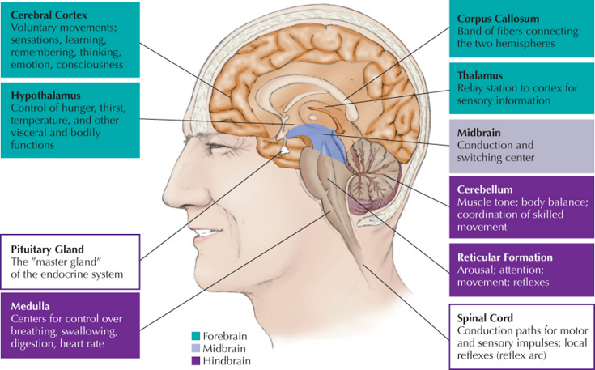
The Subcortex—An Overview

Slide 77
Hindbrain
1st layer: Hindbrain (three parts: medulla, reticular formation and cerebellum)
  Hindbrain: The hindbrain coordinates functions that are fundamental to survival, including respiratory rhythm, motor activity, sleep, and wakefulness.

Slide 78
Hindbrain
  The hindbrain is located at the lower back part of the brain and includes most of the brainstem (containing the medulla and pons), and the cerebellum. The hindbrain is located at the back of the head and looks like an extension of the spinal cord

Slide 79
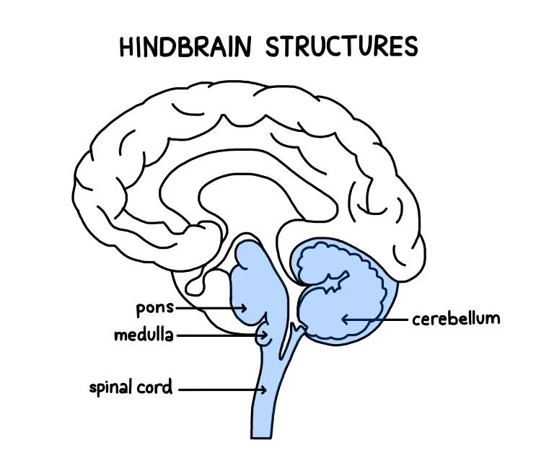
Hindbrain

Slide 80
Hindbrain
The hindbrain is also known as the rhombencephalon and is one of the most crucial parts of the central nervous system (CNS) as it connects the brain to the spinal cord so that messages can be sent from the brain, down the spinal cord, to the rest of the body.
The hindbrain is essentially an extension of the spinal cord, with tracts of axons running through the spinal cord to the hindbrain, which integrates the incoming sensory information and coordinates motor responses.

Slide 81
Hindbrain
Hindbrain function
The hindbrain’s chief role is to coordinate the vital functions of our bodies, such as breathing and heart rate. Therefore, the hindbrain is important for survival.
Another main function of the hindbrain is the organization of motor reflexes, mostly controlled by the cerebellum structure. Similarly, the hindbrain is responsible for sleep activity and wakefulness.

Slide 82
The Hindbrain
Most primitive part of the brain
Medulla: Connects brain with spinal cord and controls vital life functions
Pons: Bridge between medulla and other areas of the brain
Reticular formation: Collection of cells and fibers in the medulla and pons
Cerebellum: Near base of the brain; regulates posture, muscle tone, and muscular coordination

Slide 83
Pons
Pons
The pons comes from the Latin word for bridge, named so, as it essentially forms a bridge from the brainstem to the cerebral cortex.
The pons is situated right underneath the midbrain and serves as the coordination center for signals which flow between the two cerebral hemispheres and the spinal cord.

Slide 84
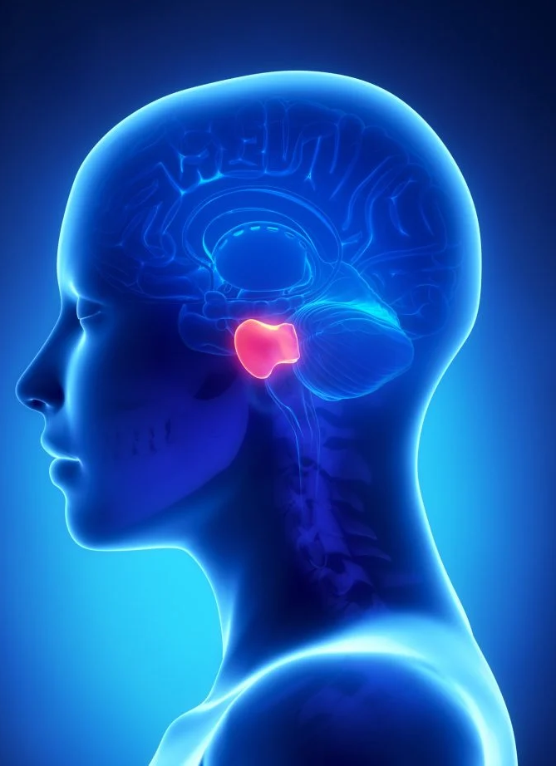
Pons
This structure is strongly associated with many autonomic functions, such as breathing, taste, sleeping, and circuits that generate respiratory rhythms.
The pons is also involved in analyzing sensory data and is where auditory information enters the brain.
Within the pons are four types of cranial nerves – these are nerves that help control head muscles and receive sensory information from the head:

Slide 85
Pons
Abducens nerve – these nerves coordinate eye movements.
Facial nerves are responsible for coordinating the movement and sensations in the face.
Vestibulocochlear nerve – these process sounds coming into the brain and aid in maintaining balance.
Trigeminal nerve – this help to coordinate the action of chewing and carrying sensory information from the face and the head.

Slide 86
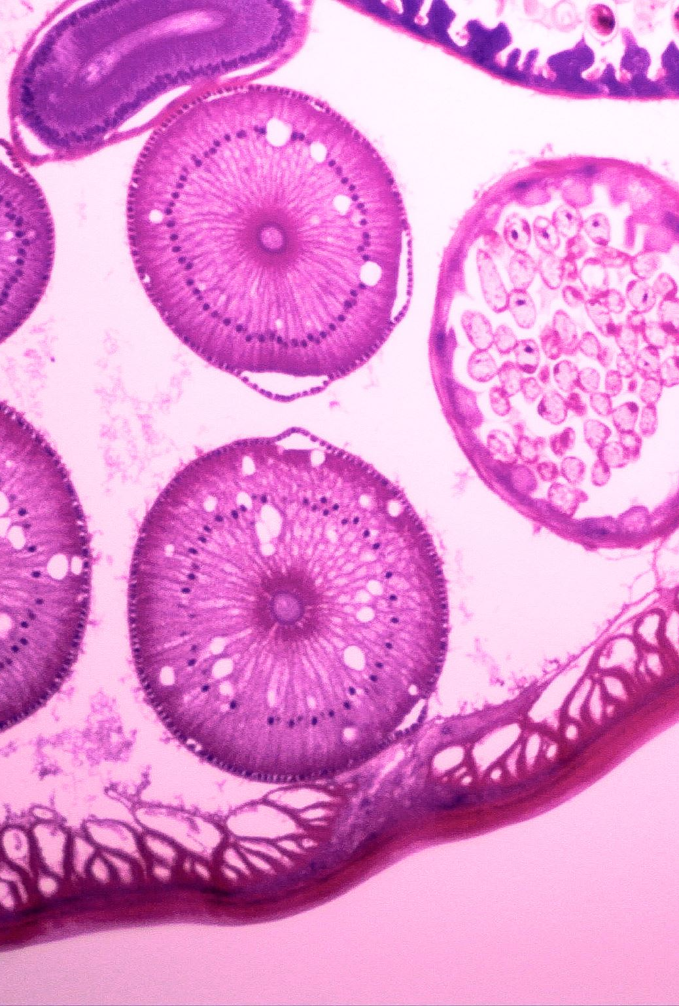
Pons
  The nuclei of the pons (pontine nuclei) are involved in learning and remembering motor skills. These nuclei act as relay stations for nerve signals from the motor cortex, which travel to the cerebellum behind the pons.

Slide 87

Medulla
The medulla - contains centers important for the reflex control of vital life functions, including heart rate, breathing, swallowing, and the like. Various drugs, diseases, or injuries can interrupt the vital functions of the medulla enough to end or endanger life.

Slide 88
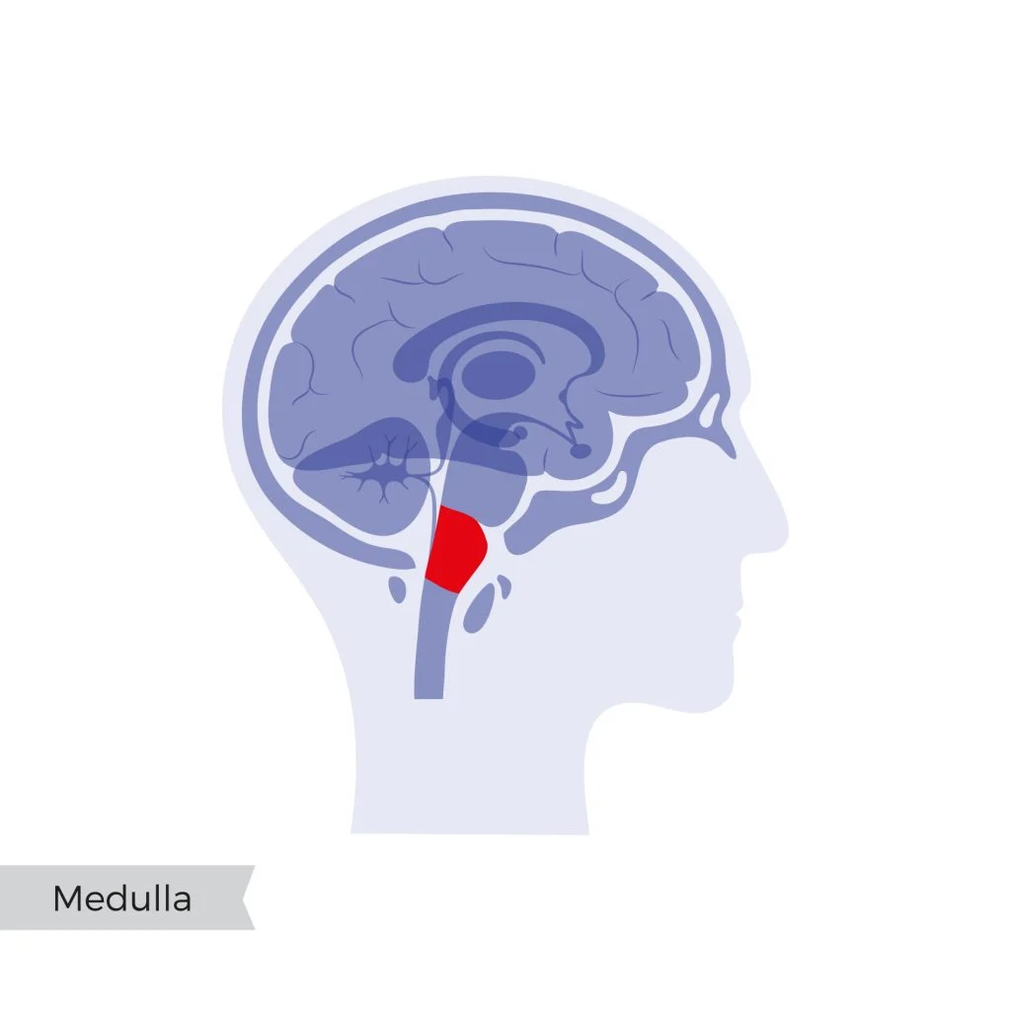
Medulla
  The medulla is a long stem-like structure of the hindbrain, which makes up the lowest part of the brainstem, lying next to the spinal cord.

Slide 89
Medulla
The medulla controls many functions outside of conscious control, such as breathing, blood flow, blood pressure, and heart rate. This makes the medulla a vital structure for survival.
This structure also involves many involuntary reflexes, such as coughing, sneezing, and swallowing. The medulla contains four types of cranial nerves within it:

Slide 90
Medulla
Glossopharyngeal nerve – these nerves coordinate some taste sensations as well as movements of the mouth.
Vagus nerve – these also control mouth movements, as well as our voice and gag reflexes.
Accessory nerve – these coordinate movements of the head and the neck.
Hypoglossal nerve – these nerves control movements of the tongue and muscles involved in speech.

Slide 91
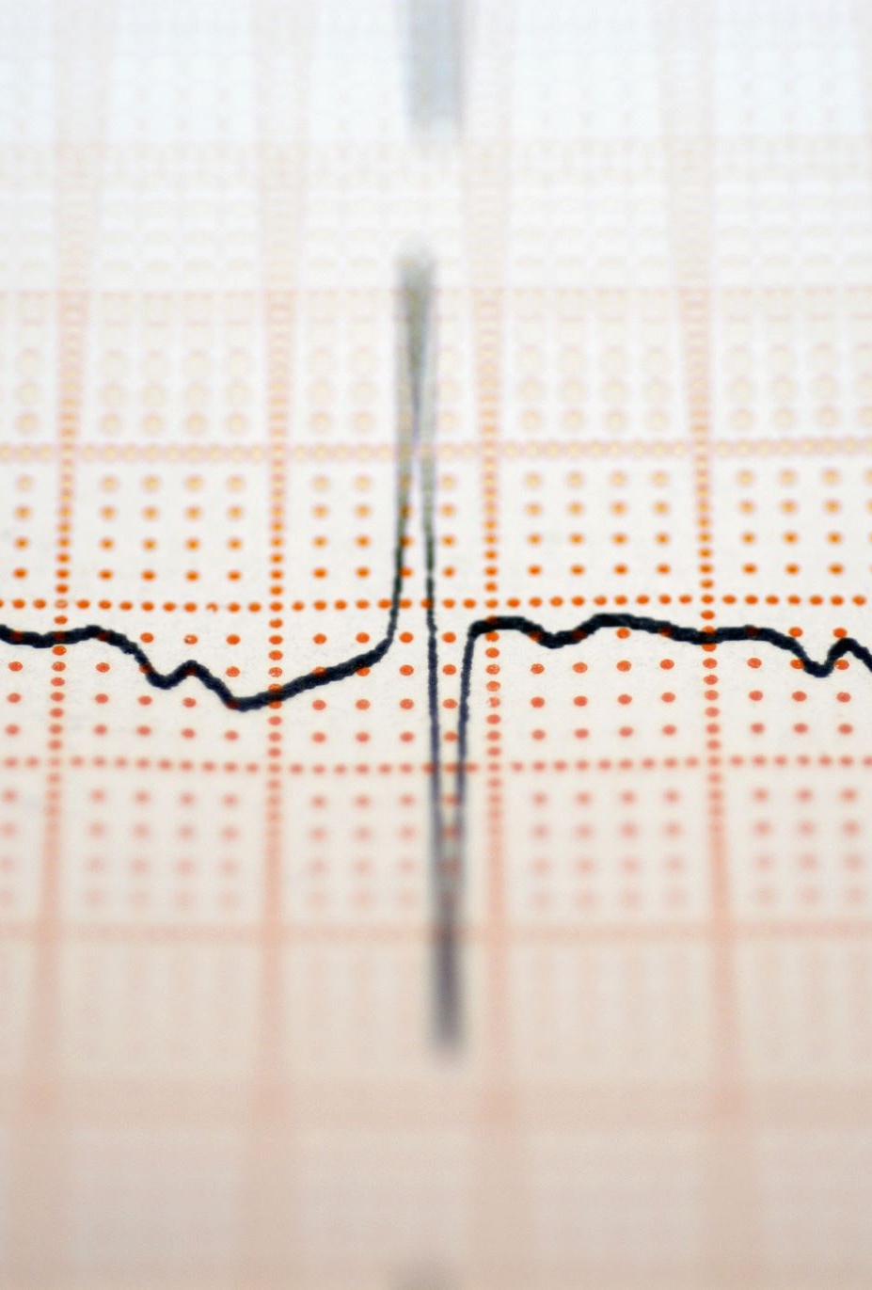
Medulla
  If the medulla becomes damaged, this can lead to respiratory failure, paralysis, or loss of sensation. Damage to this structure can be fatal as it helps the heartbeat. Therefore, damage to this area can cause termination in a heartbeat, resulting in death.

Slide 92
Reticular Formation
Functions:
1st. It acts as a kind of central clearinghouse for most information coming to and from the brain.
2nd. it gives priority to some incoming messages, while excluding others. In this way the RF affects attention. Without the RF we would be overwhelmed with useless information from the environment.
3rd. and perhaps most important, the reticular formation is responsible for alertness and wakefulness. Procedure: Incoming messages from the sense organs branch into the reticular formation. There they form a reticular activating system (RAS). The RAS bombards the cortex with stimulation, keeping it active and alert. Destroying the RAS causes animals to enter a coma resembling sleep.

Slide 93
Cerebellum
The cerebellum= looks like a miniature cerebral cortex, and it lies at the base of the brain. It is closely connected to many areas in the brain and spinal cord. It primarily regulates posture, muscle tone, and muscular coordination. May also play a role in some types of memory. Simple tasks like walking, running, or playing catch are impossible without an intact cerebellum. Spinocerebellar degeneration, a crippling disease, begins with tremor, dizziness, and muscular weakness. Soon a person over-reaches and under-reaches for objects--and eventually have difficulty standing, walking or even feeding themselves.

Slide 94
Midbrain
  The midbrain functions as a relay system, transmitting information necessary for vision and hearing. It also plays an important role in motor movement, pain, and the sleep/wake cycle.
  The midbrain consists of three parts that work to regulate various involuntary functions, such as breathing, heart rate, and blood pressure. Your brainstem also plays a critical role in sleep and consciousness.

Slide 95
The Midbrain
Connects the hindbrain with the forebrain
With the hindbrain, makes up the brainstem: The thickening of the spinal cord where it joins the brain
Virtually all communication between cerebral cortex and the rest of the body passes through the brainstem

Slide 96
Forebrain
  The Forebrain. Consists of two of the most important parts of the body and lie buried deep within the center of the brain: The thalamus and an area just below it called the hypothalamus are part of the forebrain.
  The Thalamus. A football-shaped structure that acts as a final "switching station" for sensory messages on their way to the cortex. Information from vision, hearing, taste, and touch relay through the thalamus. Sensory messages undergo initial analysis there as well. Injury to even small areas of the thalamus can cause deafness, blindness, or loss of any other sense, except smell.
  The Hypothalamus. About the size of a thumbnail. Small as it may be, the hypothalamus is a kind of master control center for emotion and many basic motives. It affects behaviors as diverse as sex, rage, temperature control, hormone release, eating and drinking, sleep, waking, and emotion. The hypothalmus is a sort of "crossroads" that connects with many other areas of the cortex and subcortex. As such, it acts as a "final path" for many kinds of behavior leaving the brain. You might think of the hypothalamus as the last area of the brain where many behaviors are organized or "decided on."

Slide 97
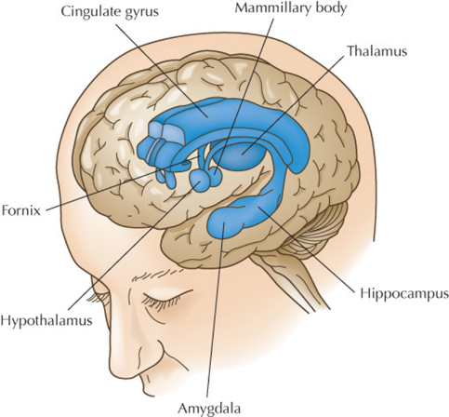
The Forebrain (1 of 2)
Includes several brain structures that regulate higher-order mental processes
Thalamus: Relay for sensory information, except smell
Hypothalamus: Regulates emotional behaviors and biological needs; where behaviors are organized and “decided on” before leaving the brain

Slide 98
The Forebrain (2 of 2)
Limbic system: Controls emotions and memory
Made up of hypothalamus, parts of the thalamus, the amygdala, hippocampus. and other subcortical structures
Amygdala: Associated with emotional processing, strongly related to fear and memory of fearful experiences
Hippocampus: Important for storing memories and navigating the space around us

Slide 99
Endocrine System
Made up of glands that secrete hormones to the body
The hormones created and released by the glands in your body’s endocrine system control nearly all the processes in your body. These chemicals help coordinate your body’s functions, from metabolism to growth and development, emotions, mood, sexual function and even sleep.
https://neuron.illinois.edu/videos/video-the-endocrine-system

Slide 100
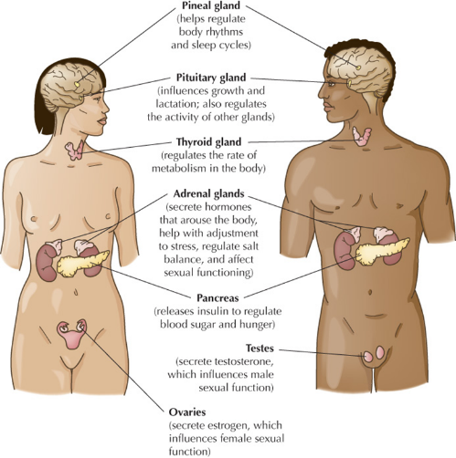
The Endocrine System
It is made up of glands that secrete hormones directly into the bloodstream or lymphatic system.
Hormones affect internal activities and visible behaviors such as puberty and personality.

Slide 101
Glands:
Pituitary Gland: regulates growth
Pineal Gland: releases melatonin (helps with sleep)
Thyroid Gland: regulates metabolism
Adrenal Gland: produces stress hormones

Slide 102
The Endocrine System
Pituitary gland: Master gland; influences other endocrine glands
Regulates body processes such as metabolism, stress responses, and reproduction
Regulates growth by releasing growth hormone
Pineal gland: Releases melatonin in response to variations in light
Thyroid gland: Regulates metabolism

Slide 103
The Endocrine System
Adrenal glands
Adrenal medulla: Source of epinephrine and norepinephrine
Epinephrine (adrenaline): Associates with fear and arouses the body
Norepinephrine (noradrenaline): Functions as a neurotransmitter in the brain, linked with anger
Together prepares body for “fight or flight”
Anabolic steroids: Supplied in small amounts by adrenal glands

Slide 104
Endocrine System: How Does it Work?
Your endocrine system continuously monitors the number of hormones in your blood. Hormones deliver their messages by locking into the cells they target so they can relay the message.
The pituitary gland senses when your hormone levels rise and tells other glands to stop producing and releasing hormones. When hormone levels dip below a certain point, the pituitary gland can instruct other glands to produce and release more. This process, called homeostasis, works similarly to the thermostat in your house. Hormones affect nearly every process in your body, including:

Slide 105
Including…
Metabolism (the way you break down food and get energy from nutrients).
Growth and development.
Emotions and mood.
Fertility and sexual function.
Sleep.
Blood pressure.
Sometimes glands produce too much or not enough of a hormone. This imbalance can cause health problems, such as weight gain, high blood pressure and changes in sleep, mood and behavior. Many things can affect how your body creates and releases hormones. Illness, stress and certain medications can cause a hormone imbalance.

Slide 106
Name the Parts of the Brain
https://neuron.illinois.edu/games/brain-quiz

Slide 107

Review

Slide 108
Summary (1 of 3)
Now that the lesson has ended, you should have learned how to:
Outline the major divisions of the nervous system.
Identify the important parts of a neuron.
Describe how neurons operate and communicate with each other.
Distinguish between neuroplasticity and neurogenesis.
Identify three methods that scientists use to understand the structures of the brain.

Slide 109
Summary (2 of 3)
Now that the lesson has ended, you should have learned how to:
Identify four methods that scientists use to understand the function of brain structures.
Explain how the left and right hemispheres of the cerebral cortex differ as a result of lateralization.
Name the four lobes of the cerebral cortex and describe their function.
Name the three major regions of the subcortex, and the parts that make up each one.

Slide 110
Summary (3 of 3)
Now that the lesson has ended, you should have learned how to:
Explain how the endocrine system works. Describe the action of four endocrine glands.
Define self-regulation. Explain how it can help you in your personal and professional life.

Slide 111
Essay Questions
Answer these in your notebook.
Which part of the brain is responsible for controlling the dexterity of our hands, such as our ability to hold a pencil or play a musical instrument?
Frontal lobe
Parietal lobe
Temporal lobe
Occipital lobe
Define Hemispheric Lateralization. Identify the tasks associated with each hemisphere.

Slide 112
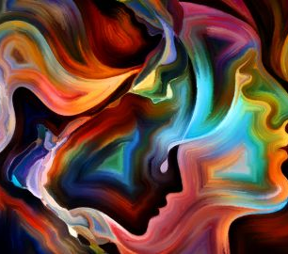
End of Chapter 2

