Slide 1


Psychology
132
M. Hines
Professor of Psychology
Chapter 1

Slide 2
Who Am I Quiz
Choose at least 4 questions to answer.
Write your answers on a sheet of paper and turn in at the end of class.
What is your idea of perfect happiness?
Which talent would you most like to have? Why?
What is your motto?
What personality trait in people causes a red flag with you?
Do you influence people more than they influence you? Explain.
What is legal that you think should be illegal? Why?
Do you operate better at night or during the day?
What do you do when you are stuck in a rut?

Slide 3
Expectations
Be on time for class.
Have all materials including a notebook and pen or pencil.
No sleeping in class.
Participate in class discussions…be engaged
Ask questions if there is something you don’t understand
Turn in all assignments on time….if you need an extension…just ask
Use JALC email for assignments or questions as needed. Put class, last name and assignment in the subject box….psy132…hines…ch. 1 essay
Attend class every day unless you have an excused absence
  Attendance is 10% of your grade
Use the website for review and obtaining quizzes.

Slide 4
What You Need For Success
Textbook: Introduction to psychology: Gateways to Mind and Behavior
  It is preferred that you have a physical copy of the book so you can write in the text or highlight.
  But you can access the text online and will be able to highlight.
  You need access to the internet so you can utilize the class website that has the powerpoints, quizzes, and supplemental videos.

Slide 5
Quizzes/Tests
There will be a quiz after every three or four chapters
The midterm will include all chapters that have been covered up to that point.
The final exam will be cumulative to cover all material.

Slide 6
Assignments
You will be responsible for obtaining an article for each chapter we cover. The article should be on a topic from that chapter.
All articles should be obtained from the John A. Logan online library.
Every article should be peer reviewed and come from a reputable journal.
You must copy the first page of each article to include with your final assignment.

Slide 7
Assignments cont.
You will write (IN APA STYLE) the reference for each article.
At the end of the semester, you will turn in a completed reference page in the correct APA style.
You will also include the copies of the articles’ first pages in the same order as your references.

Slide 8
Assignments cont.
You will choose a topic from a given list to write a personal narrative essay. It can be longer than five paragraphs but NO shorter.
Essay topics will be discussed toward the end of the semester.

Slide 9
Daily Assignments
1. Read the chapters ahead of time and be prepared for in class discussions.
2. Take notes from the lecture.
3, Answer the Think and Write questions. Add these to your notebook. These may be included as part of your final.
4. Answer the essay questions at the end of each power point. They may be used as part of your midterm and final.
5. Answer the review questions at the end of each section. Use these to study from.

Slide 10
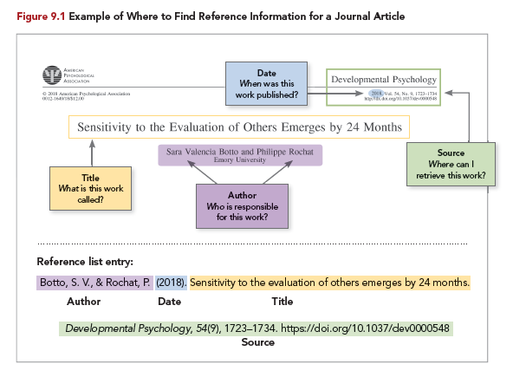
Writing a Reference

Slide 11

The Foundations of Psychological Science

Slide 12
Why study psychology?
What will I get out of this craziness?
Course content-what psychology tells us about memory, social development, the brain, child development
Skills- how to communicate with others, being independent, tolerant
Question: What is your major and how will psychology help you in your career path?

Slide 13





Commonsense Psychology:
Not Necessarily
“Common” or
“Sense” sect. 1.1

Slide 14
Common Sense:
Science has widely come to be understood as a systematic assault on common sense.
Common sense said the world was flat; science showed this to be false.
Common sense said the sun and the moon were the same size; science showed this to be wrong.
Common sense said the Earth was the center of the universe; science showed this to be false.
Common sense said matter was solid; science has shown this to be false.

Slide 15
Common Sense:
What is uncritical acceptance?
A failure to evaluate claims….
  We tend to accept what others tell us even though there isn’t sufficient evidence.
  We often believe someone just because we respect them
  We may believe things because we hear them said repeatedly
  We may just want them to be true, so we believe them

Slide 16
Science, Pseudoscience, and Superstition
Superstition: Belief lacking in objective evidence
Pseudoscience: False science
Astrology
Phrenology
Graphology
How Superstitions are Developed
https://www.youtube.com/watch?v=W9As3i8hlTM
https://www.youtube.com/watch?v=KwrvIkibaIk

Slide 17
Discussion Activity 1
If pseudosciences are false sciences, why are they so popular?
Look up horoscopes for various astrological signs for yesterday. Were they accurate? Totally off base?
Many of us read our horoscopes. Why is this considered a false science? Why do many find horoscopes to be accurate?

Slide 18
What Psychologists Do sect. 1.2

Slide 19
The Field of Psychology
Psychologists: Highly trained in methods, knowledge, and theories of psychological research
Usually, master’s degree or doctorate
Requires several years postgraduate training
Teach and do research
Consulting or therapy
Research in nonacademic settings

Slide 20
Psychological Research
Basic Research: Research for gaining knowledge
Applied Research: Research to try and solve a specific problem

Slide 21
Basic Research
The study and research meant to increase our scientific knowledge base.
By learning as much as possible about a topic, researchers are able to gather what they need to know about an issue to fully understand the impact it may have.

Slide 22
Methods for Basic Research
Observation
case studies
Experiments
focus groups
Surveys
interviews

Slide 23
Observational Research
Observation
Observational research is a research technique where you observe participants and phenomena in their most natural settings. This enables researchers to see their subjects make choices and react to situations in their natural setting, as opposed to structured settings like research labs or focus groups.

Slide 24
Types of Observational Research
What are different kinds of observational research?
Naturalistic observation
With naturalistic observation, observation occurs directly in the environment where the phenomenon occurs. The observations are made as unobtrusively as possible with the researcher not directly interacting with the participants in any way.

Slide 25
Types of Observational Research
What are different kinds of observational research?
Participant observation
With participant observation, researchers actively participate in the study itself. In addition to observing behaviors, a researcher might conduct interviews, take notes, look at documents, and take photographs.
Structured observation
With structured observation, researchers do not observe in the natural setting, but instead in a lab or a simulated environment. A structured observation is meant to observe a specific, limited set of behaviors. This method is less natural, but enables less variables to be at play.

Slide 26
Case Study Research
Case studies are in-depth investigations of a person, group, event, or community. Typically, data is gathered from various sources and by using several different methods (e.g., observations & interviews).
A case study is an in-depth study of one person, group, or event. In a case study, nearly every aspect of the subject's life and history is analyzed to seek patterns and causes of behavior. Case studies can be used in various fields, including psychology, medicine, education, anthropology, political science, and social work.
The purpose of a case study is to learn as much as possible about an individual or group so that the information can be generalized to many others. Unfortunately, case studies tend to be highly subjective, and it is sometimes difficult to generalize results to a larger population.

Slide 27
Experimental Research
Experimental research is a scientific methodology of understanding relationships between two or more variables. These sets consist of independent and dependent variables which are experimentally tested to deduce a correlation between such variables in terms of the nature and strength of such relation. Such assessment helps in deriving a cause and effect relationship and is even used for the purpose of hypothesis testing

Slide 28
Focus Group Research
A focus group is a research method used to collect opinions and feedback from a group of people about a specific product, concept, or service. The group is typically made up of 8-10 people who are invited to discuss their opinions, thoughts, and feelings in a facilitated discussion.

Slide 29
Survey Research
Survey research is defined as "the collection of information from a sample of individuals through their responses to questions" .
This type of research allows for a variety of methods to recruit participants, collect data, and utilize various methods of instrumentation. Survey research can use quantitative research strategies (e.g., using questionnaires with numerically rated items), qualitative research strategies (e.g., using open-ended questions), or both strategies (i.e., mixed methods).
As it is often used to describe and explore human behavior, surveys are therefore frequently used in social and psychological research.

Slide 30
Interview Research
There are more types of interviews than most people think. An interview is generally a qualitative research technique that involves asking open-ended questions to converse with respondents and collect elicit data about a subject.
The interviewer, in most cases, is the subject matter expert who intends to understand respondent opinions in a well-planned and executed series of star questions and answers.
Interviews are similar to focus groups and surveys for garnering information from the target market but are entirely different in their operation – focus groups are restricted to a small group of 6-10 individuals, whereas surveys are quantitative.
Interviews are conducted with a sample from a population, and the key characteristic they exhibit is their conversational tone.

Slide 31
Applied Research
Applied research “aims at finding a solution for an immediate problem facing a society, or an industrial/business organization,”[1].
A non-systematic inquiry and it is usually launched by a company, agency or an individual in order to address a specific problem.[2]

Slide 32
3 Categories of Applied Research
1. Evaluation research: focuses on analyzing existing information about the phenomenon in order to generate objective research outcomes.
Example: A study into the ways of reducing supply-chain costs
2. Research and Development. focuses on the development of new products and services to satisfy needs and wants of target customer segment.
3. Action research. Aims to tackle specific business problems.
Example: a research into the ways of restoring Starbucks brand image in UK after the tax scandal can be classified as an action research.

Slide 33
Pros and Cons of Applied Research
On the positive side, applied research can be helpful in solving specific problems in business and other settings.
On the negative side, findings of applied research cannot be usually generalized.

Slide 34
Types of Psychologists
Clinical: Treats problems and researches therapies and mental disorders
  Meet with clients to identify problems
  Use observation, interviews and tests to diagnose disorders
  Develop and implement treatment plans: may include drug therapy
Counseling: Help people identify their strengths and weaknesses and find ways to cope with everyday life events. Usually using talk therapy.

Slide 35
Helping People
Type of Mental Health Professional | Typical Activities
Clinical psychologist | Treats psychological problems; research on therapies and mental disorders
Counseling psychologist | Treats milder problems such as trouble at work or school
Psychiatrist | Medical doctor, treats serious mental disorders, often with drugs
Psychoanalyst | Psychiatrist or psychologist who uses a very specific approach to psychotherapy
Counselor | Advises, offers practical helping skills to solve problems with marriage, career, school, and so on

Slide 36
Knowledge Check Activity 1
Match the research areas with the topics they cover
Developmental
Learning
Personality
Sensation and perception
Social psychology
Conditioning, memory
Attitudes, groups, leadership
Processing sensory information
Individual difference, motivation
Child psychology

Slide 37
Knowledge Check Activity 1: Answer
Developmental → e. Child psychology
Learning → a. Conditioning, memory
Personality → d. Individual differences, motivation
Sensation and perception → c. Processing sensory information
Social psychology → b. Attitudes, groups, leadership

Slide 38
End of Day 1
Answer review questions for sections 1.1 & 1.2
Read sections 1.3 & 1.4

Slide 39
The History of Psychological Science: A Trip Through Time
Sect. 1.3

Slide 40

MWF Review Questions Sect. 1 & 2
What is basic research?
What is applied research?
What does a clinical psychologist do?
What does a counseling psychologist do?

Slide 41
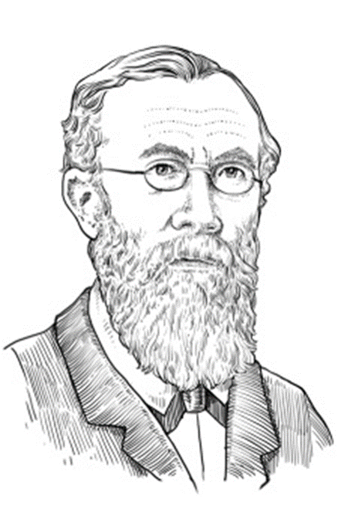
A Review of Psychological Science
William Wundt:
Considered father of psychology
Relied on scientific observation
Sought to train introspectionists to be systematic and scientific as they looked inward to report reactions to various stimuli
Studied vision, hearing, taste, touch, memory, time perception, and other topics
William Wundt

Slide 42
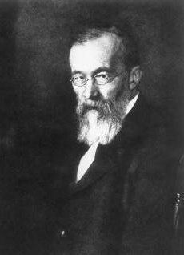
History of Psychology
Who was Wilhelm Wundt (Vill-helm Voont) and what did he study?
  Considered to be the father of psychology.
  Studied the mind, particularly how we experience sensations, images, and feelings.

Slide 43
Wundt’s Theory
Wundt believed in reductionism. That is, he believed consciousness could be broken down (or reduced) to its basic elements without sacrificing any of the properties of the whole.
Wundt argued that conscious mental states could be scientifically studied using introspection.

Slide 44
Introspection and Structuralism
Wundt observed and measured stimuli
Stimulus: Physical energy that affects a person and evokes a response
Introspection: Personal observation of mental events; thoughts, feelings, and sensations
Edward Titchener: Brought introspection ideas to the United States, naming them structuralism.
Structuralism: Study of sensation and personal experience as a basic element

Slide 45
Introspection and Structuralism
Introspection: identify your own thoughts and feelings about events
An introspective person is someone who tries to understand their mind, thoughts, feelings, and inner workings. They might engage in meditation or other contemplative practices.
Or, they might just pause to self-reflect when something is bothering them, when they handled a situation poorly, or when they are just curious to learn more about themselves. "What was really going on?"
Question: How do you use introspection in your daily life?
Question: What is a problem using introspection as a psychological tool?

Slide 46
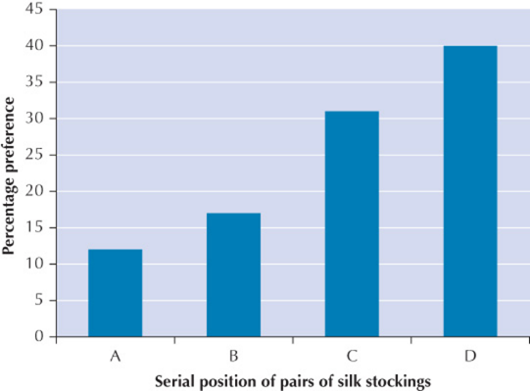
The Shortcomings of Introspection
Imageless thought: Lack of a conscious image to form though
Introspection fails to produce reliable observations of the mind
Serial positioning: Confirms much thinking takes place in the cognitive unconscious

Slide 47
Structuralism
Structuralism: analyze the elements of mental experiences, such as sensations, mental images, and feelings, and how these elements combine to form more complex experiences.

Slide 48
Gestalt Psychology
Analyzed thinking, learning, experiences as a whole and not broken down into separate parts.
For example: When you look at a photograph you first see the whole picture not an individual nose, ear, etc.
The principles are based on the idea that humans have a natural tendency in finding order in disorder. This is a process that happens in the brain and not in sensory organs like the eye.

Slide 49
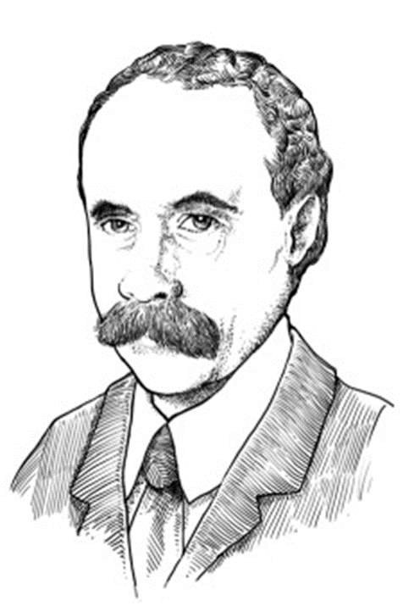
Gestalt Psychology (1 of 2)
Max Wertheimer was first to advance the Gestalt viewpoint
Gestalt psychology studied experiences of thinking, learning, personality, and perception as whole units, not by parts (structuralist)
Max Wertheimer

Slide 50

Gestalt Psychology (2 of 2)
According to Gestalt psychologist, perceptions have a powerful tendency to form meaningful patterns

Slide 51
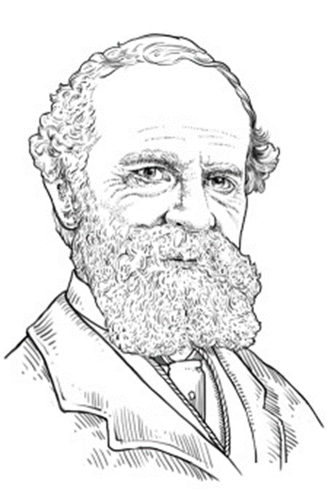
Functionalism
William James
Functionalism: Considers behavior in terms of active adaptations
Consciousness is ever-changing stream of images and sensations
Includes Darwin’s principle of natural selection
Brought the study of animals into psychology and promoted educational work
William James

Slide 52
Discussion Activity 2
William James encouraged the use of introspection and self-reporting.
What are the potential flaws with self-report data in scientific inquiry?
What might a researcher do to correct for or minimize those potential flaws?

Slide 53
Behaviorism
Studies observable actions
All behaviors are learned through interaction with the environment
Pavlov’ concept of conditioning: most behavior is a learned response to a particular stimulus
Question: Think of an example in your own life where your or someone else’s behavior is a result of a stimuli.

Slide 54
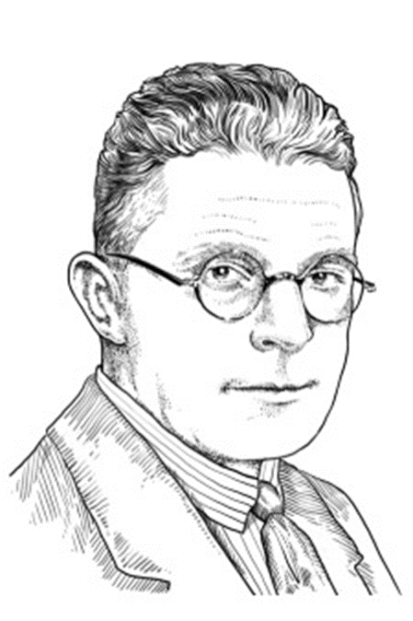
Behaviorism
John Watson
Behaviorism: Emphasizes study of observable actions over the study of the mind
Observed relationships between stimuli and animal’s response
Adopted Pavlov's concept of conditioning to explain most behavior
Believed conditioning could change people’s actions
John B. Watson

Slide 55
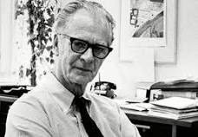
Radical Behaviorism
B.F. Skinner: believed our actions are controlled by rewards and punishments
A society based on rewards would encourage desirable behavior
Developed an operant conditioning box where he determined that reinforcement was crucial for learning.

Slide 56
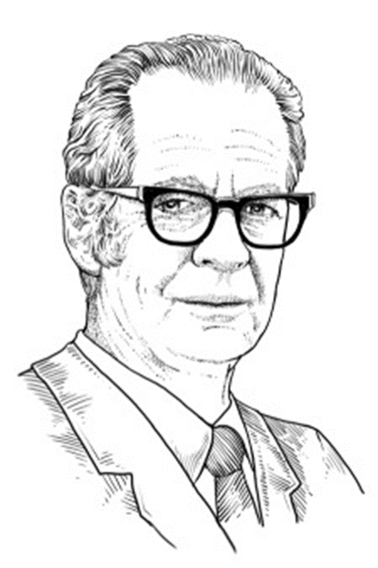
Radical Behaviorism
B. F. Skinner
Believed actions are controlled by rewards and punishments
Rejected both introspection and the concept of mind as inappropriate subject matter for scientific psychology
Felt behavior best explained without mental events such as thinking
B. F. Skinner

Slide 57
Psychoanalytic Psychology
Sigmund Freud: believed that behavior is influenced by the unconscious mind such as thoughts, impulses, desires, dreams
Believed that our childhood experiences shape our personality as adults
example: a childhood trauma may be suppressed but may reoccur in adulthood as anxiety
When we explain our behaviors we may not give a true account of our motivation because it may be something that has been repressed.

Slide 58
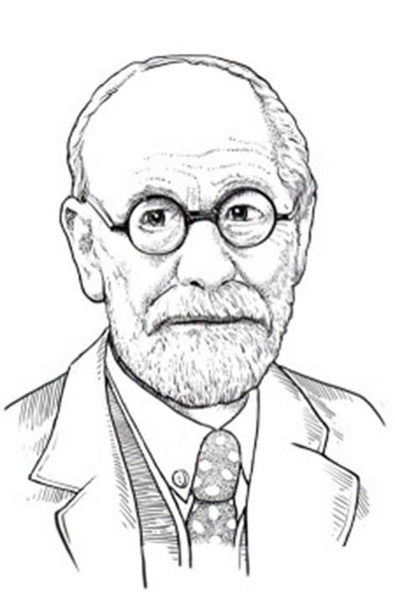
Psychoanalytic Psychology
Sigmund Freud
Mental life is like an iceberg, with only a small part exposed
Dynamic unconscious: Area of the mind outside of personal awareness
Behavior deeply influenced by unconscious thoughts, impulses, and desires, especially sex and aggression
Sigmund Freud

Slide 59
Cognitive Psychology
The study of how we think, and process information
  Memory, attention, language, problem solving, learning
  practical applications include
  providing help coping with memory disorders,
  making better decisions
  recovering from brain injury
  treating learning disorders
  structuring educational curricula to enhance learning.

Slide 60
Cognitive Psychology
Cognitive psychology: Study of information processing, thinking, reasoning, and problem solving
Open to studying mental events
Relies on objective observation rather than introspection
Operational definition: Defines a scientific concept by stating specific actions or procedures used to measure it

Slide 61
Humanistic Psychology
People have free-will
Looks at the whole person and the uniqueness of each individual
Stresses the importance of human value and dignity
Focuses on helping people live well, achieve personal growth and make the world a better place

Slide 62
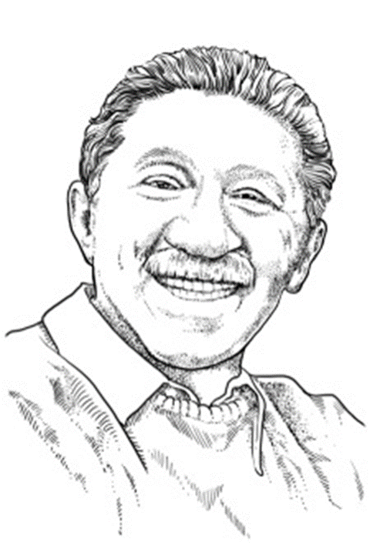
Humanistic Psychology
Abraham Maslow
Free will: Ability to make conscious choices
Humanistic psychology: People are inherently good and have potential
Self-actualization: Fully developing personal potential
Abraham Maslow

Slide 63
Knowledge Check Activity 2
Match the psychological approach with the historical figure
Structuralism
Humanistic
Functionalism
Psychoanalytic
Radical behaviorism
Gestalt
Behaviorism
Maslow
Freud
Titchener
Wertheimer
James
Watson
Skinner

Slide 64
Knowledge Check Activity 2: Answer
Structuralism → c. Titchener
Humanistic → a. Maslow
Functionalism → e. James
Psychoanalytic → b. Freud
Radical behaviorism → g. Skinner
Gestalt → d. Wertheimer
Behaviorism → f. Watson

Slide 65
Contemporary Psychological Science and the Biopsychosocial Model
Sect. 1.4

Slide 66
Biopsychosocial Model
Human behavior is influenced by a COMBINATION of biological, psychological, and social factors
There are three components:
  Biological Perspective
  Psychological Perspective
  Social Perspective

Slide 67
The Biopsychosocial Model
Biological
Psychological
Social
Genetics, brain processes, and evolution
Inherited, adaptive aspects of behavior and mental processes
Neuroscience
Behavior is result of processes within each person
Scientific observation, research, and objectivity
Mental processes
Impact of social context, crowds, groups, and cultures on human behavior
Effect of education, ethnicity, religion, and poverty on social norms

Slide 68
Human Diversity and the Biopsychosocial Model
Gender bias in research:
Most researchers were men
Most research focused on male participants
Did not account for male–female differences
Focus on WEIRD (Western, Educated, Industrialized, Rich, and Democratic societies)
Cultural relativity: Behavior must be judged relative to values of the culture in which it occurs.

Slide 69
What makes a Psychological Thriller?
What sets a psychological thriller apart is its commitment to exploring the darkest corners of the human mind. Narratives are told from the point of view of an unreliable narrator or a psychologically stressed character. They feature protagonists and antagonists driven by obsession or violence, with an emphasis on internal tension and conflict. Within every psychological thriller, the core mystery is crystalized by the inner workings of a disturbed mind.

Slide 70
How are these thrillers related to research?
Sigmund Freud’s psychological research at the dawn of the 20th century played a key role in establishing the tensions we now associate with psychological thrillers. Freud believed that the Self is split into three psychological realities with competing motives. The anxiety or discomfort we experience is caused by trying to reconcile these conflicting impulses. Works like The Interpretation of Dreams (1899), The Psychopathology of Everyday Life (1901), and Civilization and Its Discontents (1930) laid out Freud’s vision of the desires, conflicts, and motivations roiling within us. They also paved the way for greater psychological depth in modern-day fiction, from heated noir thrillers like James M. Cain’s The Postman Always Rings Twice (1934) to Patricia Highsmith’s Strangers on a Train (1950), about two men who become entangled in a doomed double-murder plot.
Today, psychological thrillers feature a wide array of fiendish plots, settings, and scenarios. And yet, like Poe’s work from more than a century ago, psychological thrillers still seek to unlock the secrets of our darkest impulses and fears.

Slide 71
Psychological Thrillers and Disorders of the Main Characters
https://www.youtube.com/watch?v=6dccwBNbQoc

Slide 72
Think about…
Can you name a tv show or movie where a particular specialty of psychology is used as part of the show? What is it and how did they use it?

Slide 73
Biological Perspective
Explains behavior through genetics, brain functions, and evolution
  Common types of biological studies on behavior include things like the effects of physical child abuse on future adult actions, how injuries such as head trauma affect behavior, or whether or not criminal behavior can be explained by genetics.

Slide 74
Psychological Perspective
Behavior is the result of individual experiences and how each person thinks and processes information.
Uses scientific observation to evaluate and objectively study thinking, memory, language, perception, problem solving, consciousness, and creativity.

Slide 75
Social Perspective
Emphasizes the relationship of social activities and opportunities has on human behavior.
Examples include: social media, advertising, belonging to an organization – religious, political, sports, etc.
Question: How are you influenced by social media or groups that you belong to? How are people manipulated by engaging in these activites?

Slide 76
End of Day 2
Answer review questions for sections 1.3 & 1.4
Read sections 1.5 to 1.8

Slide 77
The Core Features of Psychological Science
Sect. 1.5

Slide 78

Psychology’s Goals
Goals of psychology:
  Describe
  Understand
  Predict
  Control Behavior

Slide 79
Psychology’s Goals (2 of 2)
Four goals of psychology come down to asking:
What is the nature of this behavior? What does it look like? (description)
Why does this behavior occur? (understanding)
Can we forecast when the behavior will occur? (prediction)
What conditions affect the behavior? Should we use our knowledge of those conditions to change it? (control)

Slide 80
Description
Naming or classifying using detailed observations
The first part of answering a research question
Gathering information and describing the specifics of behaviors, patterns, and other phenomena. These methods focus on the who, what, and where, versus the why or how.

Slide 81
Understanding
Explain an event
State the causes of a behavior
Provides insight into other people’s behaviors and the influences and motivations behind their actions

Slide 82
Prediction
By analyzing past observed behavior, psychological studies aim to predict and anticipate how a certain behavior will appear again in the future.
  Example: How Psychological Predictions Might Be Used. If researchers notice that scores on a particular aptitude test predict high school dropout rates

Slide 83
Control
Changing or altering the conditions that may affect the behavior being studied.
  Example: Marketers and businesses often use the understanding gained from psychological research to influence and persuade buyers to behave in certain ways. For example, they might develop advertising campaigns designed to appeal to a certain audience. By tailoring their efforts to a specific type of buyer, they're more likely to elicit responses than if they used a generic message.

Slide 84
Critical Thinking
Actively reflect
Look for weaknesses in reasoning
Analyze evidence
Question assumptions
Look for alternate conclusions
  What is the claim being made?
  What tests have been run and how reliable are they?
  Who completed the tests and are they reliable and trustworthy?

Slide 85
Thinking Critically to Meet
Psychology’s Goals
Critical thinking: A type of reflection that asks whether a belief can be supported by both scientific theory and observation
Few truths transcend need for logical analysis and empirical testing
Authority or claimed expertise does not make an idea true or false

Slide 86
Thinking Critically to Meet
Psychology’s Goals (2 of 2)
Judging the quality of evidence is crucial.
Critical thinking requires an open mind.
Critical thinkers often wonder what it would take to show that a “truth” is false.
Falsification: Attempt to show how commonsense belief or theory might be false

Slide 87
Scientific Method
Look at Past Research
Define the Question
Propose the Hypothesis
Gather Evidence/Test hypothesis
Reject or Retain Hypothesis
Build Theory
Publish/Replicate Results

Slide 88
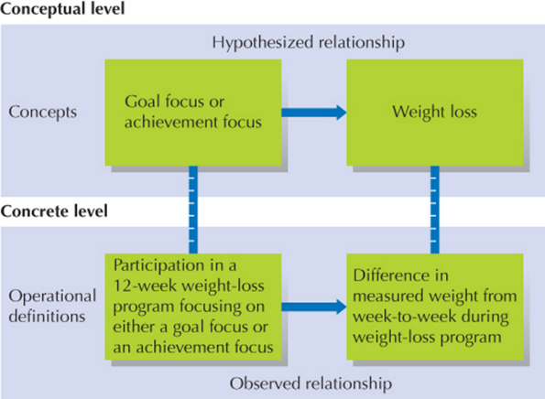
Using the Scientific Method to Meet Psychology’s Goals (2 of 2)
Hypothesis: Predicted outcome of an experiment
Theory: Ideas designed to interrelate concepts that summarize existing data and predicts future observations
Operational definition: Links concepts with concrete observations

Slide 89
Studying the Science: The Importance of Replicating Scientific Results
Must report on data in an ethical manner
Can create challenges when attempting to replicate findings
Lack of replication may be caused by:
Lack of exact methods observed
Passage of time

Slide 90
Evidence to Address Psychology’s Goals: From Tests to Testosterone
Self-report data: Most common form of data used
Survey: Each participant asked the same questions
Population: Group from which a sample is drawn
Sample: A subset of a population being studied
Representative sample: Accurately reflects a larger population
Biased sample: Does not accurately reflect the population from which it was drawn

Slide 91
Experimental Research: Where Cause Meets Effect
Sect. 1.6

Slide 92
Experimental Variables
3 types:
Independent variable: the cause for the change in behavior
  The variable that stands alone and isn’t changed by the other variables
Dependent variable:
  The variable that depends on other factors (a measurable effect)
Extraneous variable
    any variable that you're not investigating that can potentially affect the outcomes of your research study. If left uncontrolled, extraneous variables can lead to inaccurate conclusions about the relationship between independent and dependent variables.

Slide 93
Experimental Groups
Experimental Subjects: the animals or people who are being researched (human participants are called subjects)
Experimental Group: The group that is manipulated or receives the treatment
The Control Group: The subjects who do NOT receive the treatment
The two groups are compared to determine changes or differences.
Random assignment to groups is best practice, but not always wanted.

Slide 94
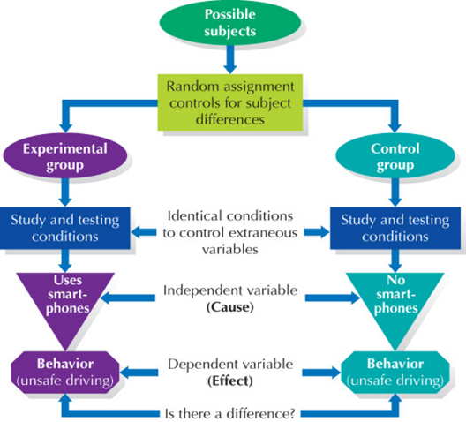
Experimental Groups and Random Assignment (1 of 2)
Experimental subjects: Participants whose behavior is investigated
Experimental group: Group that receives treatment the study is testing
Control group: Subjects who do not receive treatment

Slide 95
Experimental Groups and Random
Assignment (2 of 2)
Random assignment: Subjects placed in experimental or control groups by chance
Defining feature of a true experiment
Essential to the ability to make cause-and-effect claims

Slide 96

Evaluating Experimental Results
Results are usually described as being statistically significant or not being statistically significant.
Statistical analysis is used to determine results. Which type of analysis depends on what type of study is conducted.

Slide 97
Potential Problems with Experiments
Research Participant Bias: This includes pre-conceived ideas about the topic being studied. It is a tendency of participants (subjects) in an experiment to consciously or subconsciously act in a way that they think the experimenter or researcher wants them to act. It often occurs when subjects realize or know the purpose of the study.
Placebo Effect: Participants expect a result, so they unconsciously act as if the variable had an effect when it really didn’t

Slide 98
Nonexperimental Research: Losing a bit of Control
Sec. 1.7

Slide 99
Quasi Experiments
Used when random assignments to the control or experimental groups is not possible.
Still have as their aim to demonstrate causality between intervention and an outcome.

Slide 100
Correlational Research
Two variables are measured to determine if there is a relationship.
To determine if a relationship exists a correlation coefficient is calculated.
The correlation coefficient shows the correlation between two variables. It is a statistical measure that calculates the strength of the relationship.
The value will be between -1 and +1. If the coefficient is close to +1 there is a positive relationship, and if it is closer to -1 then there is a negative relationship, If it is close to 0, then there is no relationship between the two variables.

Slide 101
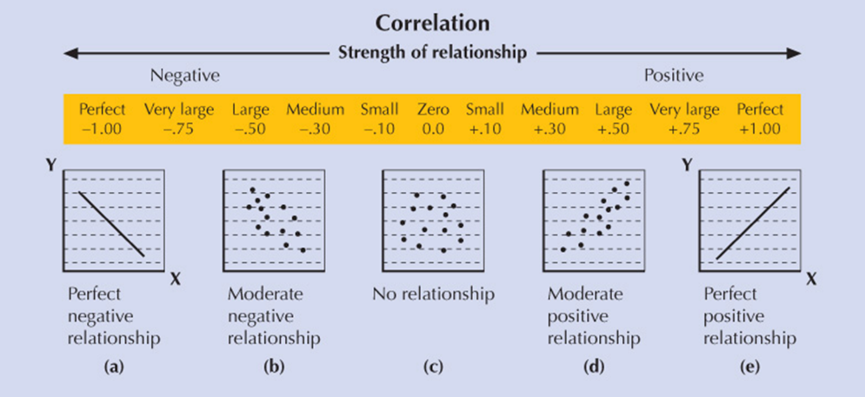
Understanding Associations Using Correlation Coefficients

Slide 102
Psychology and Your Skill Set: Information Literacy
Sec. 1.8

Slide 103
Separating Fact from Fiction in the Media
Consider the source of information
Beware of claims based on poor or carefully selected evidence
Always consider alternative explanations and remember that some things do not happen by chance
Ask yourself if there was a control group
Look for errors between correlation and causation
Beware of oversimplification, especially when motivated by monetary gain

Slide 104

APA style is used for all writing in psychological research.

Slide 105
Self-Assessment
Can you distinguish between superstition, pseudoscience, and science?
Describe the work carried out by clinical and counseling psychologists.
Differentiate between approaches to psychology, including introspection, Gestalt, structuralism, behavioral, and function approaches.
Name the three perspectives of the biopsychosocial model and the advantages and disadvantages of this perspective.

Slide 106
Summary (1 of 6)
Now that the lesson has ended, you should have learned how to:
Explain why people fail to recognize that “commonsense” beliefs are often false.
Distinguish between superstition, pseudoscience, and science.
Name some of the areas in which psychological scientists do research.
Describe the work carried out by clinical and counseling psychologists.
Explain the method that Wundt and Titchener used to study conscious experience and the limitations of this method.

Slide 107
Summary (2 of 6)
Now that the lesson has ended, you should have learned how to:
Contrast Titchener’s structuralist approach to psychology with
(a) the Gestalt approach developed by Wertheimer
(b) the functionalist approach developed by James
(c) the behaviorist approach developed by Watson and Skinner
(d) the psychoanalytic approach developed by Freud
(e) the cognitive approach
(f) the humanists’ approach developed by Maslow and Rogers

Slide 108
Summary (3 of 6)
Now that the lesson has ended, you should have learned how to:
Explain the three perspectives that comprise the biopsychosocial model.
Explain the advantages of the biopsychosocial model for explaining complex behavior.
Explain why early psychological research was prone to gender and culture bias.
Explain the goals of contemporary psychology.
Define critical thinking, and identify the five principles of critical thinking.

Slide 109
Summary (4 of 6)
Now that the lesson has ended, you should have learned how to:
Outline the six steps of the scientific method.
Describe three types of data gathered by psychological scientists, including the challenges faced by psychologists who use them.
Differentiate between independent, dependent, and extraneous variables in an experiment.
Explain how experiments allow psychological scientists to make statements about cause and effect.

Slide 110
Summary (5 of 6)
Now that the lesson has ended, you should have learned how to:
Outline how psychological scientists evaluate the results of an experiment.
Describe two problems associated with experiments, and how they can be controlled.
Differentiate between quasi-experiments and true experiments.
Explain what is meant by correlational research, and how the degree of association between two variables is assessed in correlational research.
Describe the conditions under which case studies are useful.

Slide 111
Summary (6 of 6)
Now that the lesson has ended, you should have learned how to:
Name six ways that people can critically evaluate information found in the popular press and on social media
Create a plan to analyze and evaluate information that you are exposed to in the popular press and on social media.

Slide 112
Essay Questions
Answer these in your notebook.
1. List and describe in your own words the steps of the scientific method.
2. Describe an internet-based claim that you have viewed on Facebook, Twitter, etc.
In relation to the claim, describe the six ways that people can critically evaluate the information.

Slide 113
End of Day 3
Answer review questions for sections 1.5 to 1.8
Read sections 2.1 - 2.2

Slide 114

End of Chapter 1

